Slide 1
Laboratroy methods in forensic medicine

Slide 2
Identification of spots of biological origin
Is this a trace of human origin?
Where does the clue come from?
Blood
Semen
Saliva
Urine
Amniotic fluid
Stool

Slide 3
Blood stains
Determination if it is blood (blood evidence):
orientation tests and specific crystallographic methods
Determination of species affiliation
human protein evidence
Determination of blood group
ABO system, Rh system, MN system, etc.
Determination of blood origin
menstrual blood,
pregnancy blood,
newborn blood

Slide 4
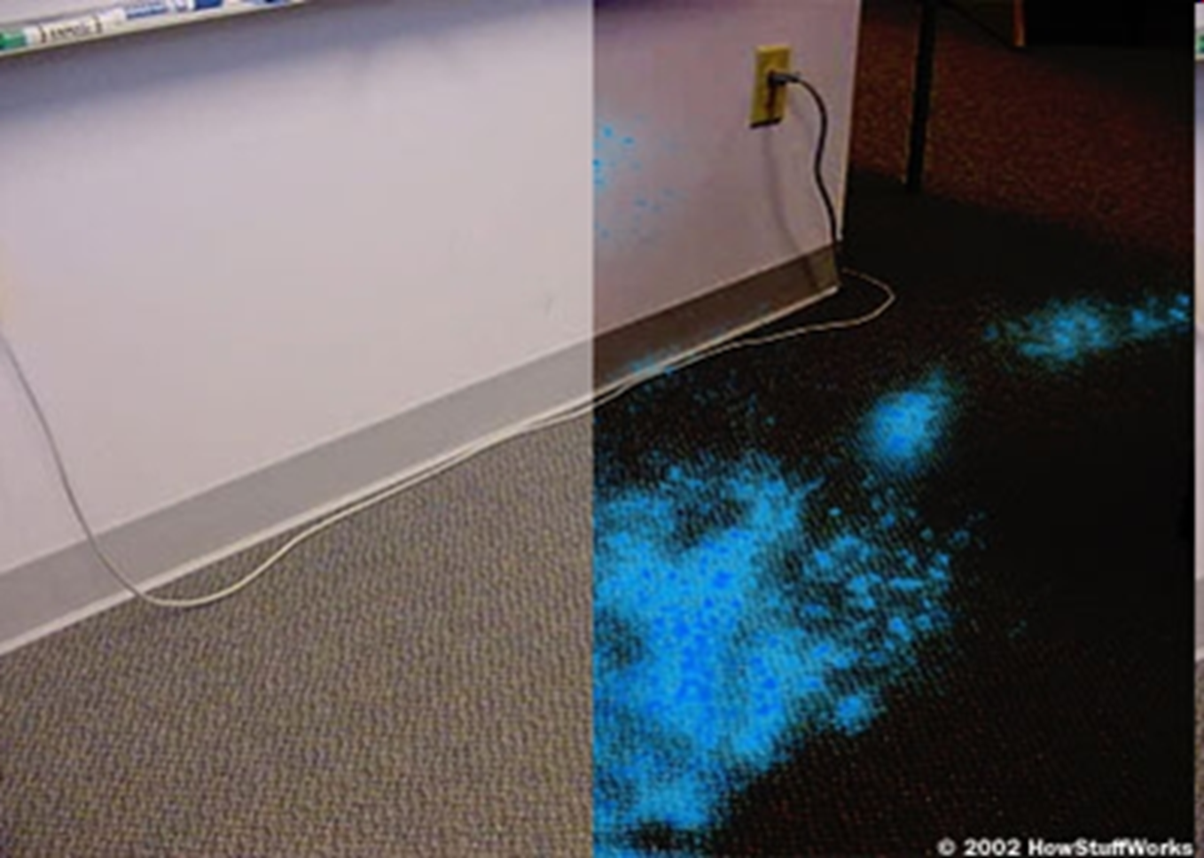
Proof of blood - unspecific
Non-specific (indicative)
Chemiluminescence reaction with luminol (to make latent traces visible)
Peroxidase reaction the heme group of hemoglobin has a peroxidase-like activity that catalyzes the cleavage of H2O2. Oxidation products then react with a whole range of substances (benzidine, phenolphthalein, orthotolidine, etc.) causing their color to change.
Detection papers
The disadvantage of these tests is that they have different probative value and can give a false positive result
Luminol reaction

Slide 5
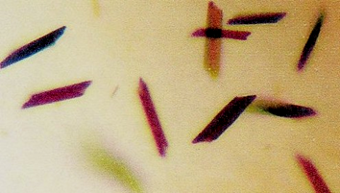
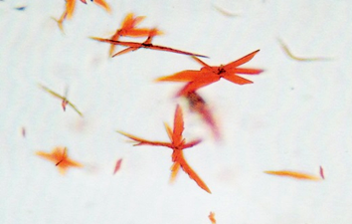
Proof of blood - specific
Crystallographic methods:
Bertrand's method – formation of acetchlorhemin crystals
Takayama's method: formation of hemochromogen crystals
Spectroscopic method: spectral line of hemoglobin

Slide 6
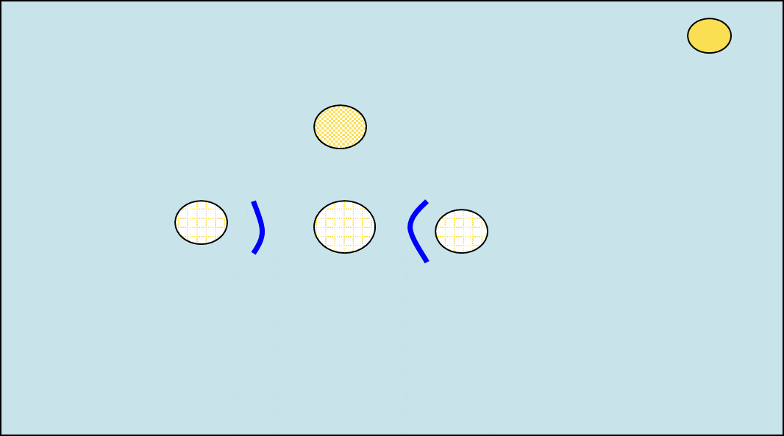
Proof of human origin (human protein)
Immunodifusion on agar according to Outcerlony
Normal saline solution control
Human protein as positive control
Extract from suspected spot
Precipitation lines between human protein control and extract from suspected spot means that spot is of human origin
Antibody against human protein
Underlay on which a spot was found

Slide 7
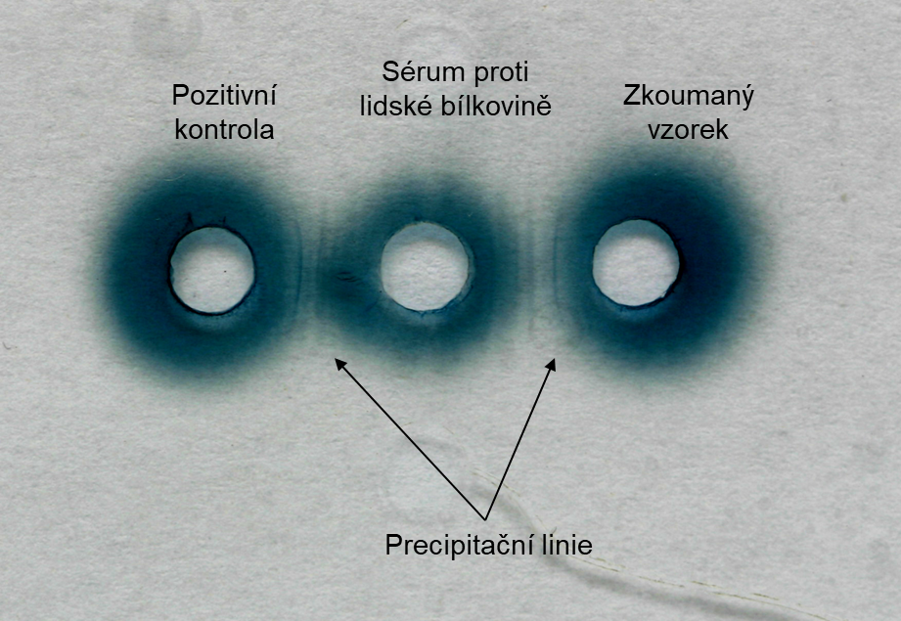
Proof of human origin – real case
Precipitation lines between human protein control and extract from suspected spot means that spot is of human origin

Slide 8
Blood groups
There are agglutinogens on the membranes of erythrocytes:
Group A - Only agglutinogen A is formed.
Group B - Only agglutinogen B is formed.
Group AB - Both agglutinogens are formed.
Group 0 - No agglutinogen is formed.*
*Better said - no agglutinogen (antigen) A or B is formed. However, we can find here the so-called antigen H, which is actually a precursor for antigen A and B. In some texts, therefore, group 0 is called group H.
Blood plasma, on the other hand, contains protein antibodies called agglutinins (anti-A, anti-B).
Group A - Only anti-B agglutinin is formed.
Group B - Only anti-A agglutinin is formed.
Group AB - No agglutinin is formed.
Group 0 - Both agglutinins are formed (ie anti-A and anti-B).

Slide 9
Blood groups
Haemolysis
haemolysis
agglutination
Result
Whole blood - the principle:
reaction of an unknown antigen with a known agglutinin
A small amount of known antiserum is added to a few drops of whole blood (i.e. unknown blood type).
Result: if an agglutinate is formed in the well with the relevant antiserum, the blood group corresponding to the antiserum is proven, i.e. blood cells of unknown blood are clumped (agglutinated) by known antibodies.

Slide 10
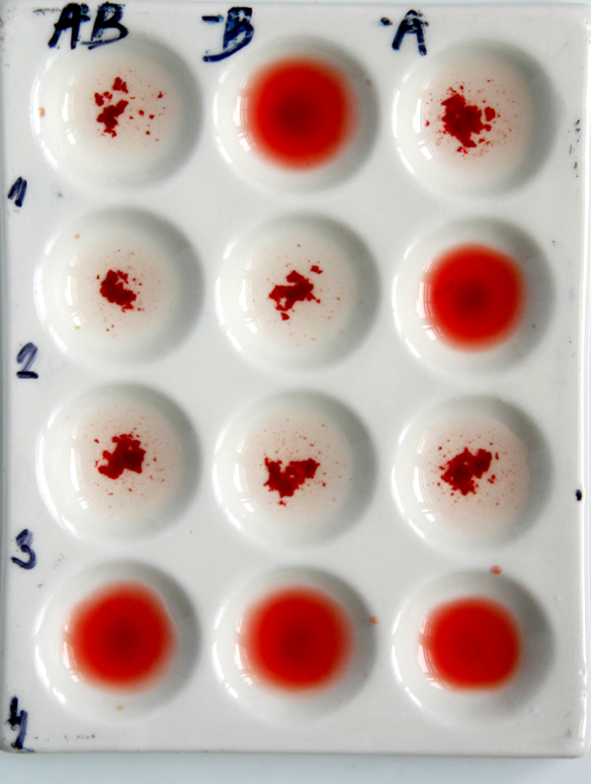
Blood groups – proof of blood group, real case
Group
A
B
AB
0

Slide 11
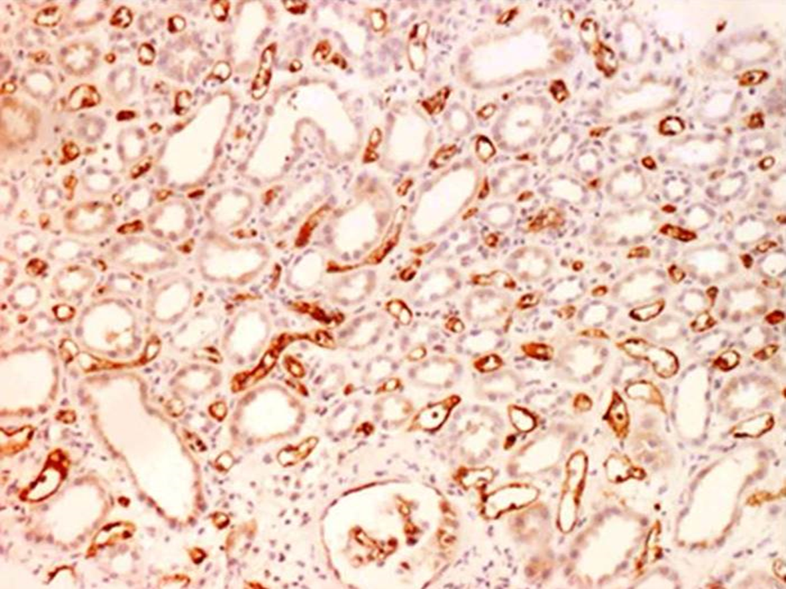
Blood groups
Many method for blood group were developed for different purposes depending mainly on the amount of material
Therkelsen
Absorption-elution
Mixed agglutination
Histochemical proof:
In cases where blood cannot be collected (extensive traumatic devastation or putrefactive decomposition). Agglutinogens also present on the endothelium

Slide 12
Blood different origin - menstrual
Proof can be made microscopically
By staining the glycogen contained in vaginal cells
By determination of fibrinolysin

Slide 13
Blood different origin – pregnancy blood
Pregnancy tests (immunoanalysis using specific antibodies).
It is a qualitative detection of human chorionic gonadotropin. Can be used also for determining pregnancy urine.

Slide 14
Blood different origin – fetal, newborn, infant blood
Detection of alpha-1-fetoprotein (concentration reaches a maximum between 11-14 weeks of intrauterine life, does not occur in children older than 6-7 months).
Examination of fetal hemoglobin (HbF), which is characterized by significant alkali resistence. HbF in alkali solution is pinky while hemoglobin of adult persons will be yellow-brown because it is less stable and will convert into hematin.

Slide 15
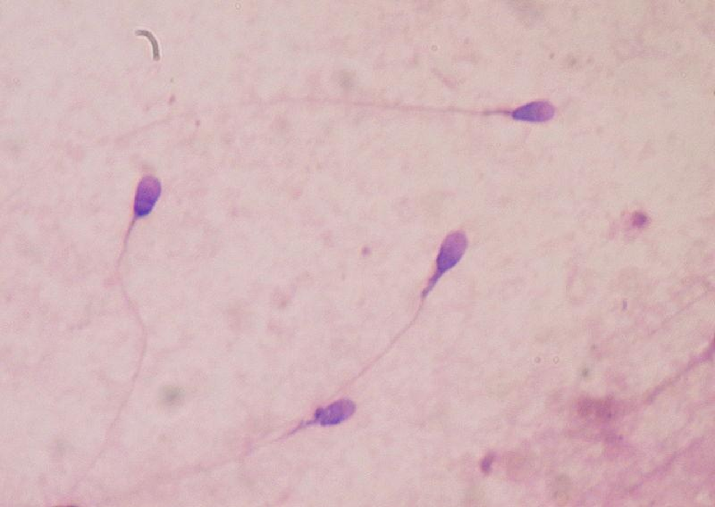
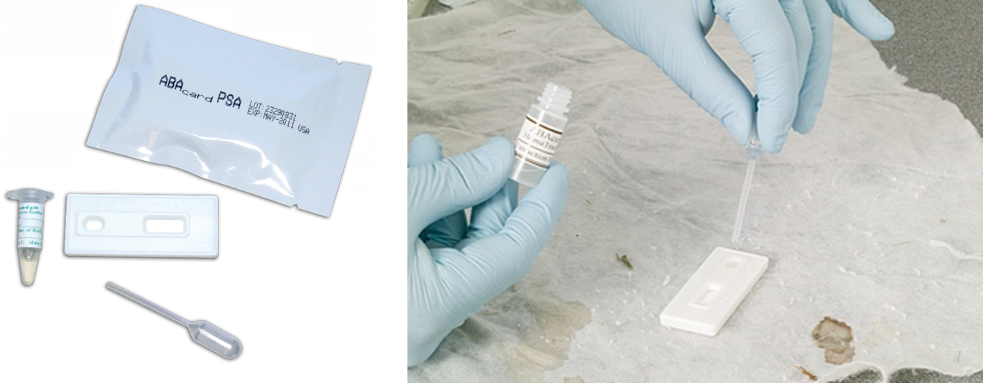
Semen spots
Sperm
Direct evidence - we look for sperm under a microscope
Indirect evidence – we detect substances contained in seminal plasma: acidic phosphatase, spermin or specific prostate antigen (PSA)

Slide 16
Proof of saliva
Saliva detection is based on
the enzymatic activity of alpha-amylase – hydrolytically cleaving polysaccharides
Immunologiec- reactikon of monoclonal antbodies against human alfa amylase

Slide 17
Urine
Chromatographic –
determination of 3 main components of urine (urea, creatinine and hippuric acid)
Immunochromatographically (RSID-urine test) –
determination of THP (Tamm-Horsfall glycoprotein) - it is a glycoprotein produced in the kidneys - the test does not show cross-reactions with other body fluids or animal urine

Slide 18
Stool
Detection of stercobilin by a sublimate solution, after the addition of which a brick-red coloration of the stain occurs.
Stercobilin can also be detected by chromatography

Slide 19
Amniotic fluid
Microscopically –
cells of vernix casesosa, meconium bodies, lanugo hairs (the microscopic image is usually not very conclusive)
Detection of placental alkaline phosphatase -
Placental alkaline phosphatase is thermostable, we demonstrate it after inhibition of thermolabile alkaline phosphatase, using e.g. alpha-naphthyl phosphate and diazonium salt Fast blue B

Slide 20
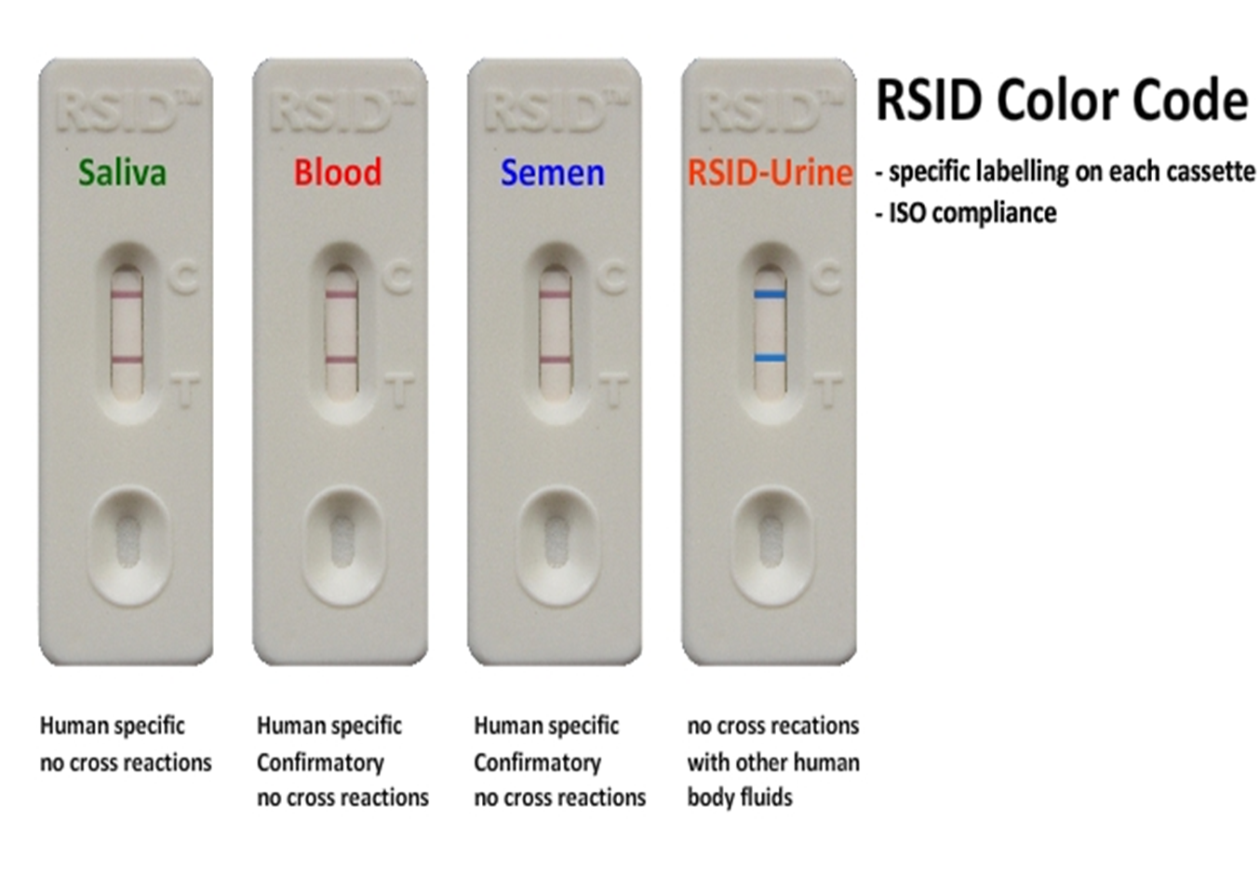
Immunochromatographic method

Slide 21
DNA/RNA should not be forgotten
it solves nearly all laboratory problems
in forensic sciences

