Slide 1
Fall from height

Slide 2
How it happens
By falling from above we mean the movement of the body from a higher to a lower level, whereby two basic situations can occur:
Fall from standing position:
occurs when the body touches the underlay with both or one foot
Fall from height
occurs when the body does not touch the underlay
Depending on how the fall occurs, it is a fall
Passive – from a resting position e.g. standing, sitting;
Active - from some activity before falling e.g. running, walking etc.

Slide 3
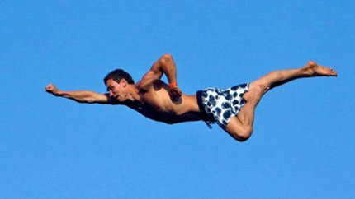
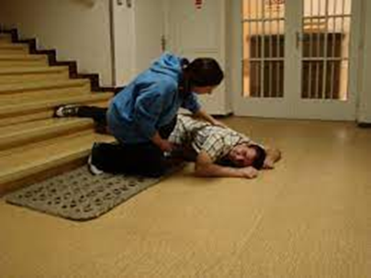
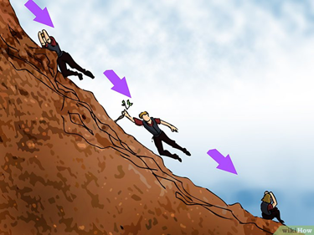
Different types of falls
Free fall: the body overcomes a certain path and only the force of gravity acts on it
Coordinated - sports
Uncoordinated
Stepped fall (gradual): during the fall, the body hits obstacles

Slide 4
Injuries
On external examination:
abrasions:
their appearance is related to clothing - almost no abrasions may be visible on a clothed body. This also applies to free fall. On the contrary, in the case of a gradual fall, the abrasions are numerous and extensive.
contusions:
subcutaneous hemorrhages tend to be more extensive during a stepped fall,
lacerations:
caused by contact of the body with an obstacle during a gradual fall, but during a free fall when hitting an uneven surface,
fractures:
From fissure fracture to comminuted fractures of the vault and base of the skull, bone fractures of the limbs, chest, skeleton, pelvis.

Slide 5
Injuries - mechanism
The appearance and extent of the injury depends on several factors:
whether it is a free or stepped (gradual) fall
on the height from which the body falls
on clothing and the number of layers of clothing
which part of the body it hits which underlay it lands on
Fall from height of good dressed man – no bruises, no abrasion on external examination

Slide 6
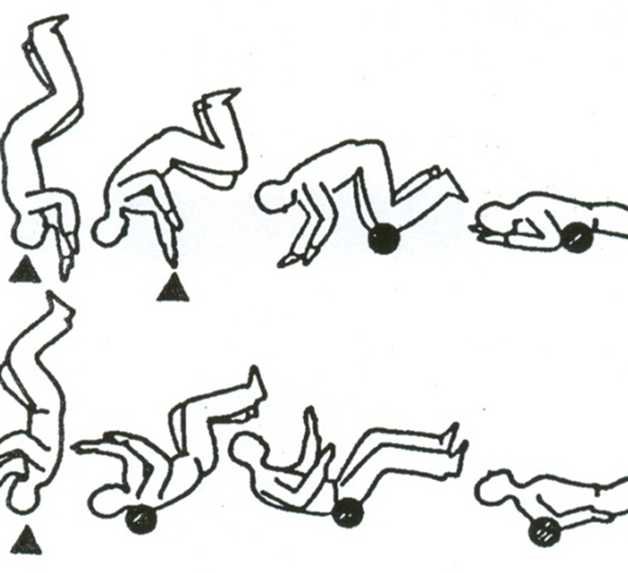
Injuries according to site of impact
The body can land in these basic positions:
on head
to the front of the body
on the lower limbs
on the buttocks (sitting)
on back

Slide 7
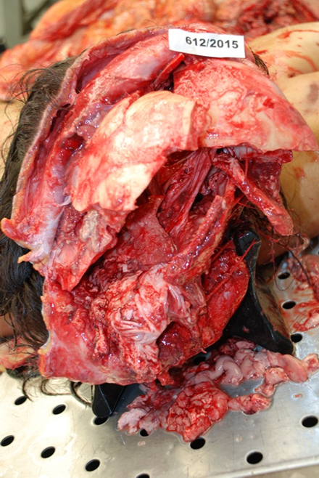
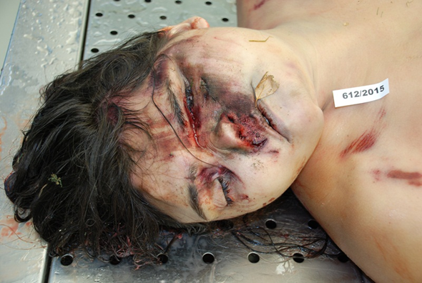
Different types of injury
Injury to internal organs:
Cranial cavity:
fractures, crash of skull
contusion to laceration of the brain with blood effusions in the cranial cavity.
inhalation of blood into the lungs is also related to fractures of the base of the skull.

Slide 8
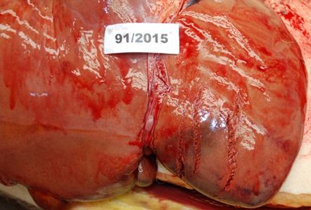
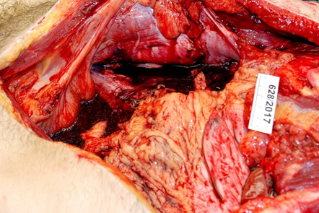
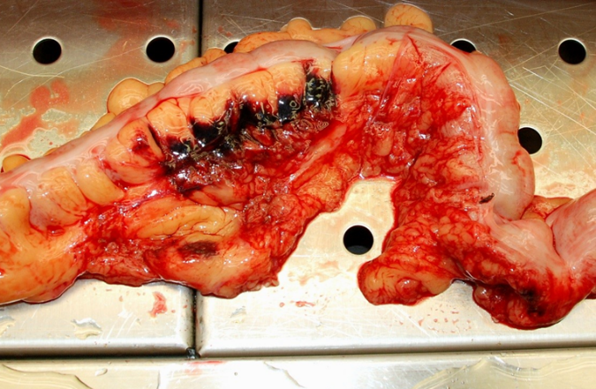
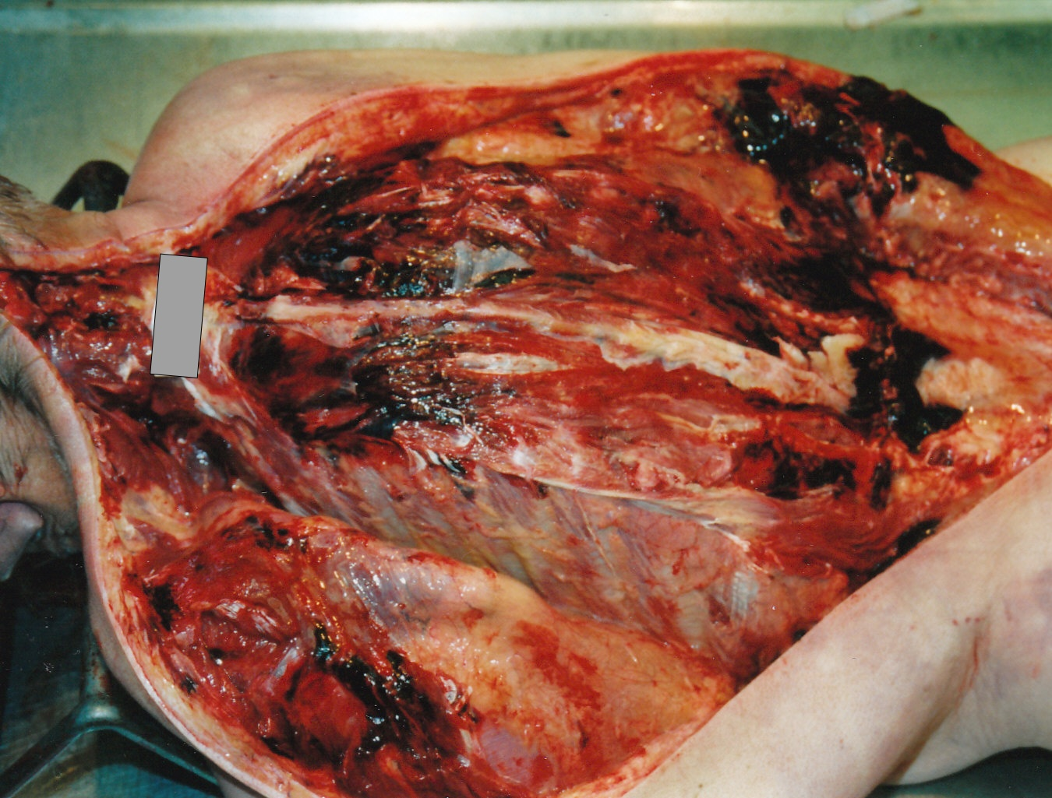
Different types of injury
Abdominal cavity:
lacerations or contusions of the liver are common,
spleen with blood effusion into the abdominal cavity
bruising or laceration, or detachment of the kidney (or both) from the pedicle
ruptures of the stomach,
peritoneum (intestine suspension) and ruptures of the small or large intestine - not common
Contusion of the pancreas - rare, it is quite well hidden
Multiple hemorhages on back

Slide 9
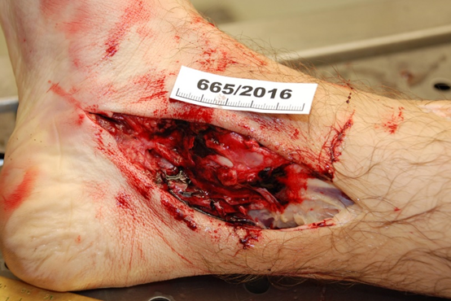
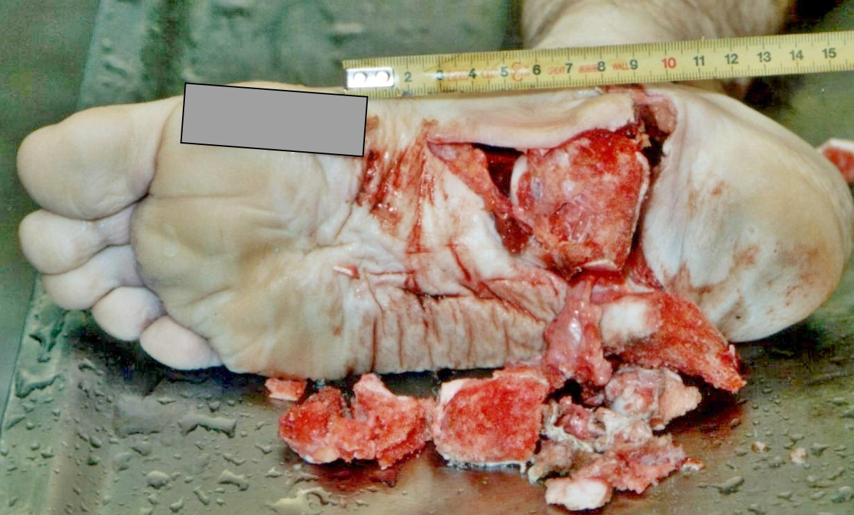
Different types of injury
Limbs
Different types of fractures
Typical is fracture of ankle and bones of foot in case of impact on lower limbs

Slide 10
Zdroje obrázků
Skydiving 4 way - Parašutismus – Wikipedie (wikipedia.org)
https://www.studenta.cz/akrobaticke-skoky-do-vody-a-festival-v-jednom-quix-highjump/r~st:iphoto:369/r~st:article:369/
https://www.wikihow.cz/Jak-p%C5%99e%C5%BE%C3%ADt-p%C3%A1d-z-velk%C3%A9-v%C3%BD%C5%A1ky
https://www.prozeny.cz/clanek/desivy-snar-aneb-co-znamenaji-vase-nocni-mury-72982?mol-gallery--selected=393207

