Slide 1
Electrocution

Slide 2
Electrical Injuries
The effect of the electrical current depends on:
  Voltage (tension)
  Amperage (intensity)
  Resistance
  Alternating/direct current
  Time of contact
  Size of contact area
  Pathway of electric current

Slide 3
Electrical Injuries
Voltage
  is less important than the amperage
  low tension about 50 V rarerly cause accidents
  most fatalities follow shocks from current at a tension of 220 – 250 V

Slide 4
Electrical Injuries
Amperage
  is important as probably most important factor in electrocution. It is the cause of „hold-on“ to conductors which, in turn is the cause of serious local damage and fatal shock. Contact with current at only 1mA can yield a sensation of tingling. As the amperage rises the sensatins become increasingly unpleasant an then painful. Currents between 10mA and 60mA cause „hold on“, loss of muscular control, asphyxia or ventricular fibrilation.
  With direct current the critical amperage is of the order of 200 – 250 mA. The danger increases above 100 mA to about 4 A, thereafter it decreases – current above 4 A arrests heart fibrilation.

Slide 5
Electrical Injuries
The resistance:
plays important part.
Different tissues has different resistance.
skin 500 – 10 000 ohms
mucosa 1500 – 2000 ohms
bone 900 000 ohms
Wet tissues have lower resistance then dry.

Slide 6
Electrical Injuries
The effect of electric current on the organism:
  Ventricular fibrilation
  Tetanic asphyxia – contraction of extrinsic muscles of respiration
  Respiratory arrest – in the event when the current psasses through respiratory centre in the head
  Cerebral anoxia – with prolonged ventricular fibrilation

Slide 7
Electrical Injuries
The autopsy findings:
  External examination:
    Signs of entrance or exit of electrical current
  Internal examination
    :Signs of suffocation
  Microscopic examination:
    Metalization – the presence of ions of metals from conductor

Slide 8
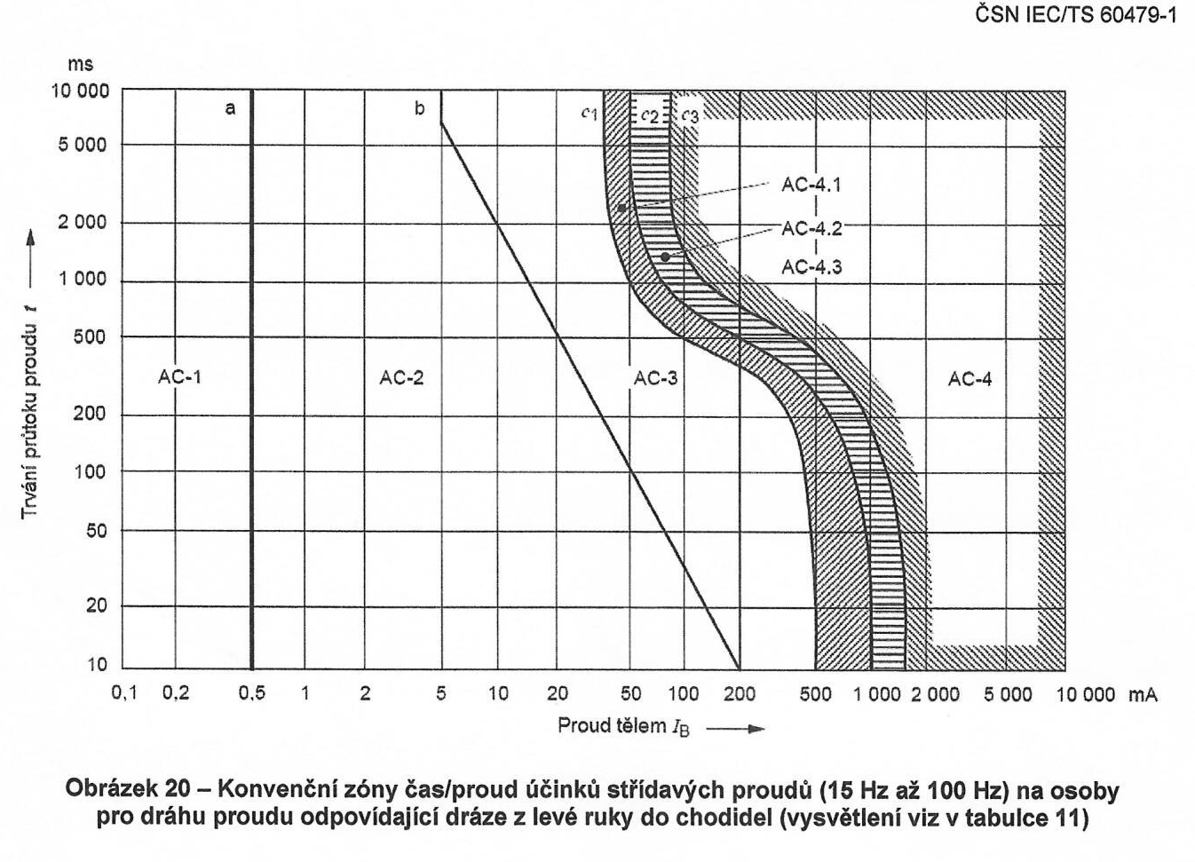
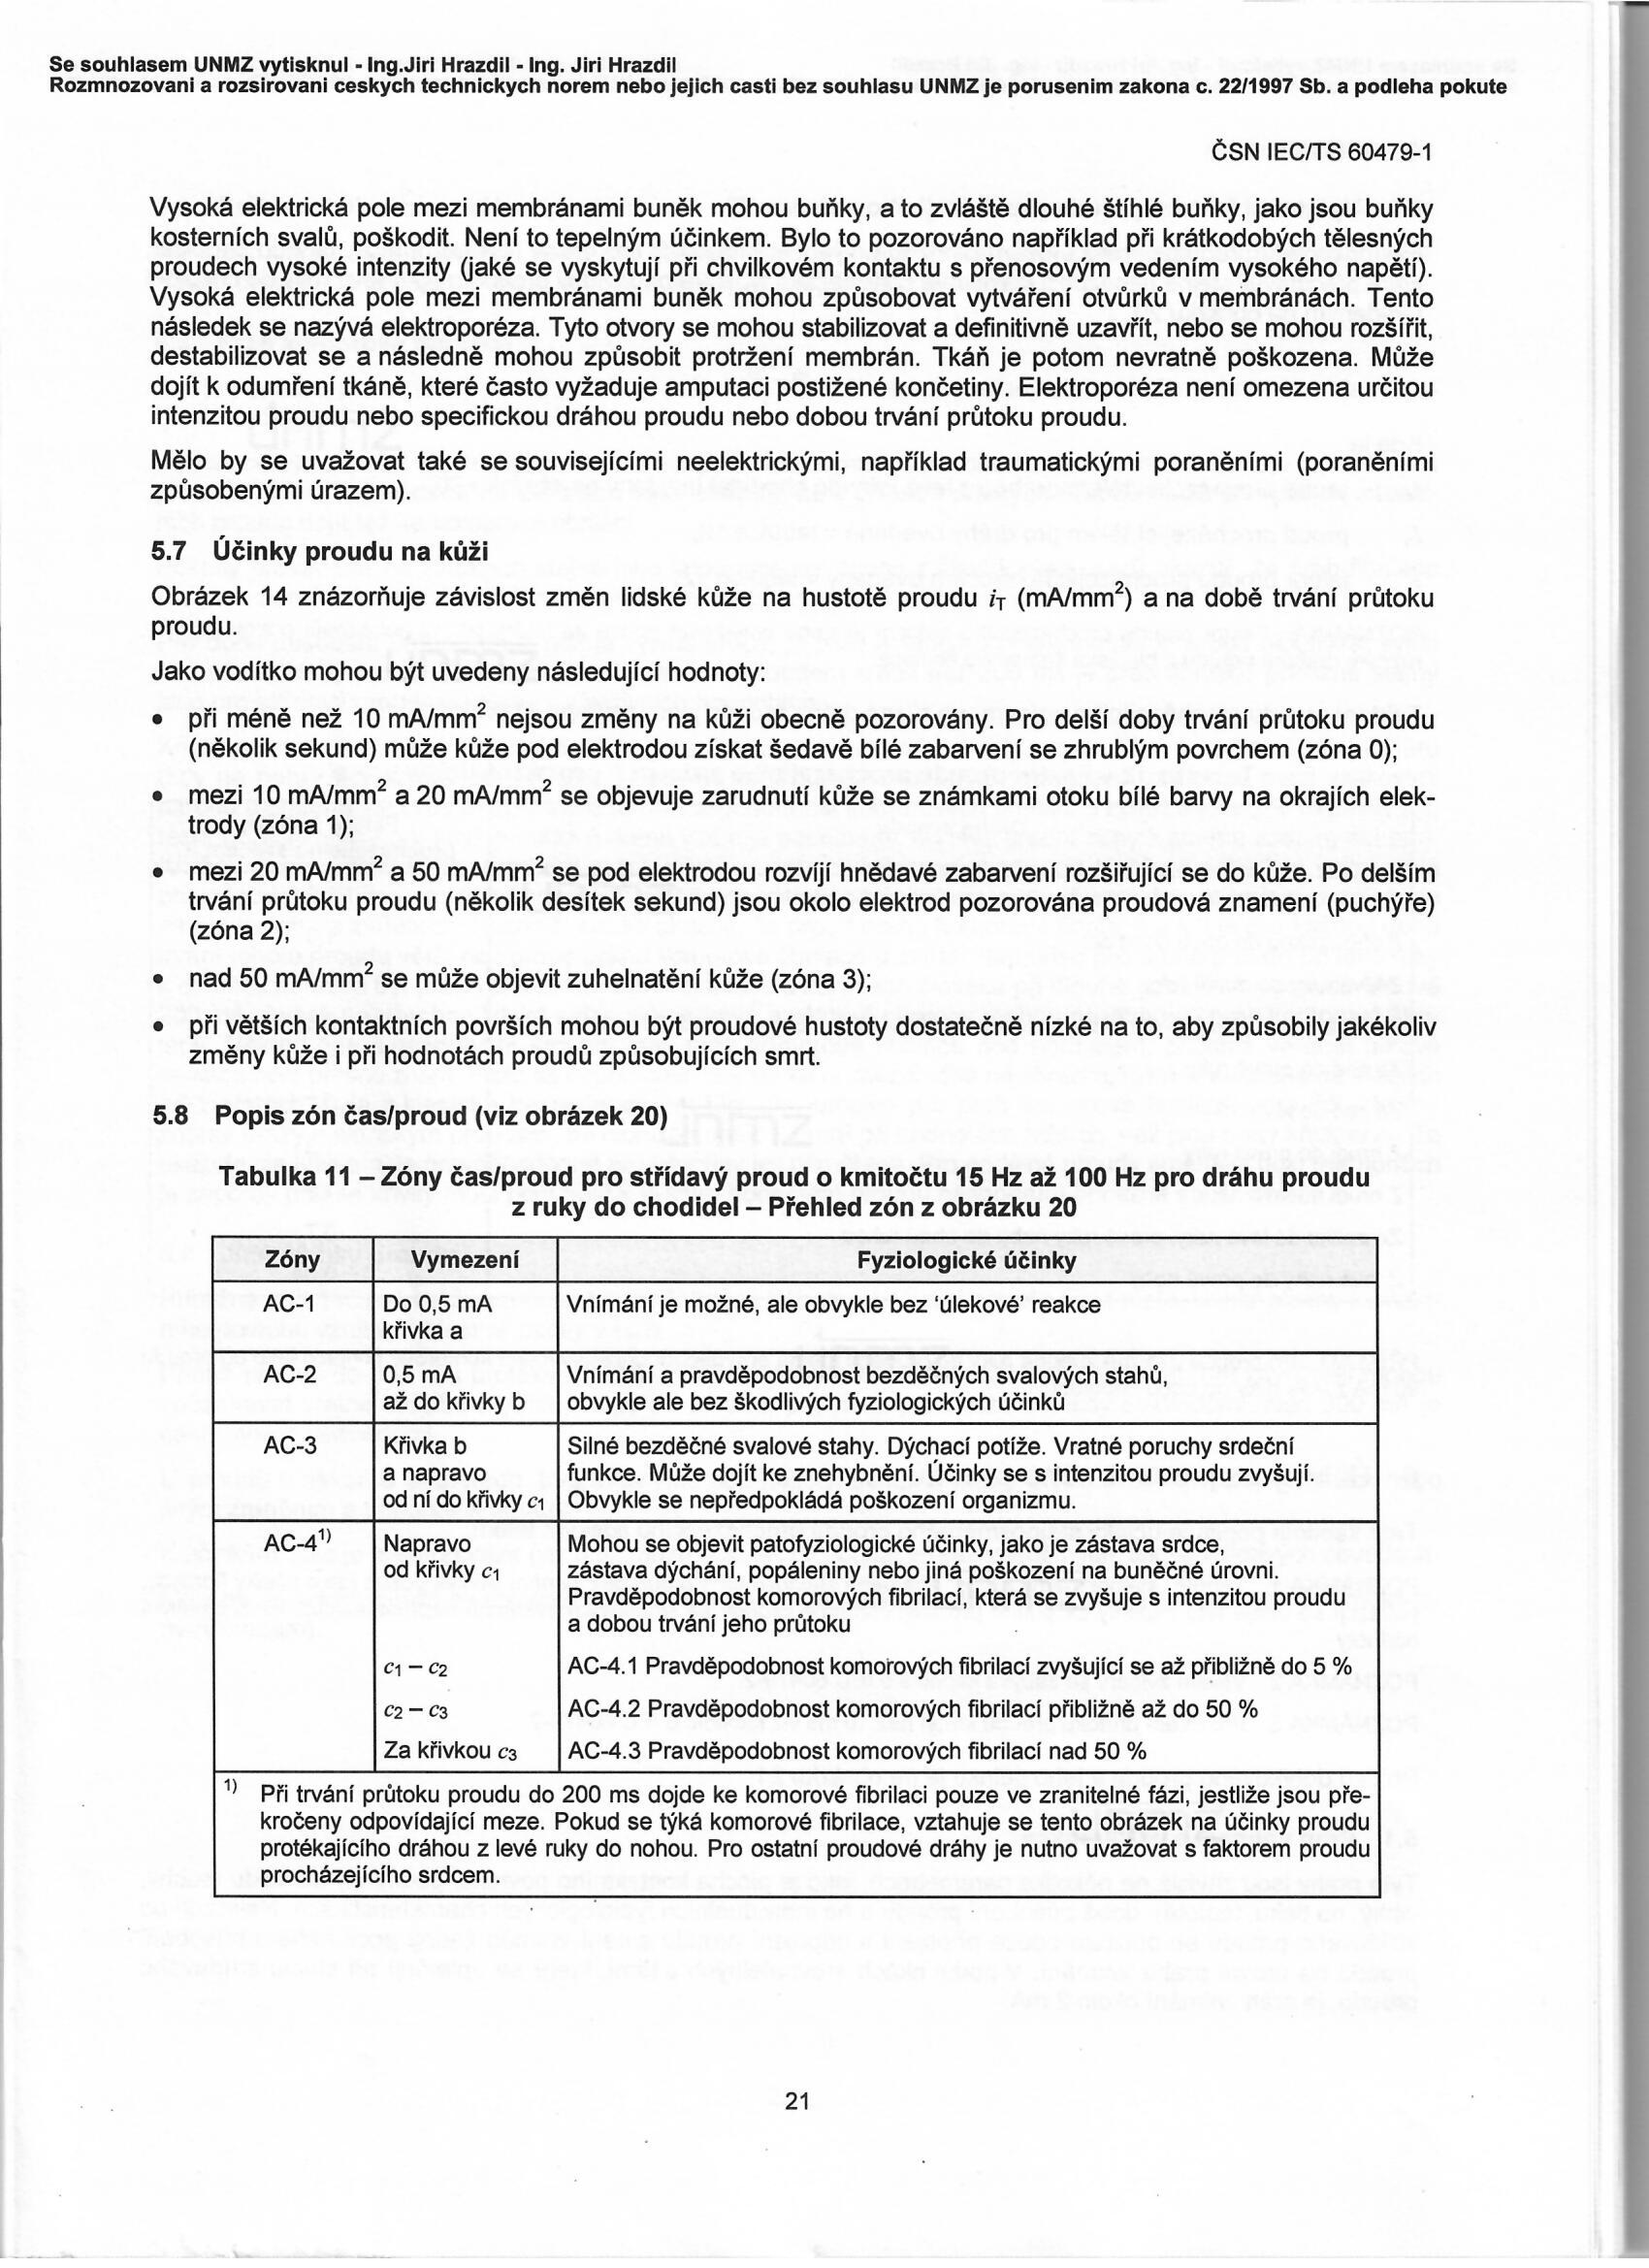

Slide 9
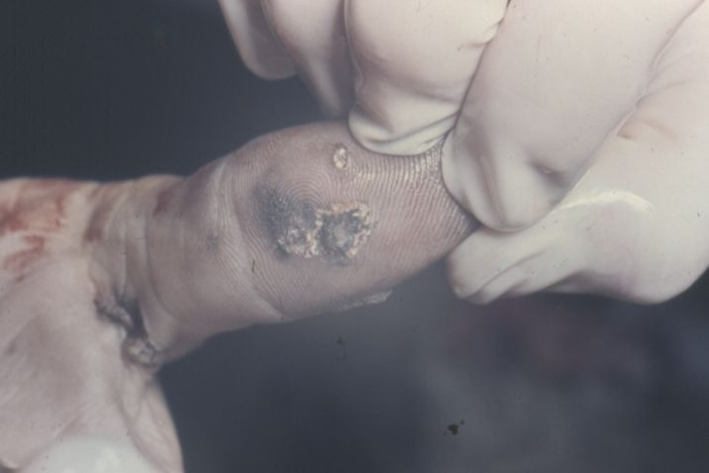
Electrical Injuries
Signs of electrocution:
Electric mark -round or oval shallow craters bordered by a ridge of skin. The crater floor is flattened by pale skin.

Slide 10
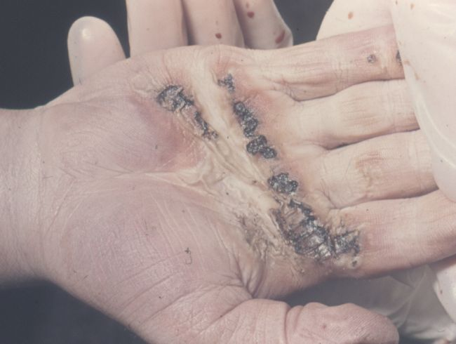

Slide 11
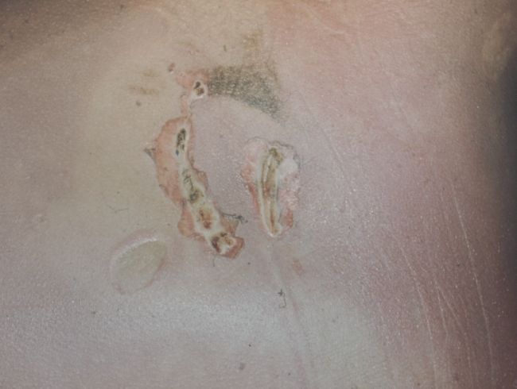

Slide 12
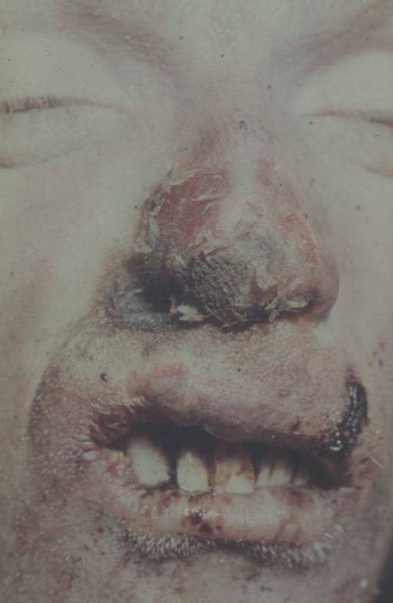

Slide 13
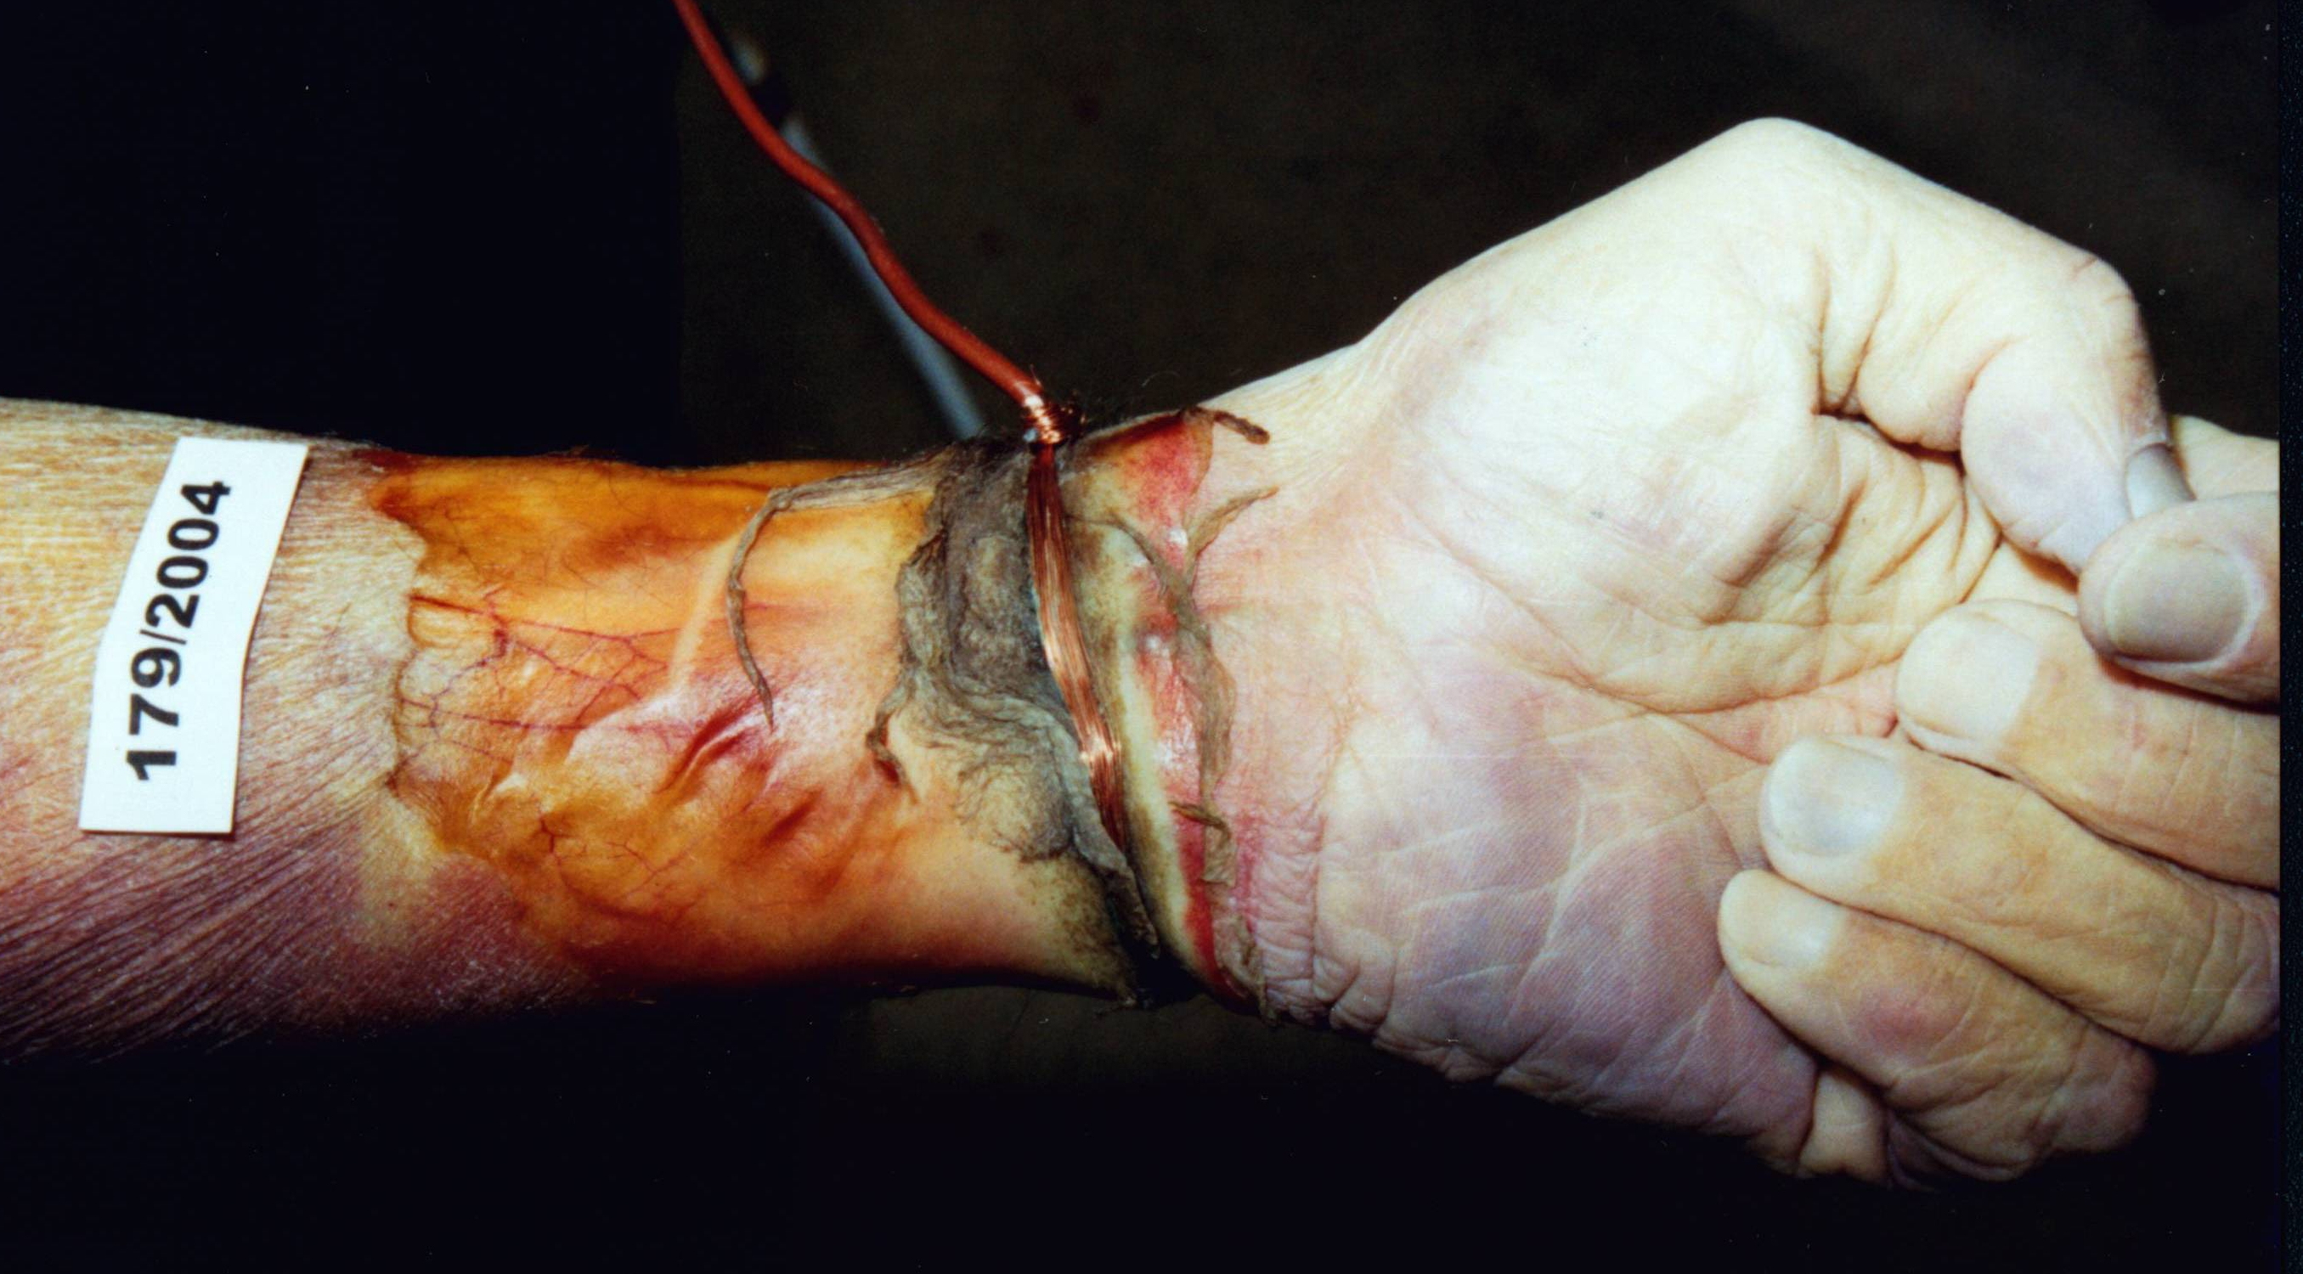

Slide 14
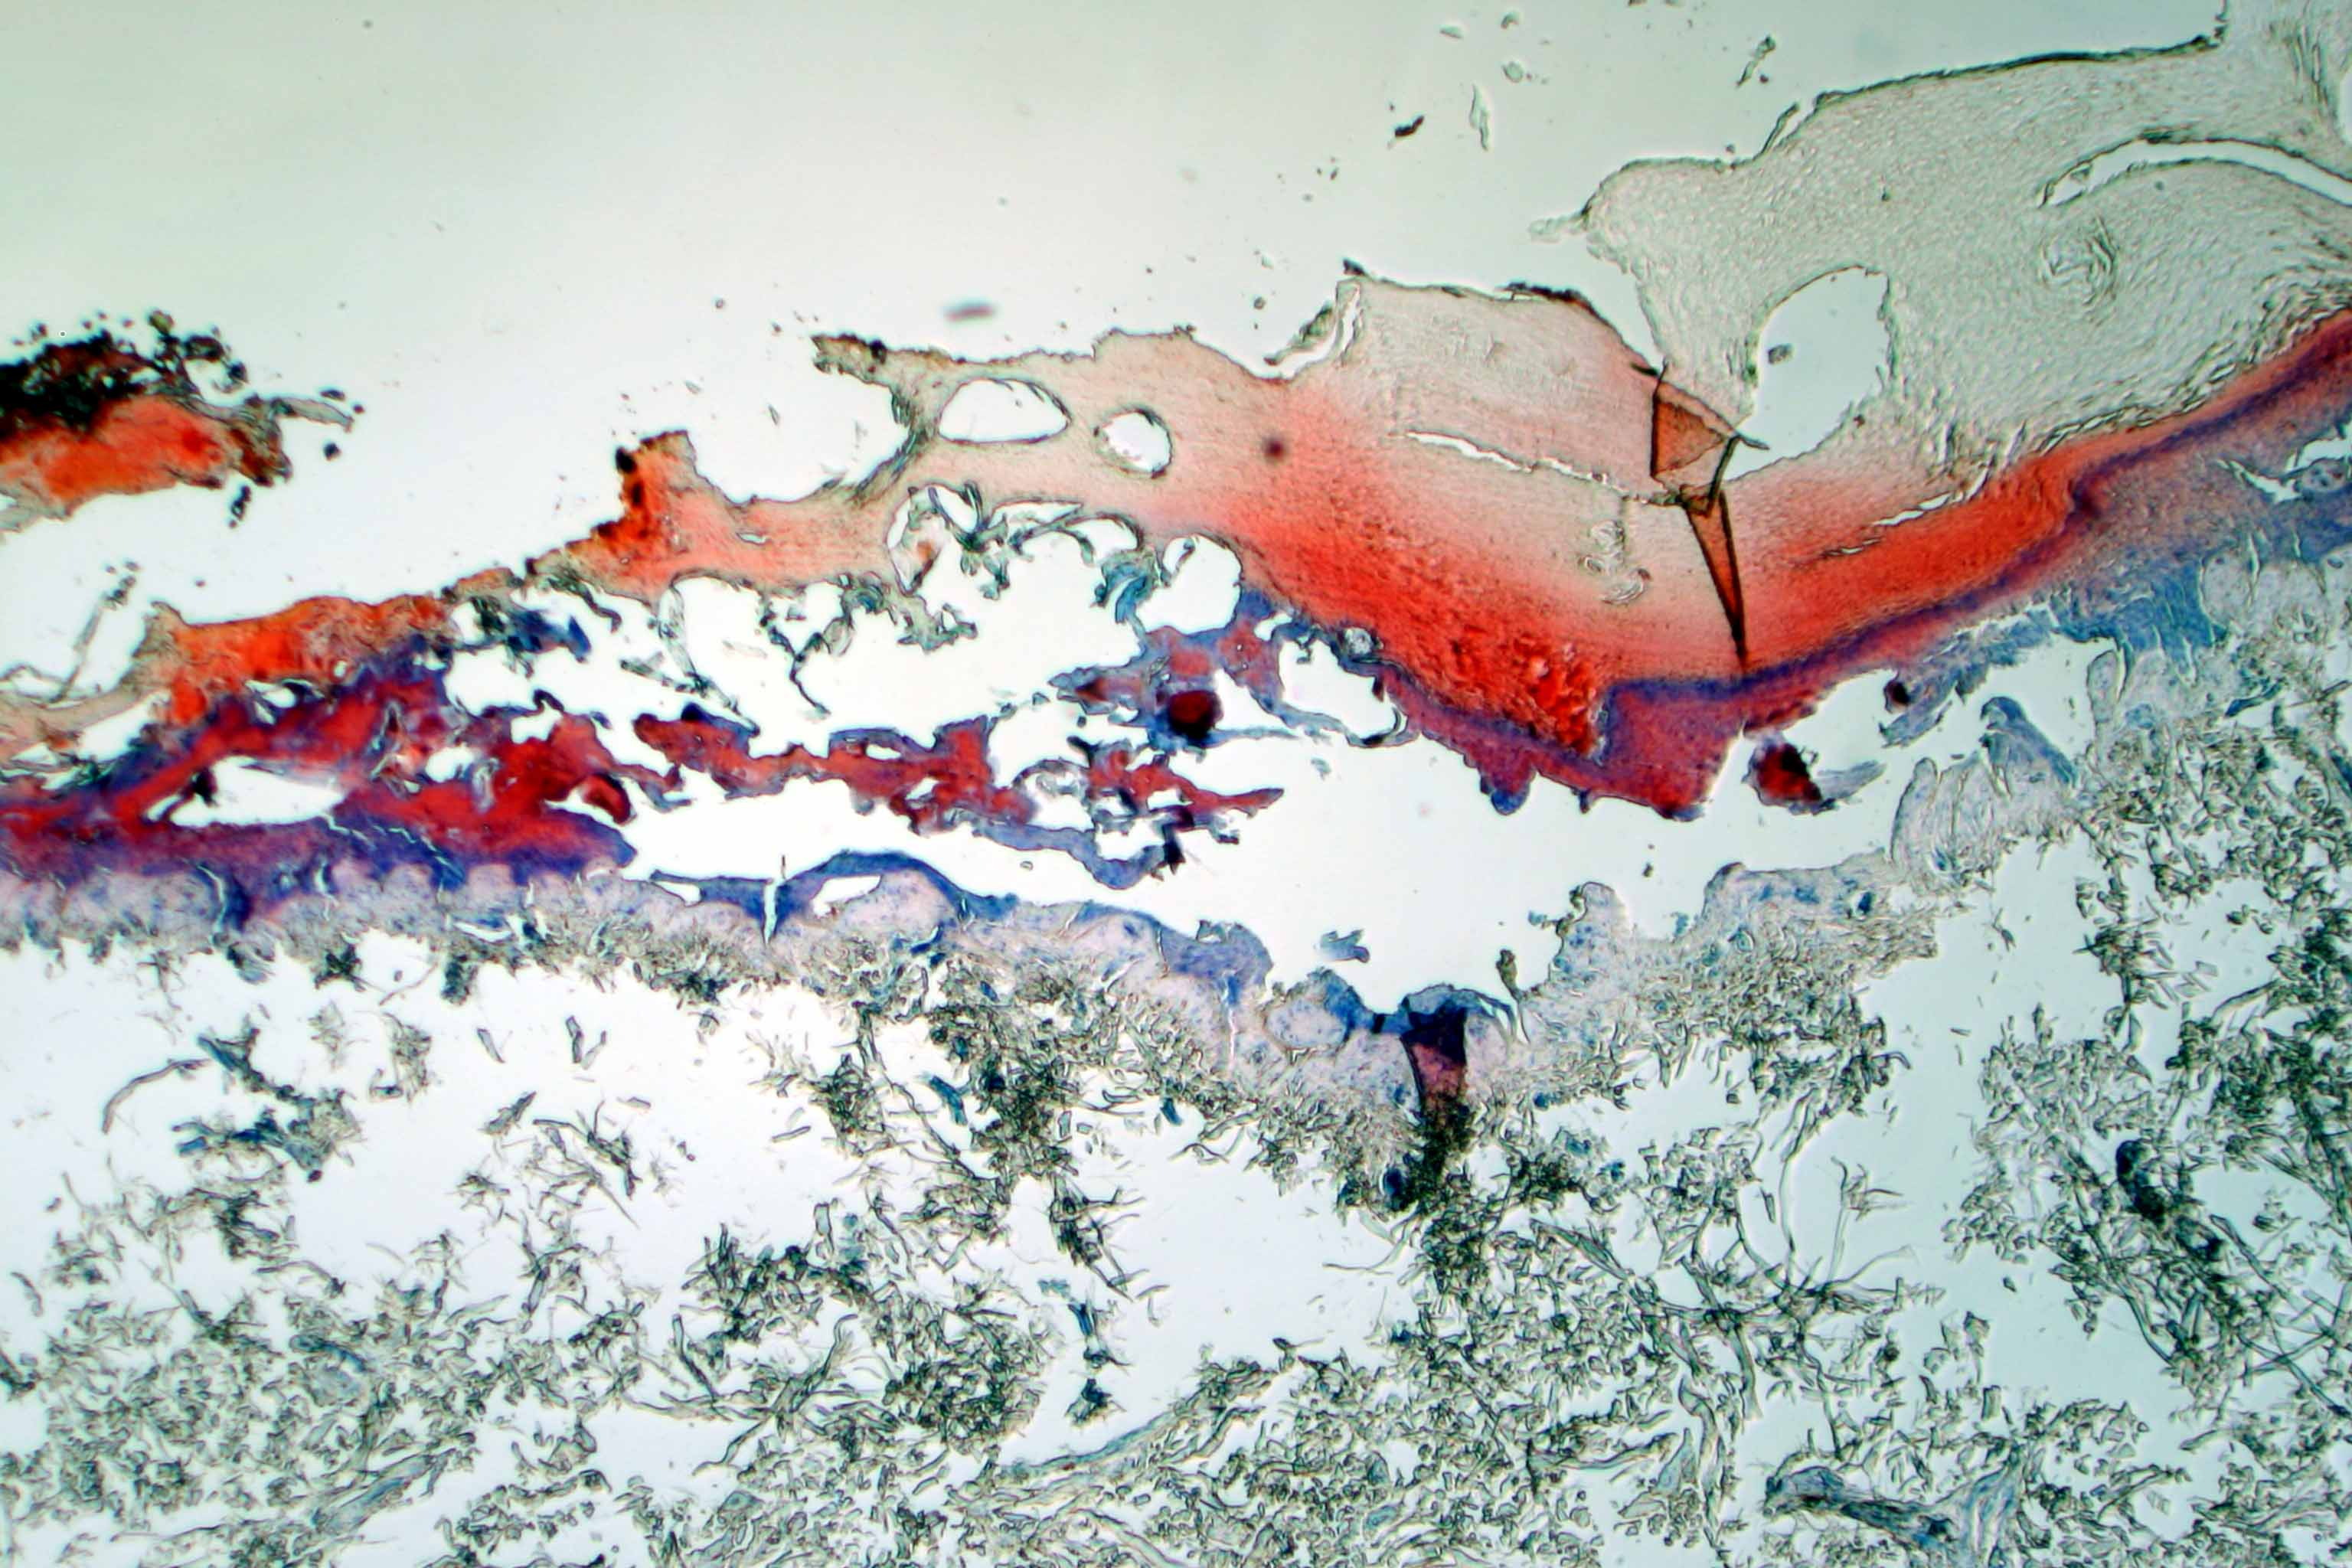

Slide 15
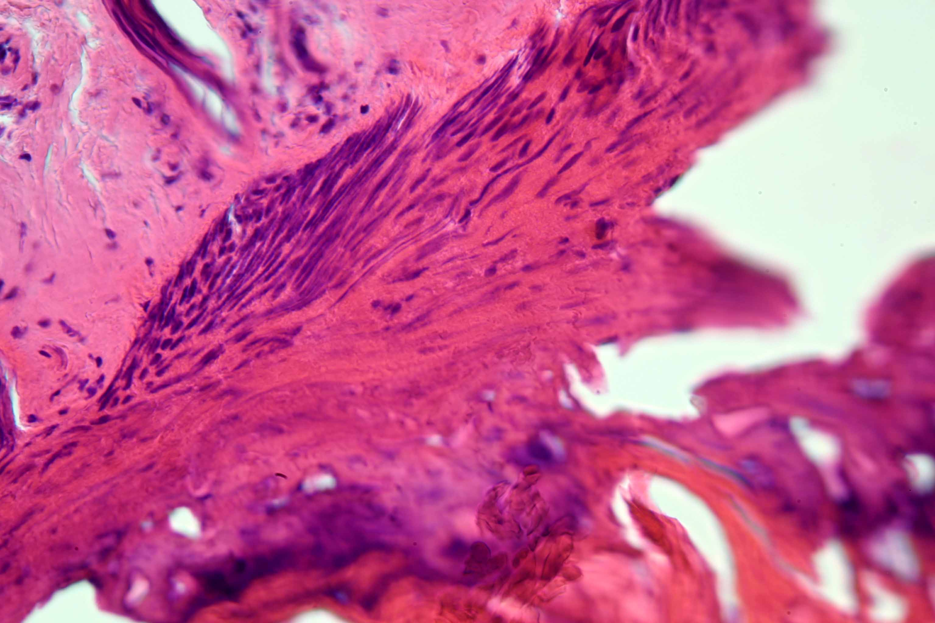

Slide 16
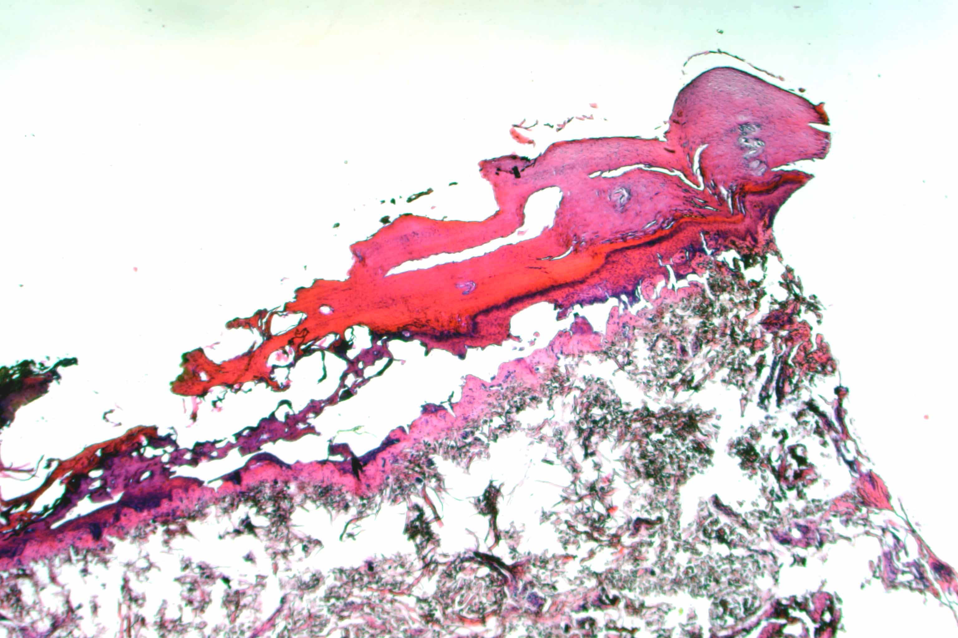

Slide 17
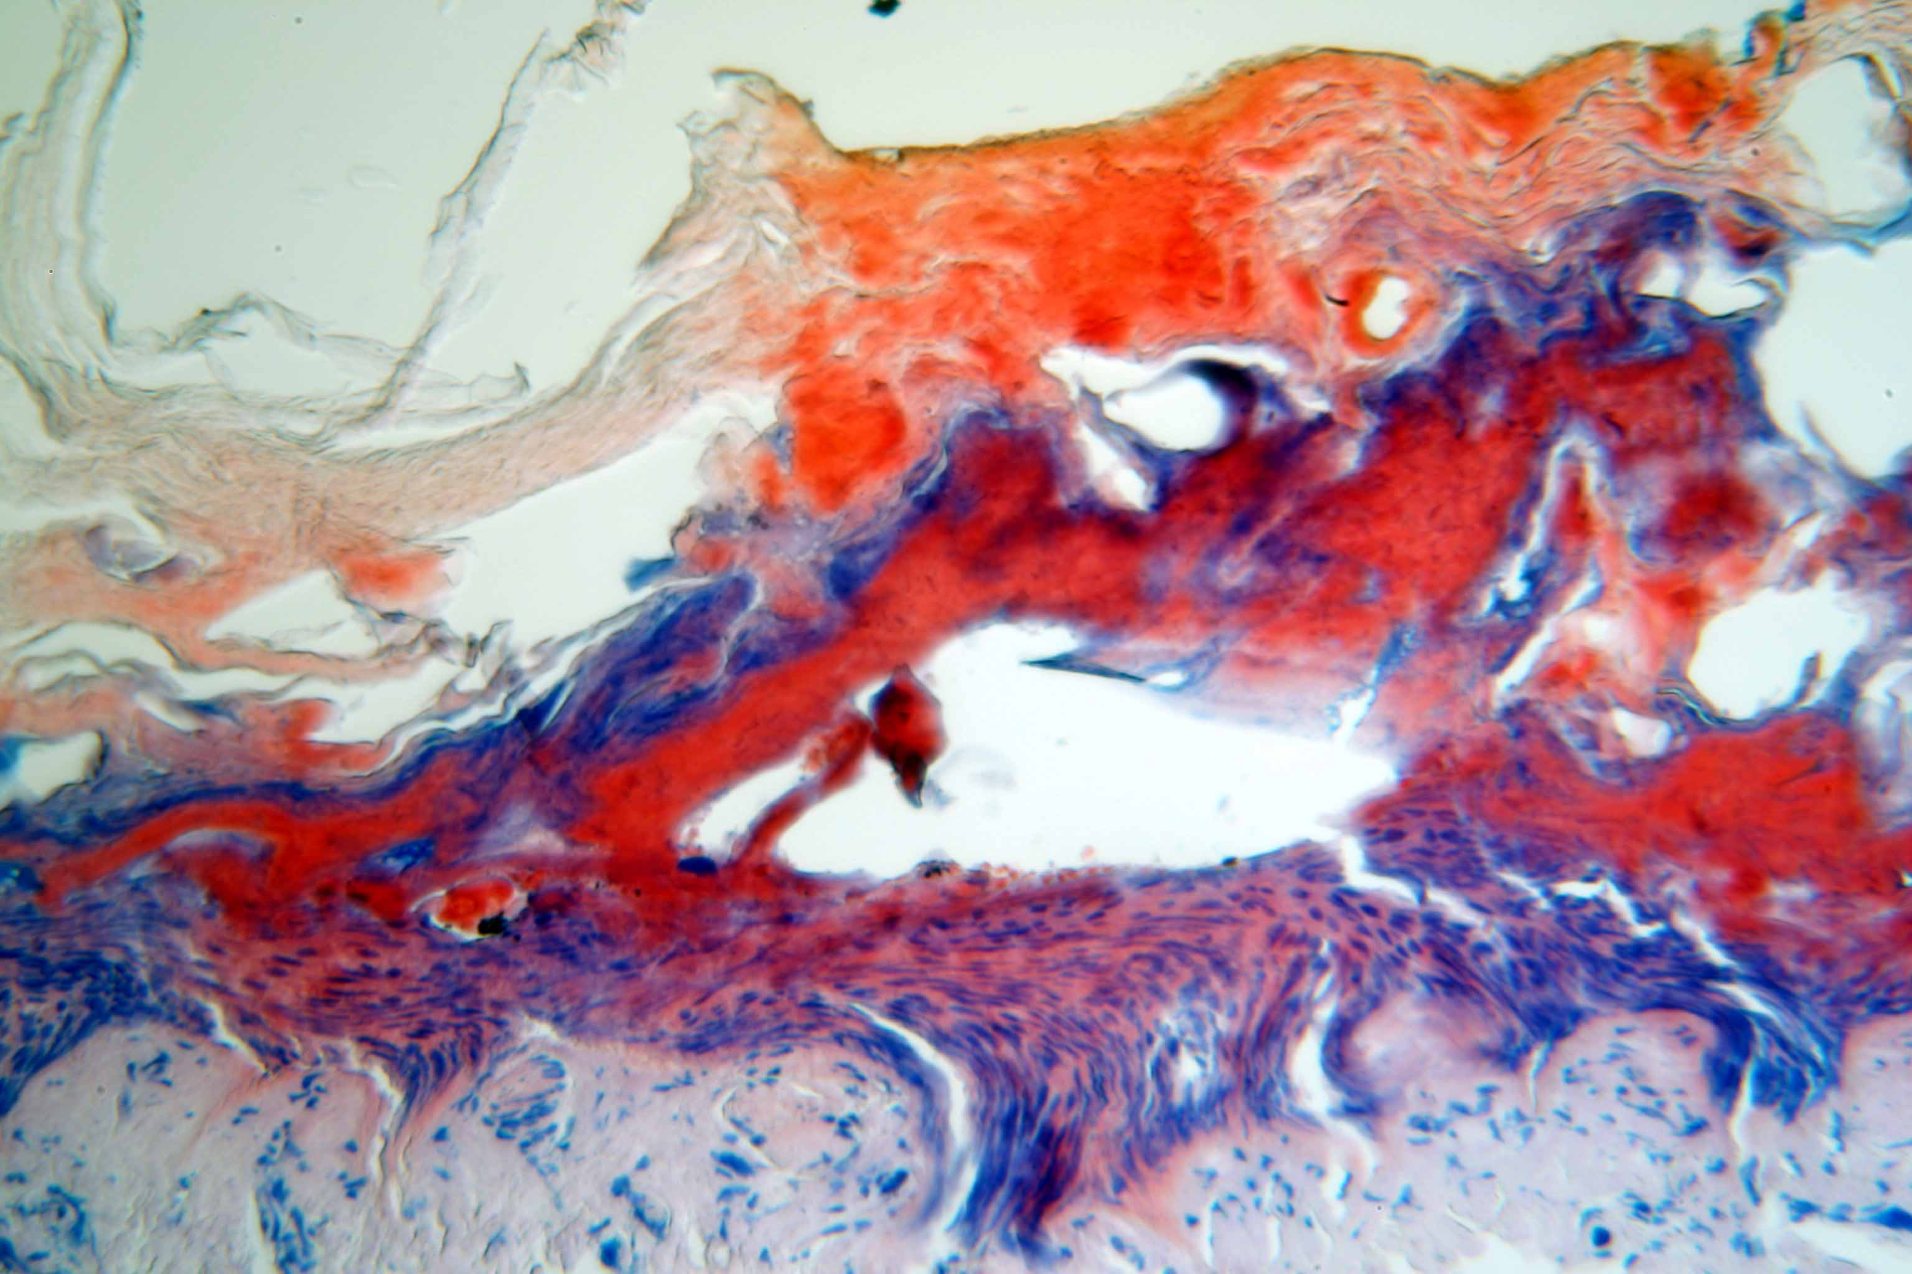

Slide 18
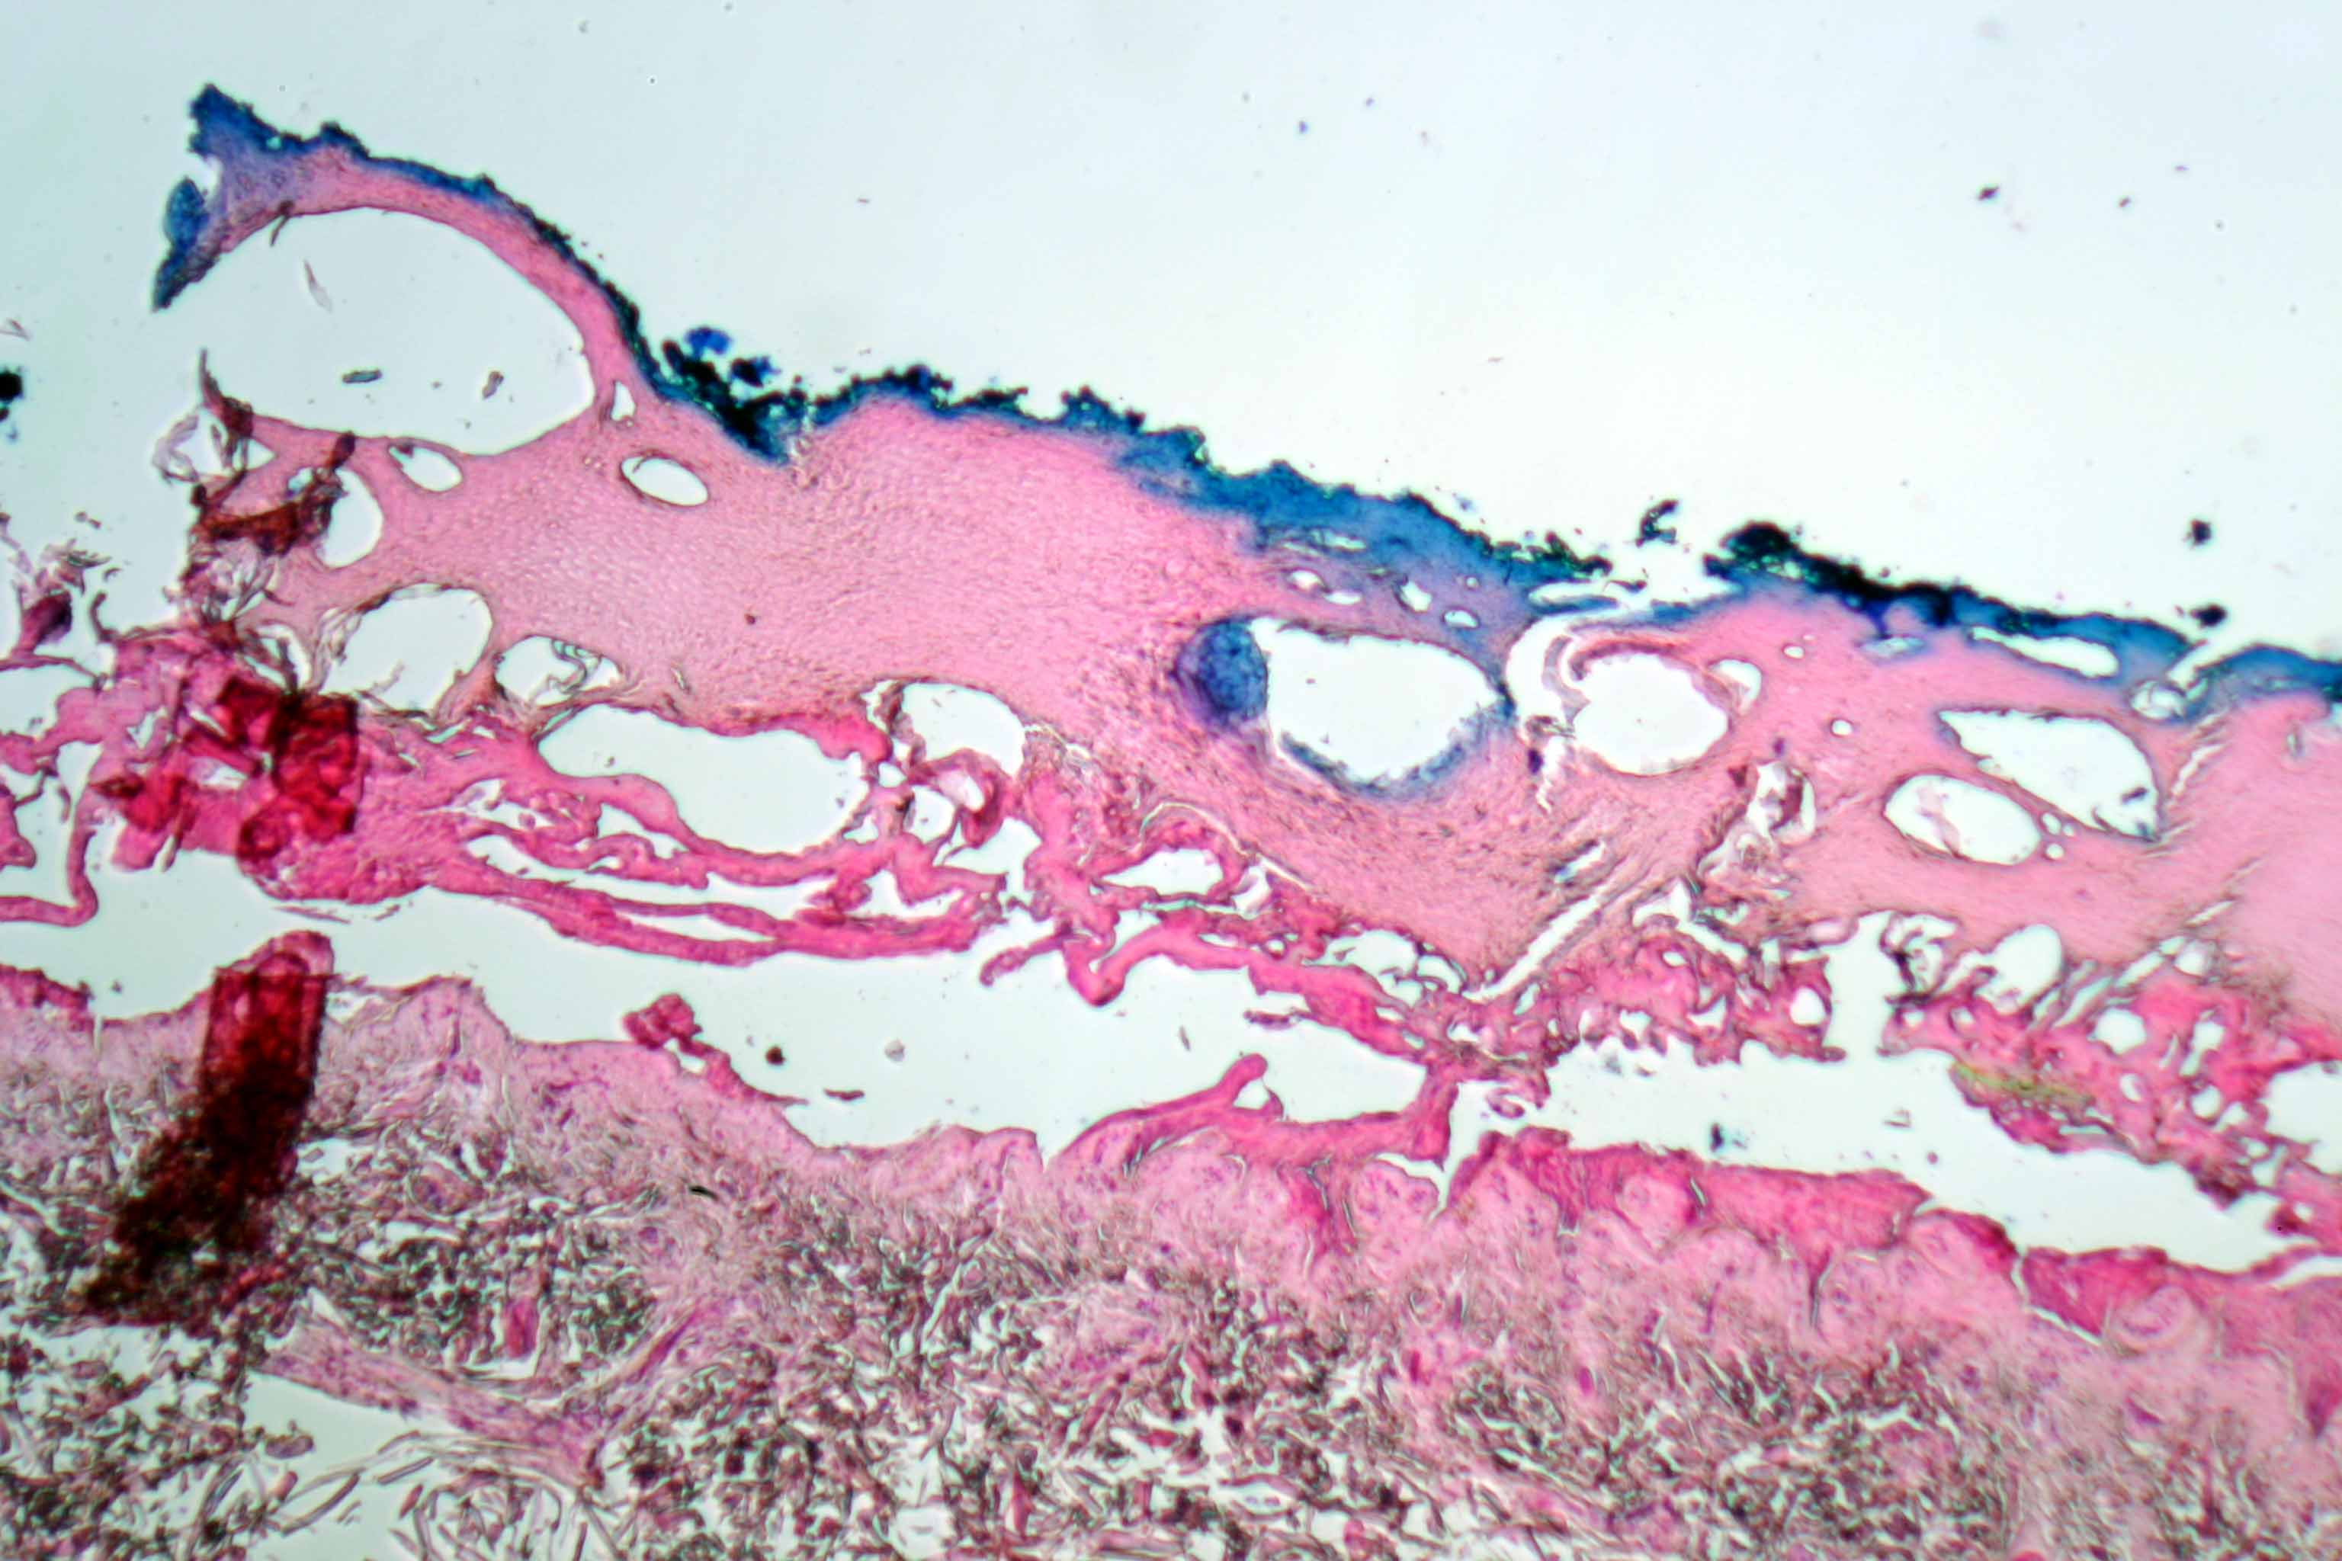

Slide 19
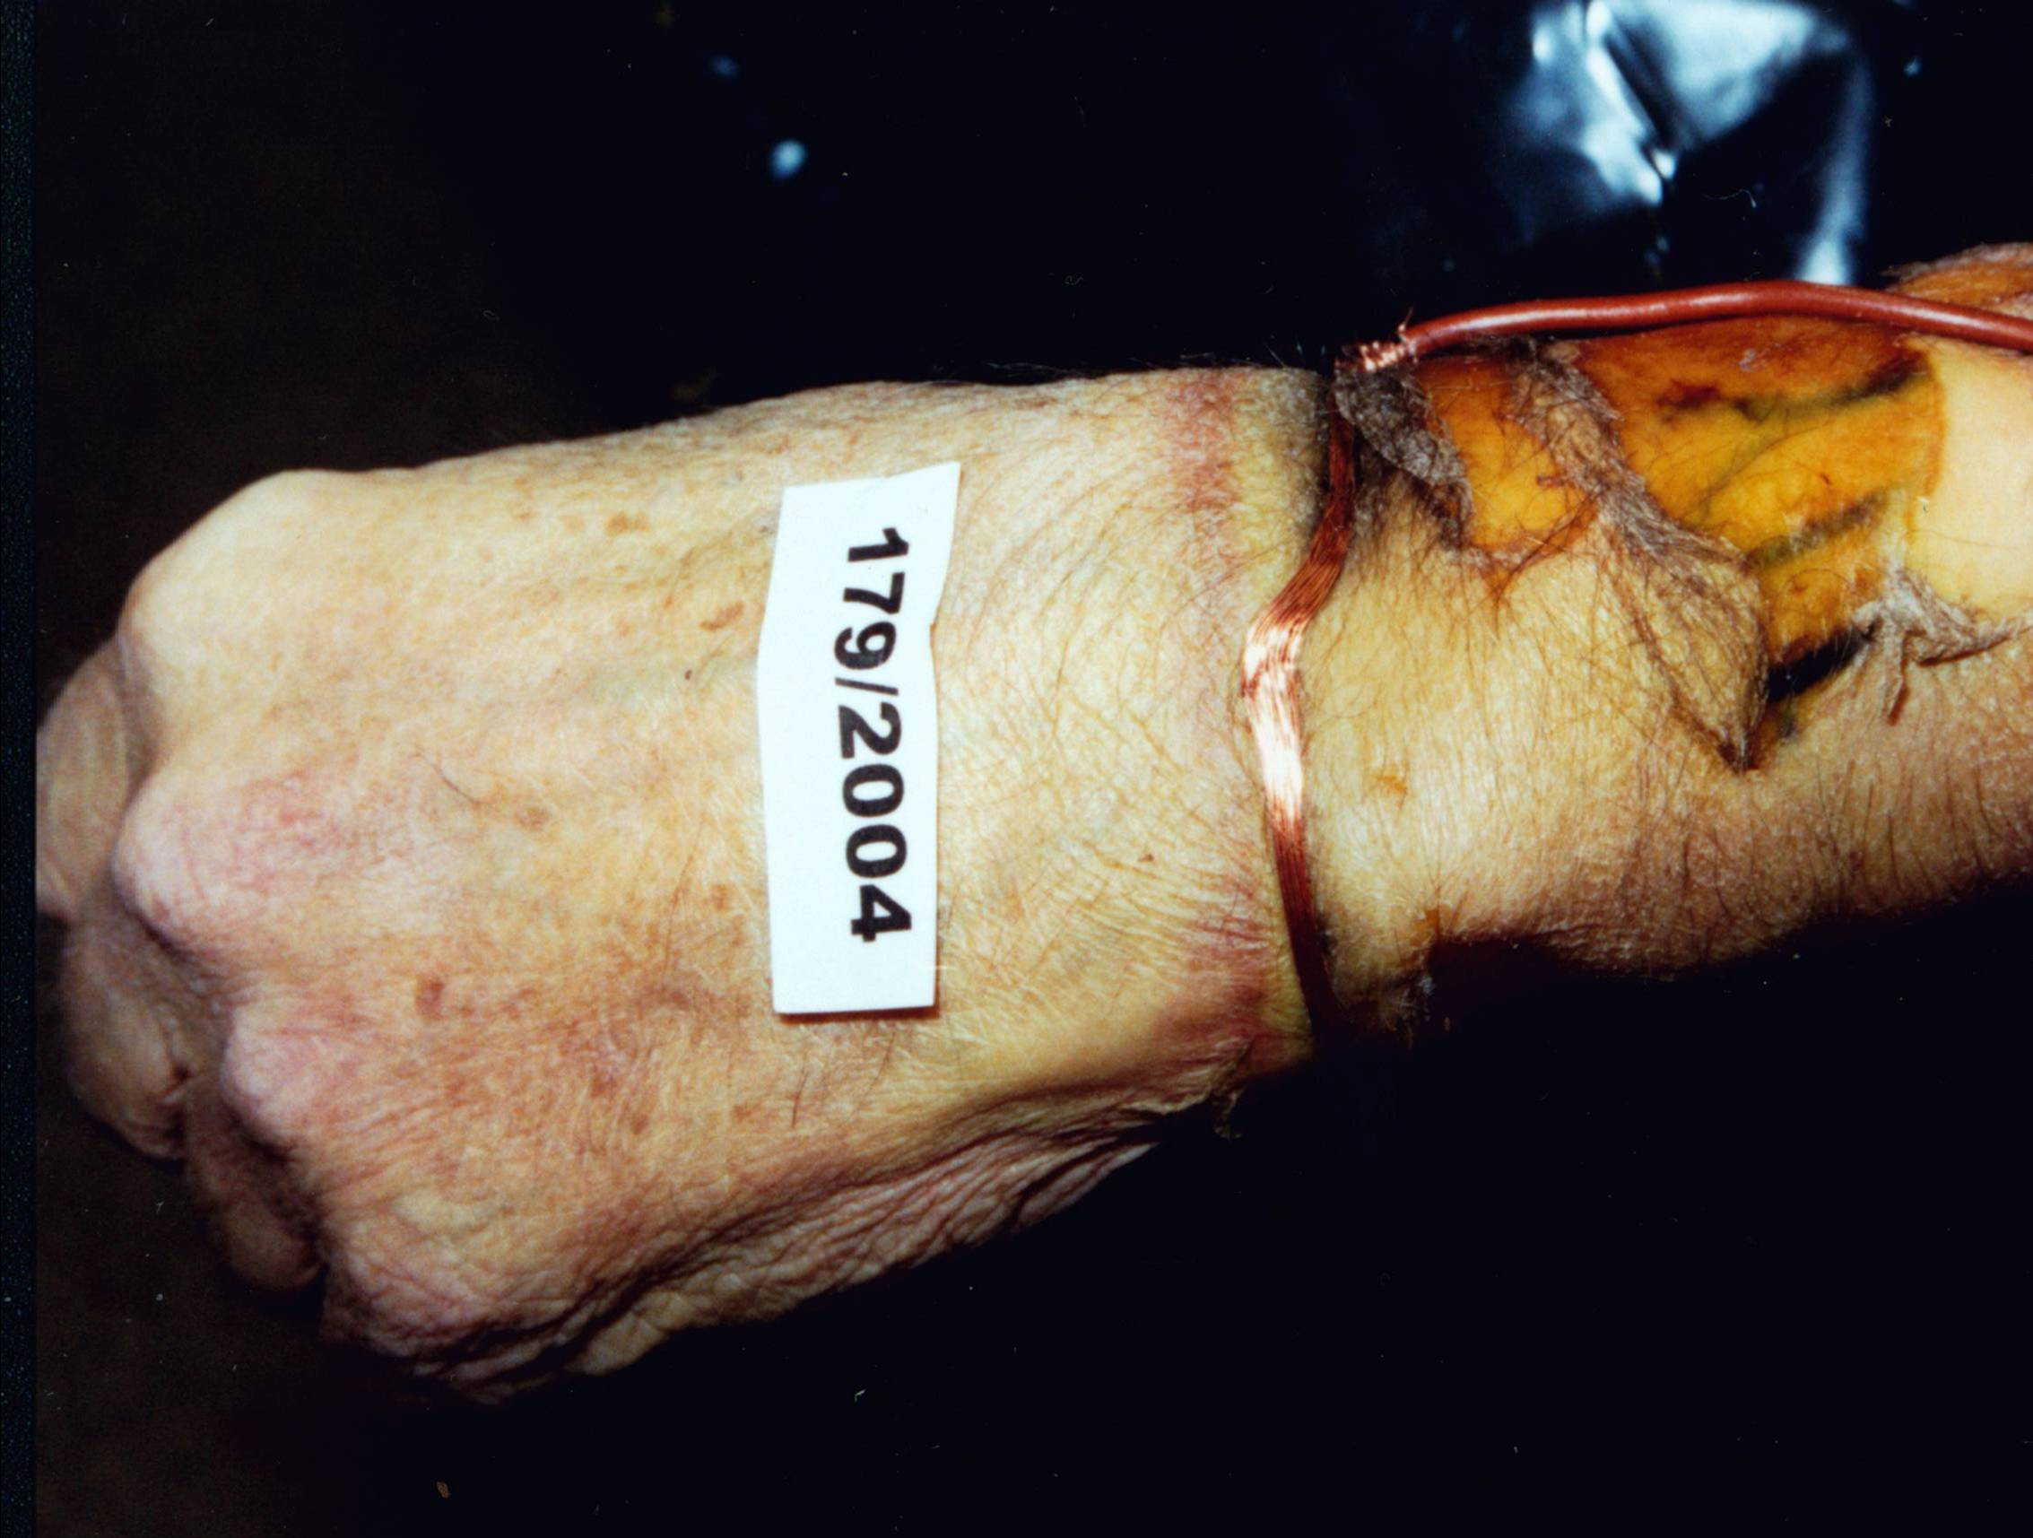

Slide 20
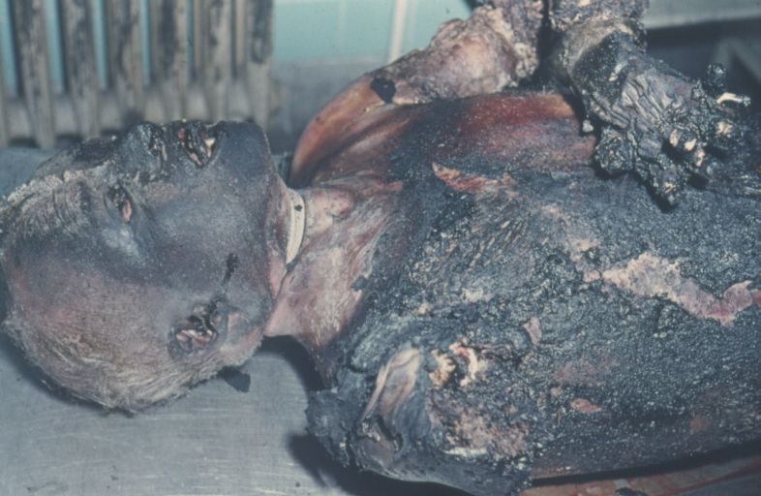

Slide 21
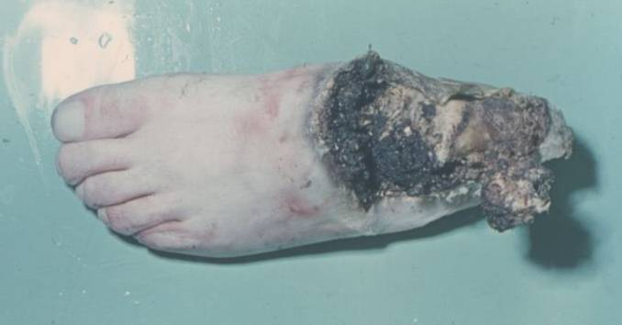

Slide 22
Electrical Injuries
Forensic importance:
Accident
  the most common, careless handling or non-compliance with work safety rules
Suicide
  Infrequent, mostly in people who have worked with electricity•
Murder
  unusual

Slide 23
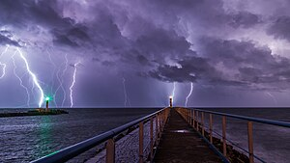
Electrical Injuries
The lightning stroke
Lightning is a natural phenomenon formed by electrostatic discharges through the atmosphere between two electrically charged regions, either both in the atmosphere or with one in the atmosphere and on the ground, temporarily neutralizing these in a near-instantaneous release of an average of one gigajoule of energy

Slide 24
https://youtu.be/2VcBQOio54M

Slide 25
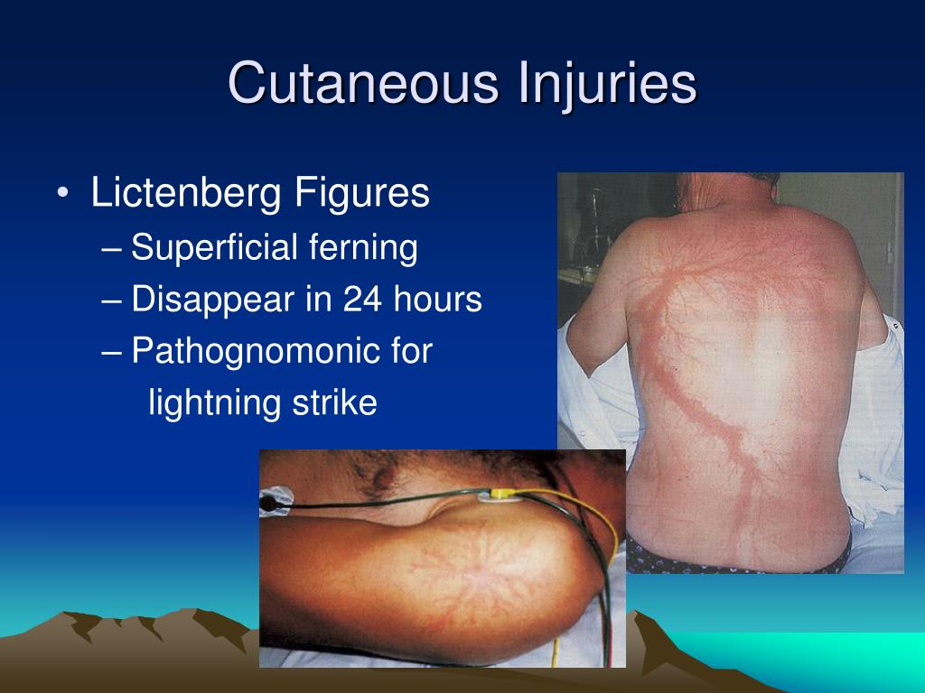
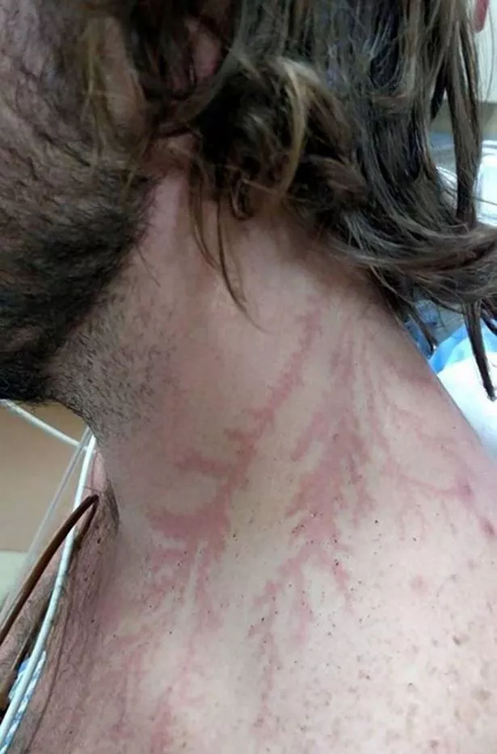
Lichtenberg figures are reddish, fern-like patterns that appear on the skin when a patient is struck by lightning. These appear to be a result of an inflammatory response as current spreads out causing ionisation and heat effects and damage to the small subcutaneous capillaries.
Mahajan L.A. et al. J Plast Reconstr Aesthet Surg. 2008;61(1):111-3.

Slide 26
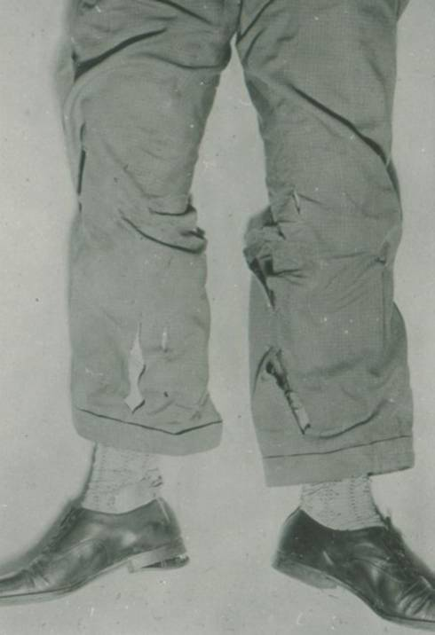

Slide 27
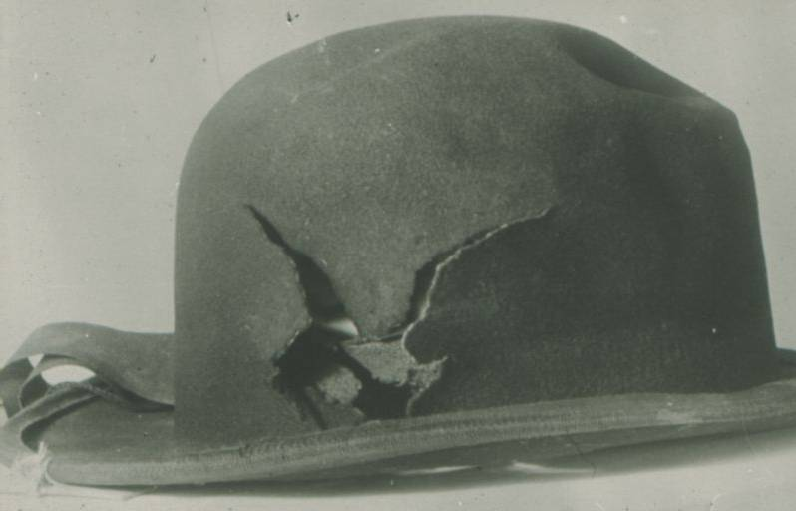

Slide 28
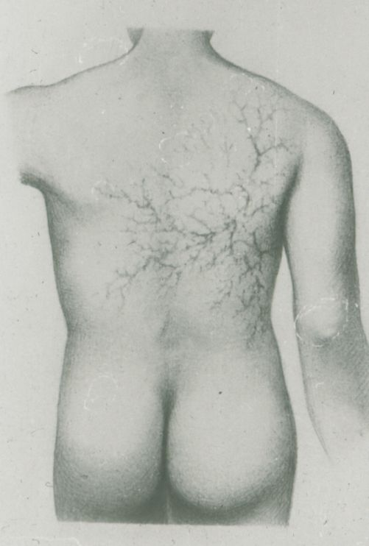

Slide 29
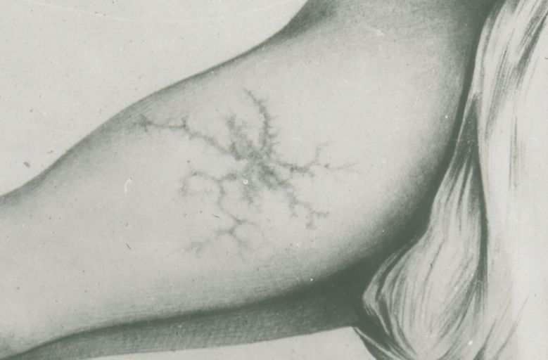

Slide 30
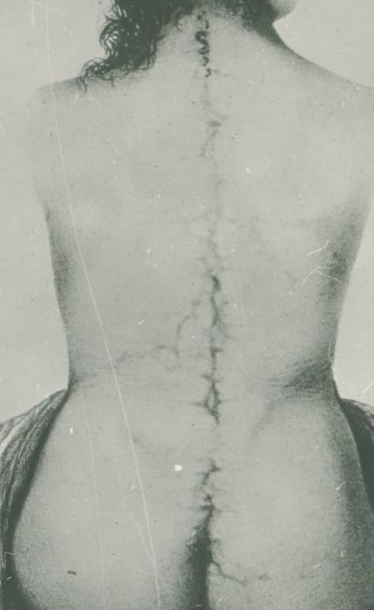

Slide 31
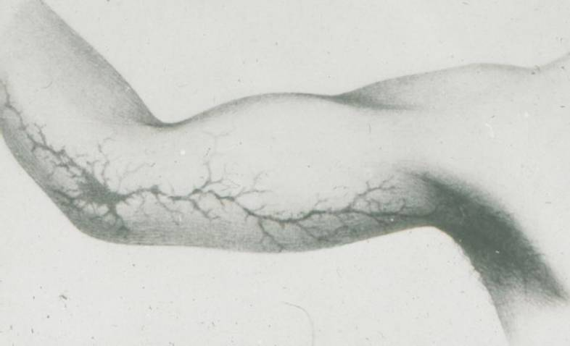

Slide 32
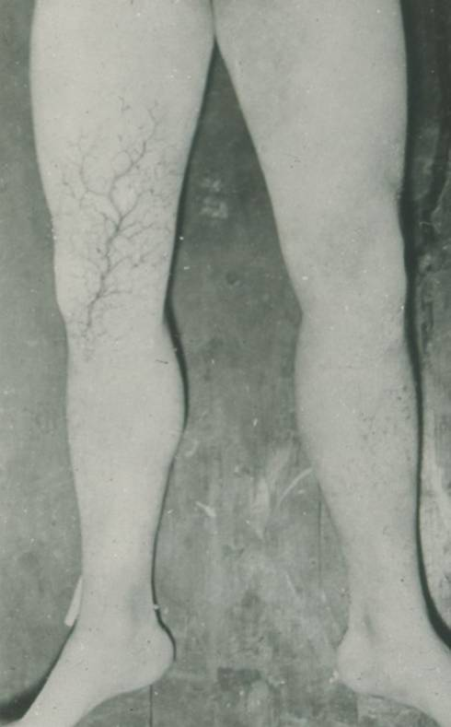

Slide 33
