Slide 1
IMPAIRMENT OF HEALTH DUE TO VIOLENCE

Slide 2
Basic terms
Violence: deliberate use or threat of use of force against person or group persons which is able to commit harm to the health, psychical damage, deprivation or harm.
Injury: disorder of health caused suddenly by external force.
Accident: process which rises unplanned, unforeseen, unintentional and causes damage of body.
Selfinflicted trauma:knowingly and intentionally causing injury to oneself
Suicide: knowingly and intentional termination of one's own life.
Homicide: intentional killing of another person.

Slide 3
Forensic traumatology
INJURY:
The damage of any part of human body
not important if physical or mental

Slide 4
Classification of violence
Direct violence –
the injury occurs directly at the place of force.
Indirect violence –
the injury occurs in a place distant from the place where the force was applied
From the point of view of violation of tissue cohesion, injuries are further divided into open or closed (covered).

Slide 5
Types of violence
Physical:
Mechanical:
Blunt object injury
Sharp object injury
Gunshot wounds
Suffocation
Termic:
increased
lowered
Electric current
Ionizing radiation
Changes of pressure

Slide 6
Types of violence
Chemical violence:
Effect of a chemical compound on the human organism
Anorganic compounds
Organic compounds
Definition of a poison

Slide 7
What does the injury depend on?
Injury: each of the types of energy has a characteristic effect on tissues, which depends on the quantity of the applied force. When the force is only small, only a short-term transient disintegration of cellular and intercellular structures can occur without longer-lasting functional or morphological changes, or damage is associated with functional impairment (this can be temporary or permanent) and, in the last case, a violation of the integrity of the tissue.
It is important to imagine that this is such an amount of energy that is harmful to the organism. This is because different types of energy are used in diagnostic or treatment procedures and thus serve the benefit of the patient

Slide 8
Intensity of violence
In most cases, we rely on a semi-quantitative point of view, based on breaking the cohesion of the tissue, when evaluating the size of the force.
The size of the area and the shape of the object that caused the injury also play a role in the assessment.
Application of mathematical models in the assessment of the occurrence of injuries is called Biomechanics.
Small: e.g. swelling after a blow, small blood loss, small abrasion
Moderate: e.g. lacerated contusion wound, joint distortion
Major: e.g. joint dislocation, bone fracture
Critical (significantly large): e.g. laceration of an organ, traumatic amputation of part or the whole limb

Slide 9
What does the injury depend on?
When evaluating an injury caused by mechanical energy, we evaluate:
Size: semi-quantitative scale - small, large, considerable
Direction: vertical, tangential
Move
Pressure
Bend
Torsion
Skid
Area of object: small, large

Slide 10
Main types
Violation of health mechanically:
Blunt
Sharp
stab wounds
scized wound
cut wound
Suffocation

Slide 11
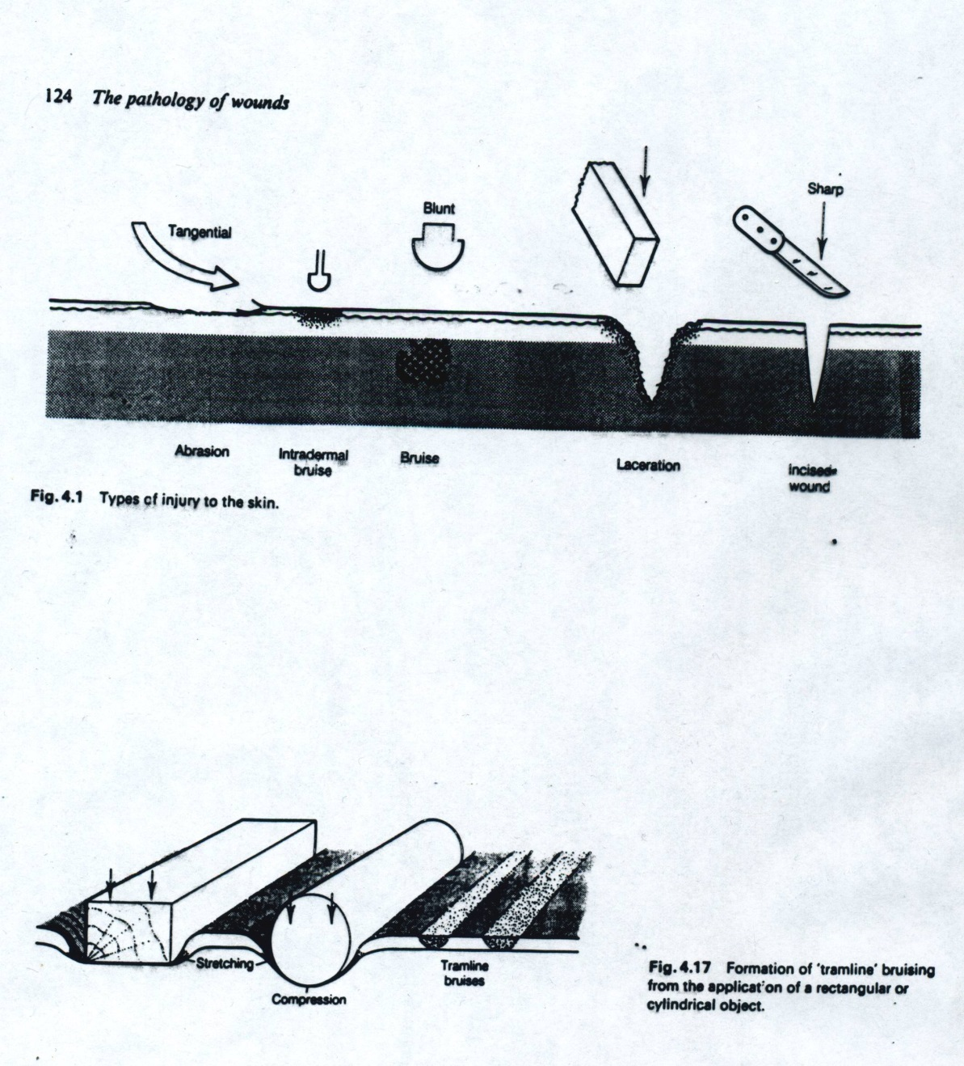
Forensic traumatology
Blunt injury
Active: kinetic energy acts on the body (blow, impact, stab
Passive: body collides with a solid obstacle
Bruise, contusion
Abrasions
Contuso-lacerated wounds

Slide 12
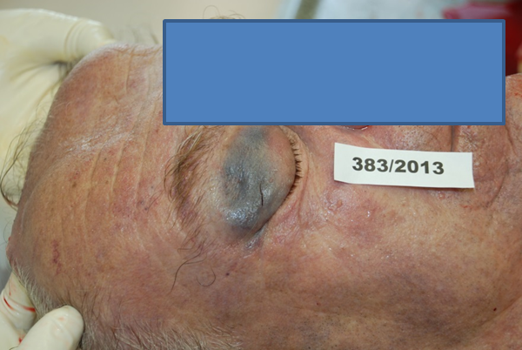
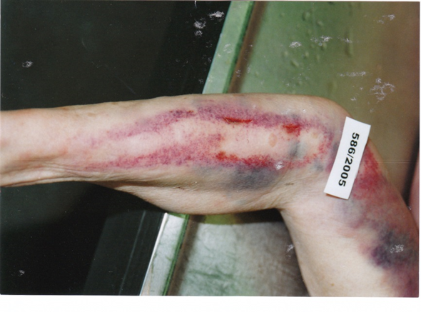
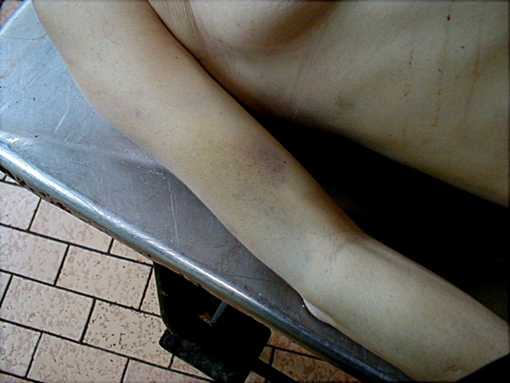
Bruise, contusion
It is a sign of a vital reaction
It is evidence that an injury has occurred
the color change enables dating
the shape will sometimes help identify the object

Slide 13
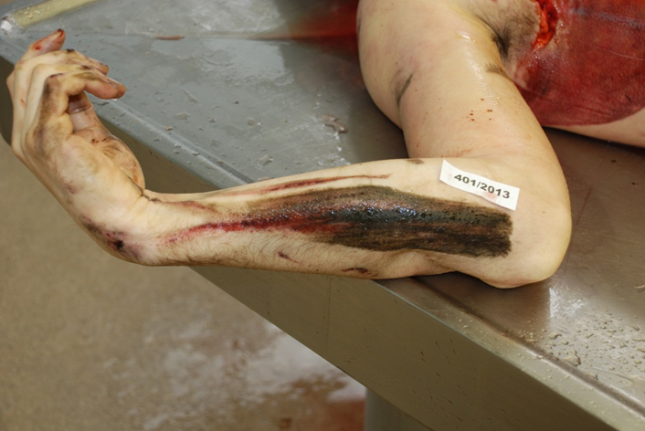
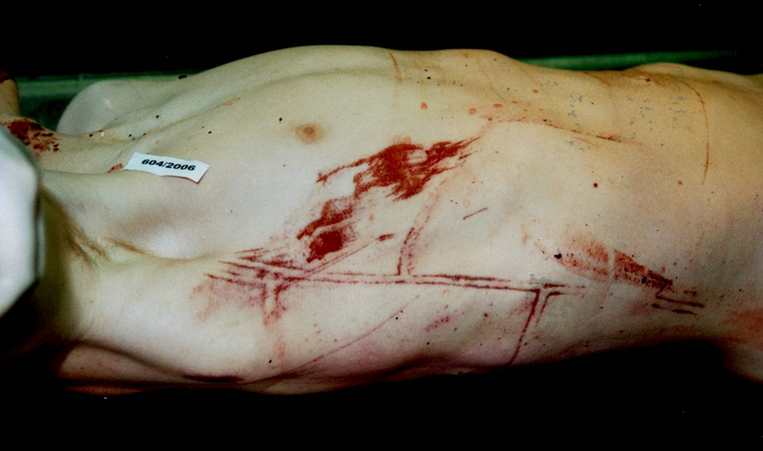
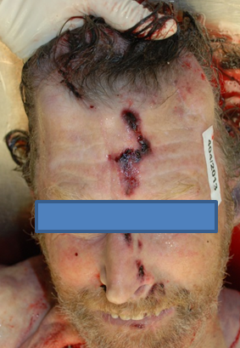
Abrasion
Forensic significance:
color: reddish-brown is a sign of a vital reaction, i.e. that the injury occurred alive,
they can help explain the mechanism of injury

Slide 14
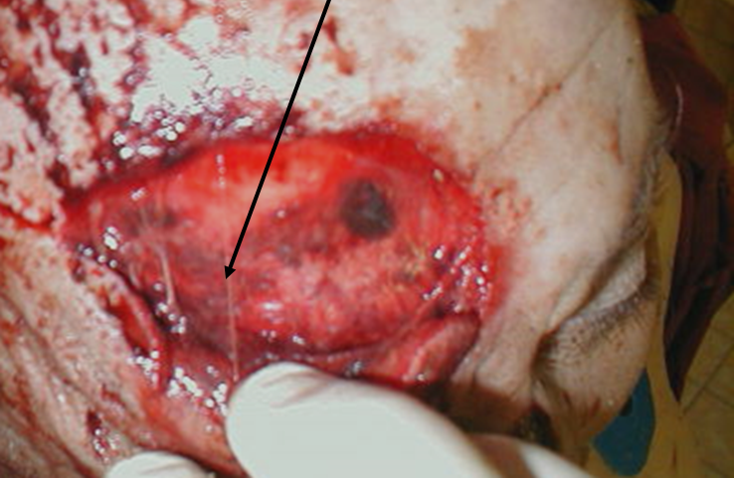
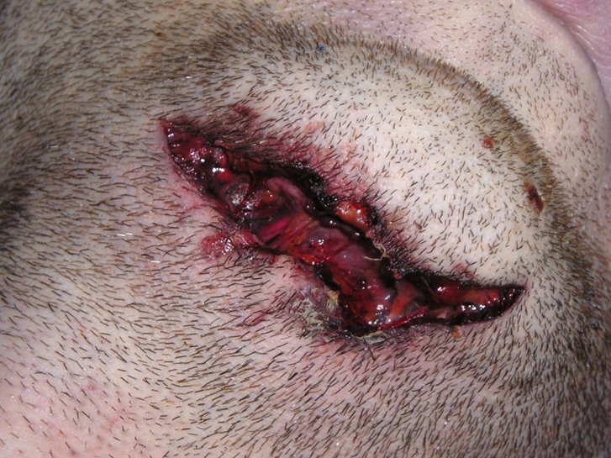
Contused/lacerated wonds
Morphology of CL wounds:
the laceration has obtuse angles, the edges are uneven, the subcutaneous tissue is usually bruised. There is a blood spurt at the base and so-called fibrous bridges are visible - thin fibers of the tissue that connect the edges of the wound at the base of the wound

Slide 15
Forensic traumatology
Injury caused by sharp instrument
Wounds
Incised wounds
They occur by pulling and pressing of a sharp instrument on the skin
Cut wounds
They occur when a cut instrument (an axe, a sword) falls on the skin
Stab wounds
They occur when a narrow pointed sharp instrument penetrates in to the body facing its longitudinal axis

Slide 16
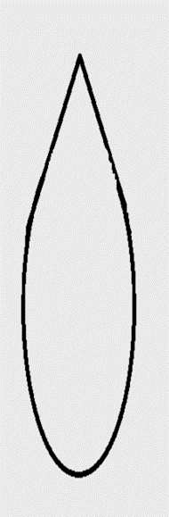
Morphology of sharp wounds
Edge:
they are smooth
Angles:
sharp/round (according to the shape of the blade)
Where there is an acute angle, it may be additionala small incision, a small flap of skin is formed,caused by re-movement of the instrument in the wound.For cuts, both angles are sharp, for stab wounds they areeither both sharp, or one sharp and the other round.
Length:
distance between angles
Width:
distance between edges
Depth
edge
Sharp angle
length
width
Blunt angle

Slide 17
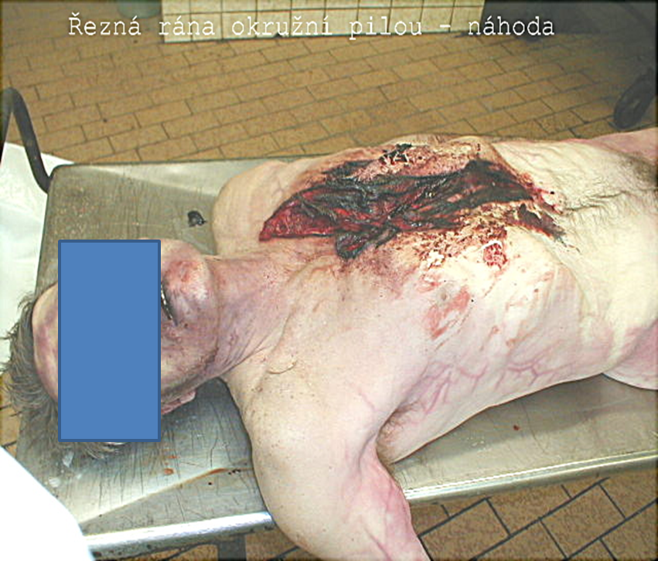
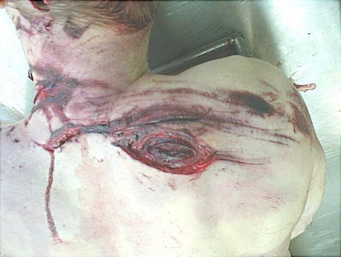
Incised wound - accident

Slide 18
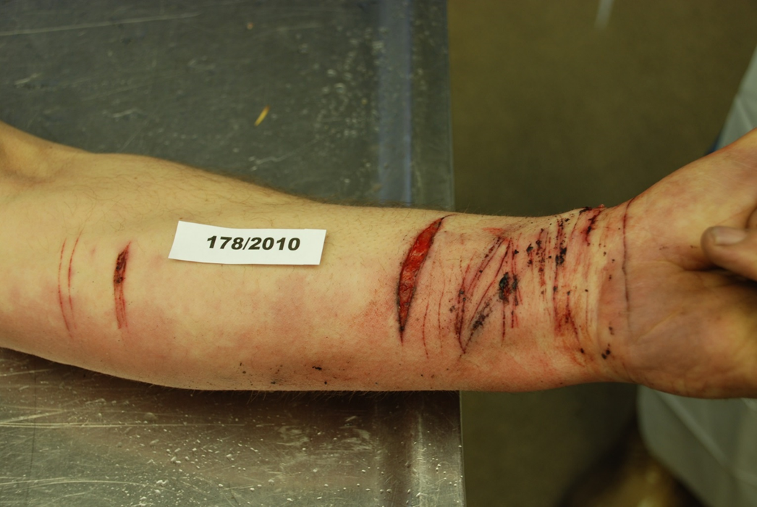
Incised wound-suicide

Slide 19
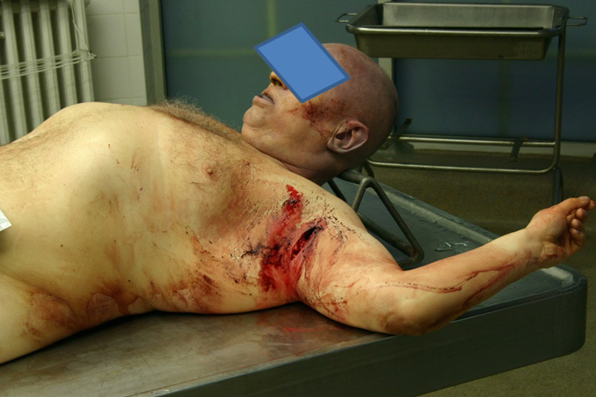
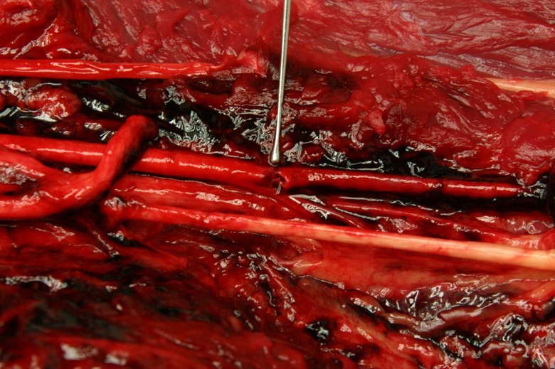
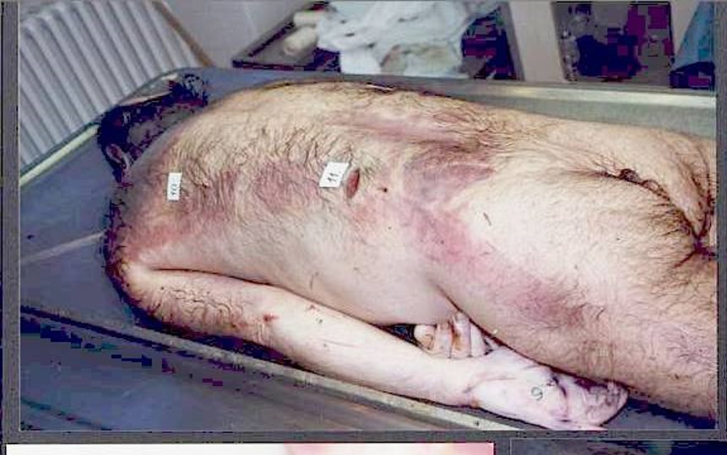
Incised wound-homicide

Slide 20
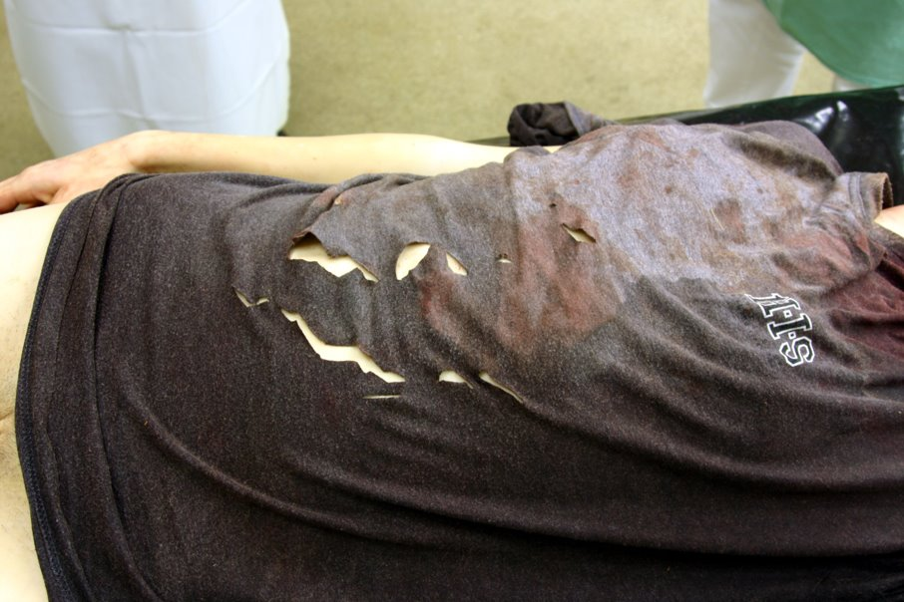
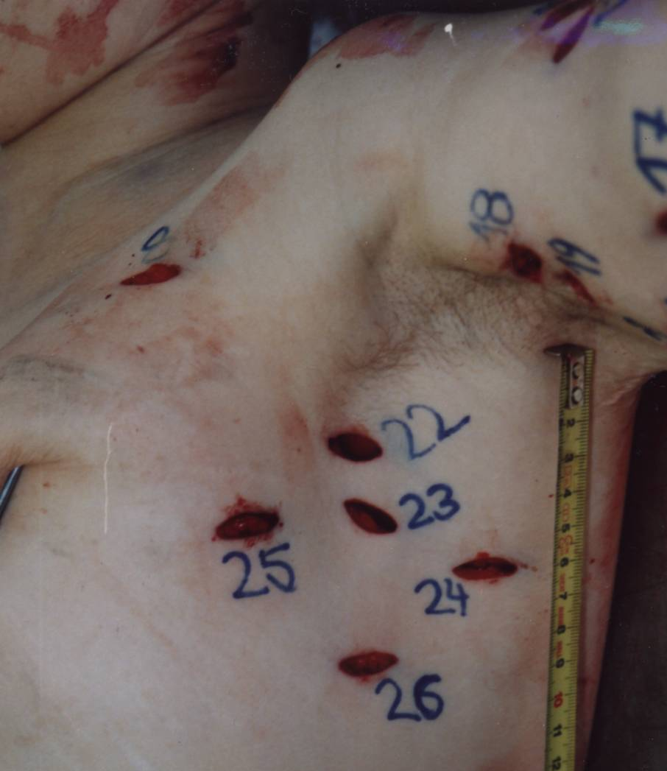
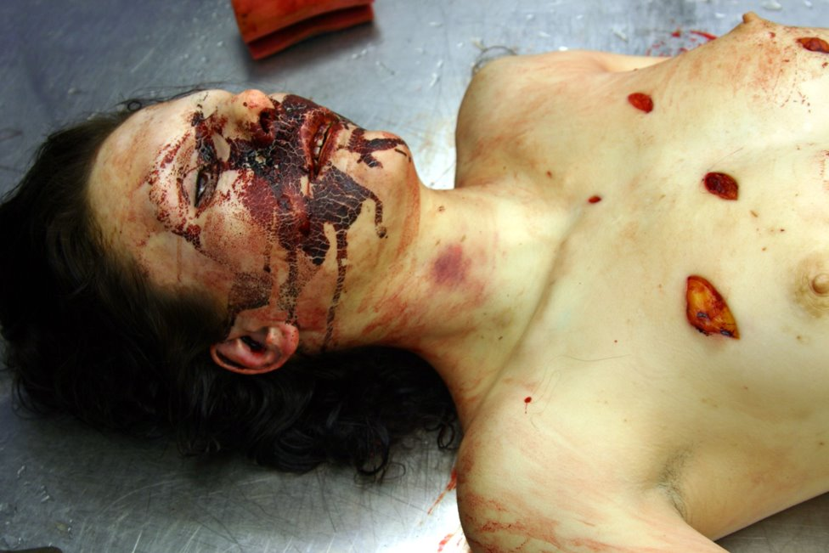
Stab wound-homicide

Slide 21
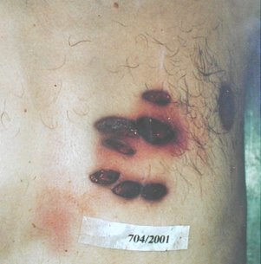
Stab wound-suicide

Slide 22
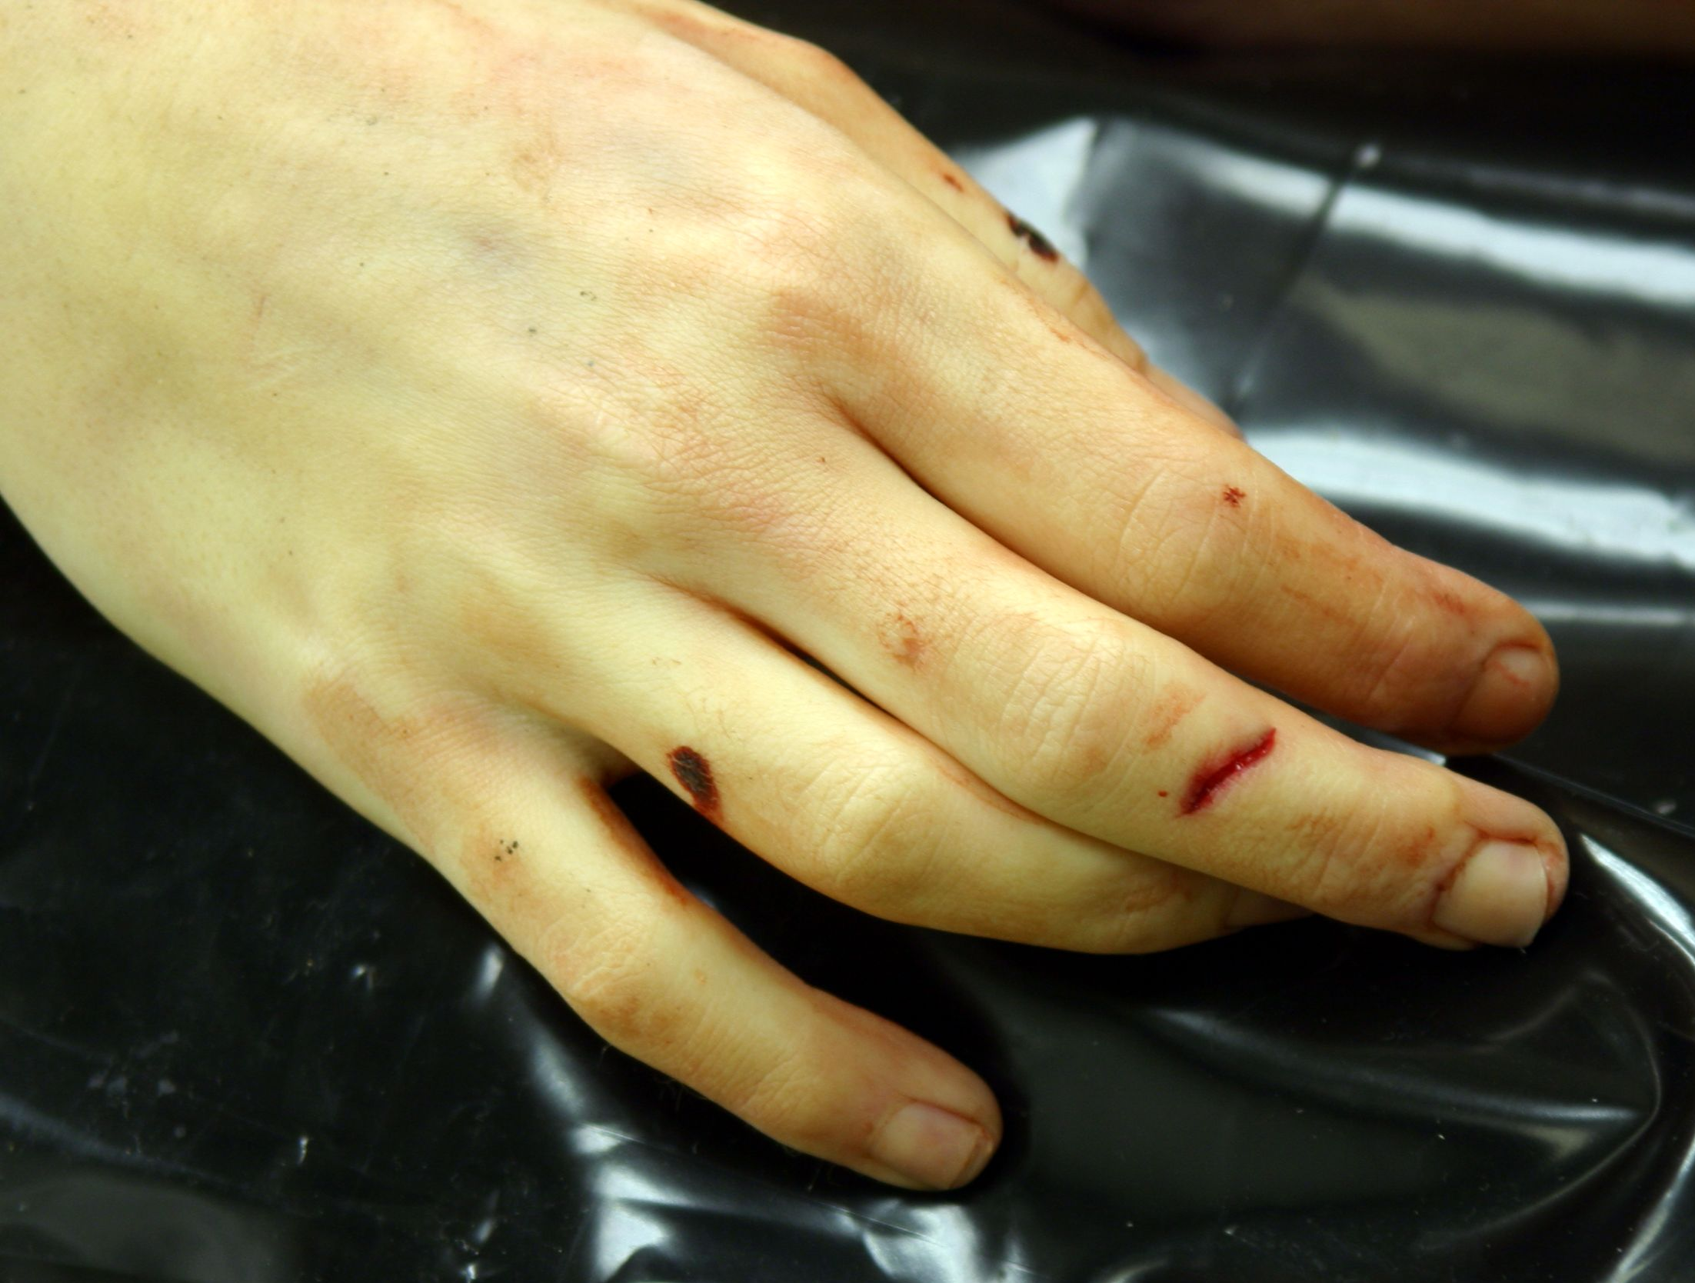
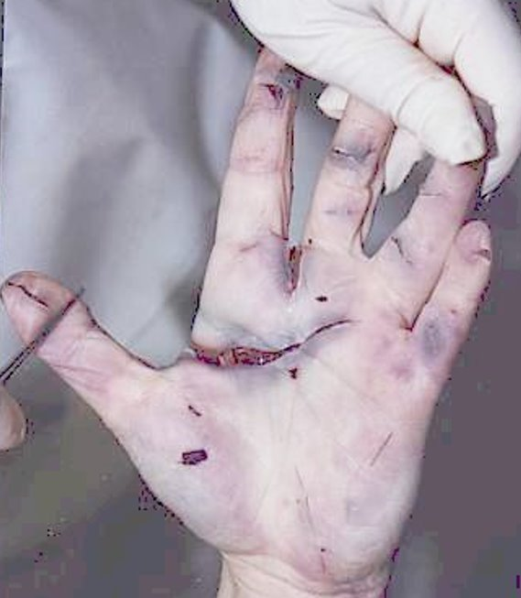
Self defensive injury

Slide 23
