Slide 1
Forensic Medicine - the history and presence
Alexander Pilin, M.D., PhD

Slide 2
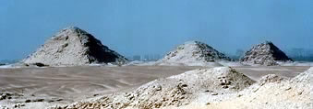
The history of Forensic Medicine
Egypt:
Embalming gave first infomation on human body composition.
Jewish: some information about autopsy of fetuses to know whether they were able to live or not
Before J.C.:
only few information
Egypte
Israel
Notes:
Egypt:
Embalming gave first infomation on human body composition.
Jewish: some information about autopsy of fetuses to know whether they were able to live or not

Slide 3
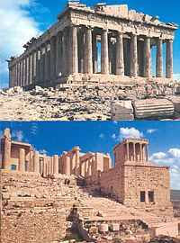
The history of Forensic Medicine
Antique epoque
Old Greece
Greeece:
there are information about court trial where Hippokrates was heard out in the case of adultery and based od his testimony a sentence was given. An other one example is the Lysios´speech about a wretch man who received a financial support from governement because of health handicap while he was acused to be in good health condition and able to work. Demosthenes in his speech against Everg mentioned a lady who was manhandled and she died six days after attack on her. The prosecutor called up physicians to give testimony about her health condition and they said that her conditon had been hopeless.
The autopsies were not done, only external examination was performed.
Notes:
Greeece:
there are information about court trial where Hippokrates was heard out in the case of adultery and based od his testimony a sentence was given. An other one example is the Lysios´speech about a wretch man who received a financial support from governement because of health handicap while he was acused to be in good health condition and able to work. Demosthenes in his speech against Everg mentioned a lady who was manhandled and she died six days after attack on her. The prosecutor called up physicians to give testimony about her health condition and they said that her conditon had been hopeless.
The autopsies were not done, only external examination was performed.

Slide 4
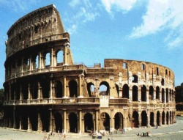
The history of Forensic Medicine
Antique epoque
Old Rome
Rome empire:
Theodosian codex contains rules which cannot be solved without medical expertise. A little bit later, Rome physicians were distinguishing dangerous and lethal wounds, as it is written in Celsius writting „De Medicina“, mental condition was appreciated – mentally ill people were not be punished, intoxication by alcohol was considered to be extenuating circumstance. The Law Act „Lex Cornelia“ punished errors in treatment. The law act also distinguished between the death of a person due to general conditon of a trauma or the death resulting from complication. The „Iustinian law acts“ conteins regulations about fertility, clasiffication of monsters, differention of the delivery on at term, premature and delayed.
Notes:
Rome empire:
Theodosian codex contains rules which cannot be solved without medical expertise. A little bit later, Rome physicians were distinguishing dangerous and lethal wounds, as it is written in Celsius writting „De Medicina“, mental condition was appreciated – mentally ill people were not be punished, intoxication by alcohol was considered to be extenuating circumstance. The Law Act „Lex Cornelia“ punished errors in treatment. The law act also distinguished between the death of a person due to general conditon of a trauma or the death resulting from complication. The „Iustinian law acts“ conteins regulations about fertility, clasiffication of monsters, differention of the delivery on at term, premature and delayed.

Slide 5
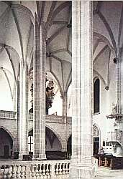
The history of Forensic Medicine
Germans required examination of the injured people in the court trial. A part of the human body was considered as a part of private assets and the injury severity played great role in compensations. The extent of the wound have been considered in the relation to the death. There is an eldest law act called „Salick law act“ which contains some forensic medicine regulation. The four type of injury have been distinguished: wounds, contusion, mutilation and paresis. The types of wounds were simple (only bleeding), measurable and big which required medical care and reached bone or internal organs. In spite of this quite „scientific“ distinguishing of wounds there are no direct evidence for forensic expertise in court trial. Only it was recommended to consider the meaning of a physician.
During the Middle Ages some acts required the expertise of a physician mainly in cases of a homicide (regulations of the Pope Innocence the 3rd). Also, there solitary reports about the autopsy. The second half of 16th century can be considered as a dividing line: a law act called „Constitutio Carolina“ was edited in 1532 in Bamber countries. The article No.147 required testimony of the physician in cases when someone died after having been sustained an injury and there was no certainty whether there is relation between death and injury, what was the status of consciousness and ability of doing. The article No.149 ordered the judge to administer an oath a physician who examined the injured person to make the detailed description of all wounds, injuries etc.
Early Middle Ages
German nations
Regulatons of Charles the Great
Later Middle Ages
Notes:
German nations:
Germans required examination of the injured people in the court trial. A part of the human body was considered as a part of private assets and the injury severity played great role in compensations. The extent of the wound have been considered in the relation to the death. There is an eldest law act called „Salick law act“ which contains some forensic medicine regulation. The four type of injury have been distinguished: wounds, blows, mutilation and paresis. The types of wounds were simple (only bleeding), measurable and big which required medical care and reached bone or internal organs. In spite of this quite „scientific“ distinguishing of wounds there are no direct evidence for forensic expertise in court trial. Only it was recommended to consider the meaning of a physician.
During the Middle Ages some acts required the expertise of a physician mainly in cases of a homicide (regulations of the Pope Innocence the 3rd). Also, there solitary reports about the autopsy. The second half of 16th century can be considered as a dividing line: a law act called „Constitutio Carolina“ was edited in 1532 in Bamber countries. The article No.147 required testimony of the physician in cases when someone died after having been sustained an injury and there was no certainty whether there is relation between death and injury, what was the status of consciousness and ability of doing. The article No.149 ordered the judge to administer an oath a physician who examined the injured person to make the detailed description of all wounds, injuries etc.

Slide 6
History of forensic medicine
Toxicological writings
Santis Adoyni:
De venenis lib. VII, 1492
F.Pouzetti
De venenis lib.III, 1492
Notes:
De venenis lib. VII: Santis Adoyni, 1492 with the first remarque about of forensic autopsy of an intoxicated man.
Fidelis and Zachias dealt mainly with questions of fertility virginity, pregnancy and delvery.
The writnig of Bohn is considered as best in that time. He differentiated lethal wounds from those which repaired with or without difficulties.

Slide 7
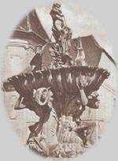
The history of Forensic Medicine
The Modern Time
Modern times:
Since that time, we can see the boom of forensic medicine which was based on the scientific work of Vesalius, Fallop, Eustach and anatomical autopsies which enabled knowledge of the composition of the human body. Neverthless, no complete forensic autopsy were made. The autopsy of wound were performed only. The complete autopsies of dead bodies were made since the second half of 17 century.
Notes:
Modern times:
Since that time, we can see the boom of forensic medicine which was based on the scientific work of Vesalius, Fallop, Eustach and anatomical autopsies which enabled knowledge of the composition of the human body. Neverthless, no complete forensic autopsy were made. The autopsy of wound were performed only. The complete autopsies of dead bodies were made since the second half of 17 century.

Slide 8
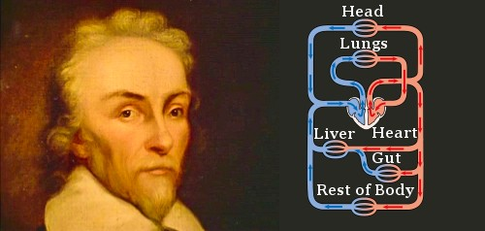
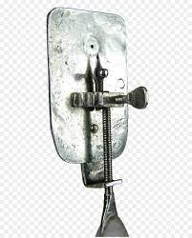
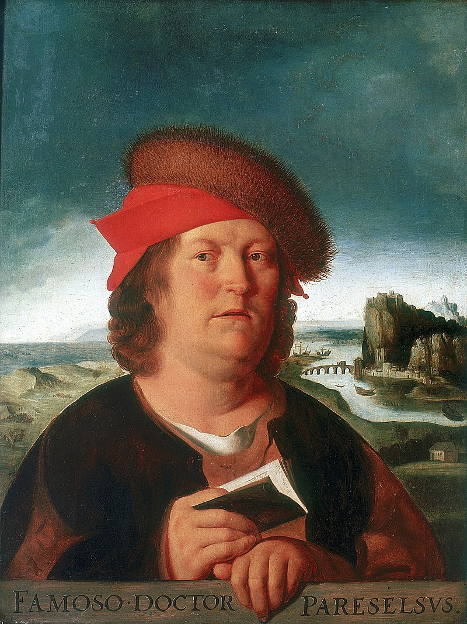
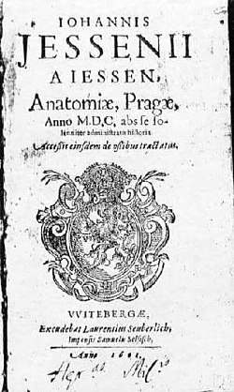
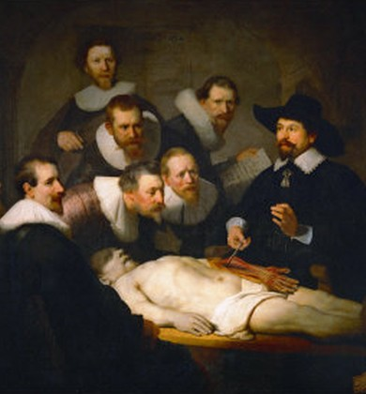
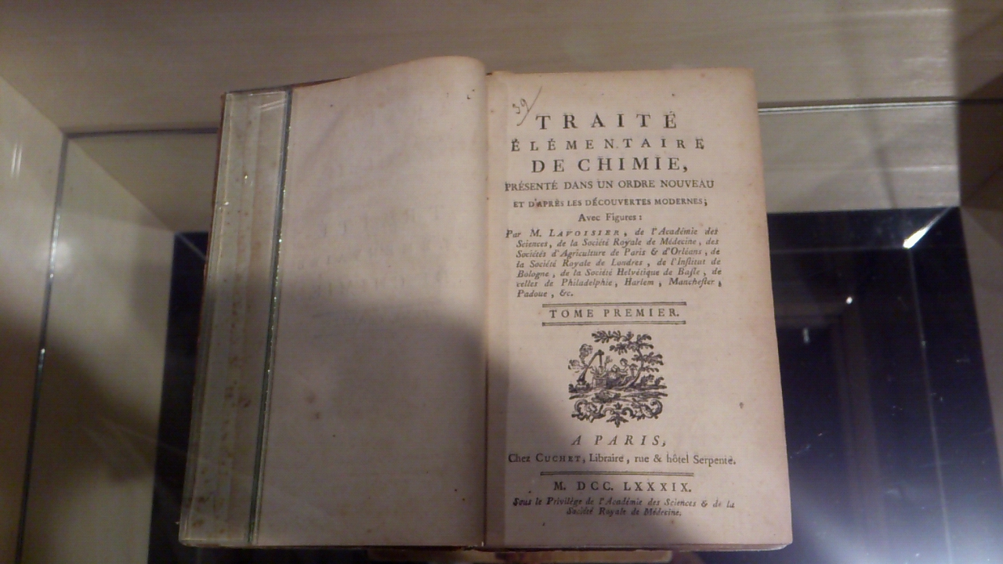
Kořeny
The development of knowledge about the structure of the body, based on the performance of dissections and the structure of tissues related to the discovery of the microscope in the second half of the 17th century, advances in natural, especially biological sciences and medicine were reflected in the application of this knowledge in the investigation of harmful acts in various areas of social life.
Wiliam Harvey
Leeuwenhoekův mikroskop
Paracelsus: Dosis sola facit venenum.“
In Bohemia, it was the first autopsy performed in June 1600 by Prof. Jan Jesenský. The description of the dissection was prepared by Jessenius in Anatomiae Pragae Anno M.D.C. abs se solenniter administratae historia, which he published in the Saxon university town of Wittenberg.
ANTOINE LAURENT DE LAVOISIER

Slide 9
The history of Forensic Medicine
Baptista Condronchi
The first medico-legal writing, issued in 1597
Fortunatus Fidelis
„De relationibus medicorum. Libti IV, issued in 1601on Palermo
deals with virginity, hereditatry ilnesses, pregnancy,injuries, errors in medical treatment
Paulus Zacchias
Qustiones medicolegales, 1621
Calllisen
Distinguished wounds in not important, serious and lethal
Pavel Amman
he introduced the term of lethal by itself
Bohn
he wrote the writing „De renuntiatione vulnerum seu vulnerum letalium examen“
in 1689. He distinguished the death from the injury, from complications of injury
and wounds defintely lethal or lethal by chance.
Notes:
Modern times:
Since that time, we can see the boom of forensic medicine which was based on the scientific work of Vesalius, Fallop, Eustach and anatomical autopsies which enabled knowledge of the composition of the human body. Neverthless, no complete forensic autopsy were made. The autopsy of wound were performed only. The complete autopsies of dead bodies were made since the second half of 17 century. At the same time basics of toxicology were established.

Slide 10
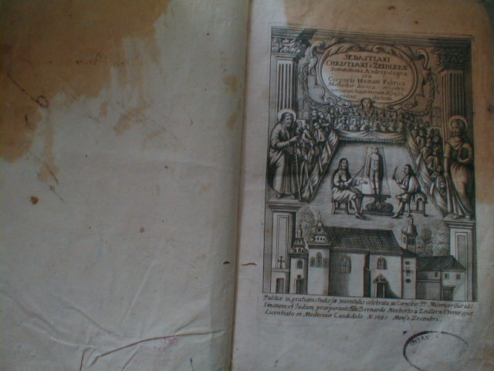
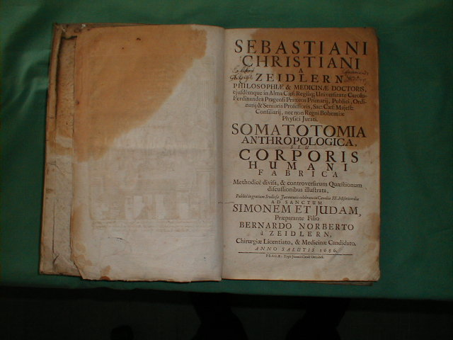

Slide 12
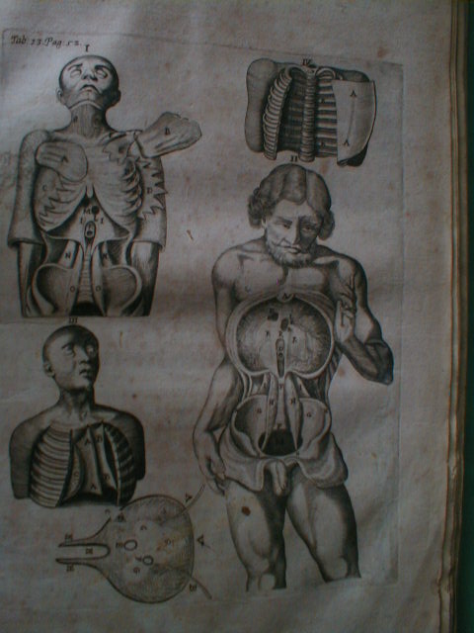
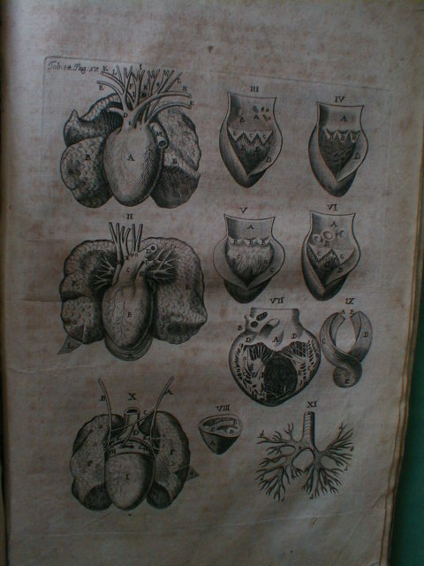
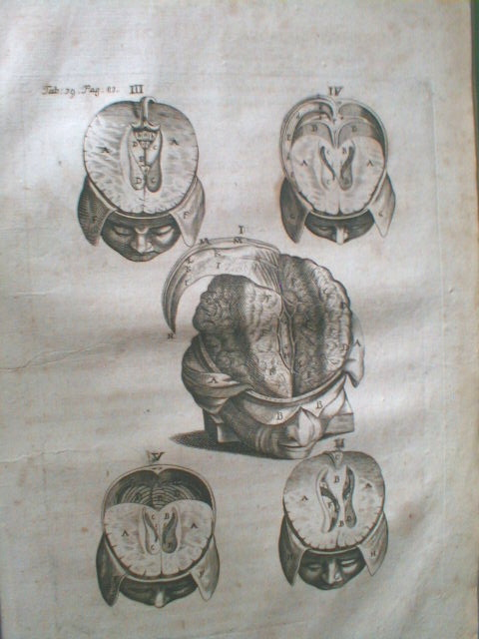

Slide 15
The history of Forensic Medicine
Toxicological writings
De venenorum differentiis, Hieronymus Cardanus,1563
De venenis et venenorum morbis, H. Mercurialis, 1584
Libri de venenis eorumque curatione, Fonesca1587
De venenis et antidotis, A. Baccius,1586
Notes:
At the same time basics of toxicology were established.

Slide 16
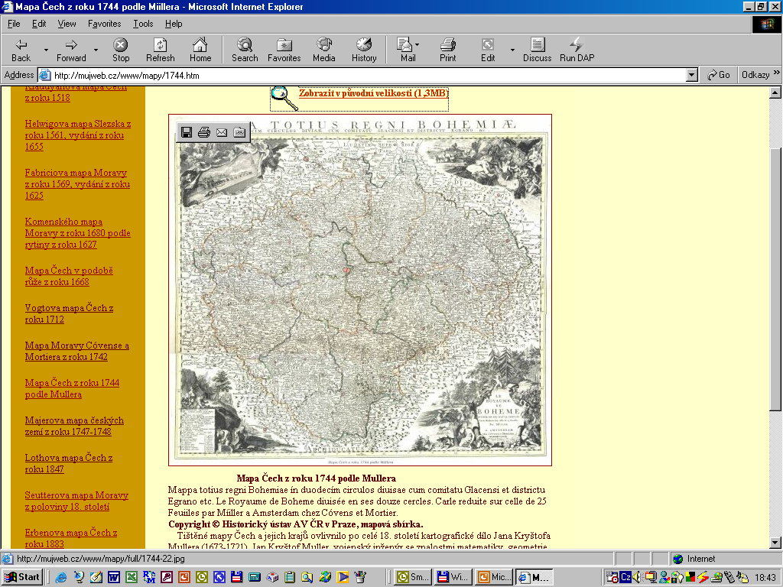
Mapa Čech z r. 1744

Slide 17
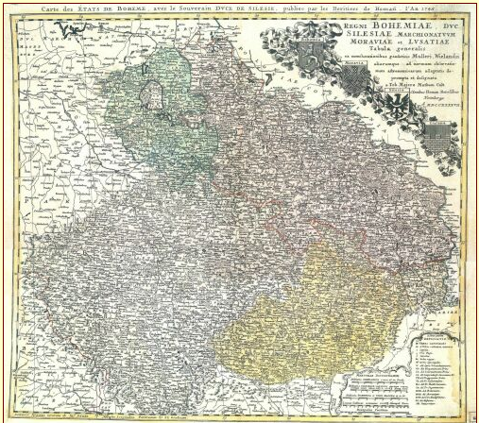
Mapa českých zemí z r. 1747-1748

Slide 18
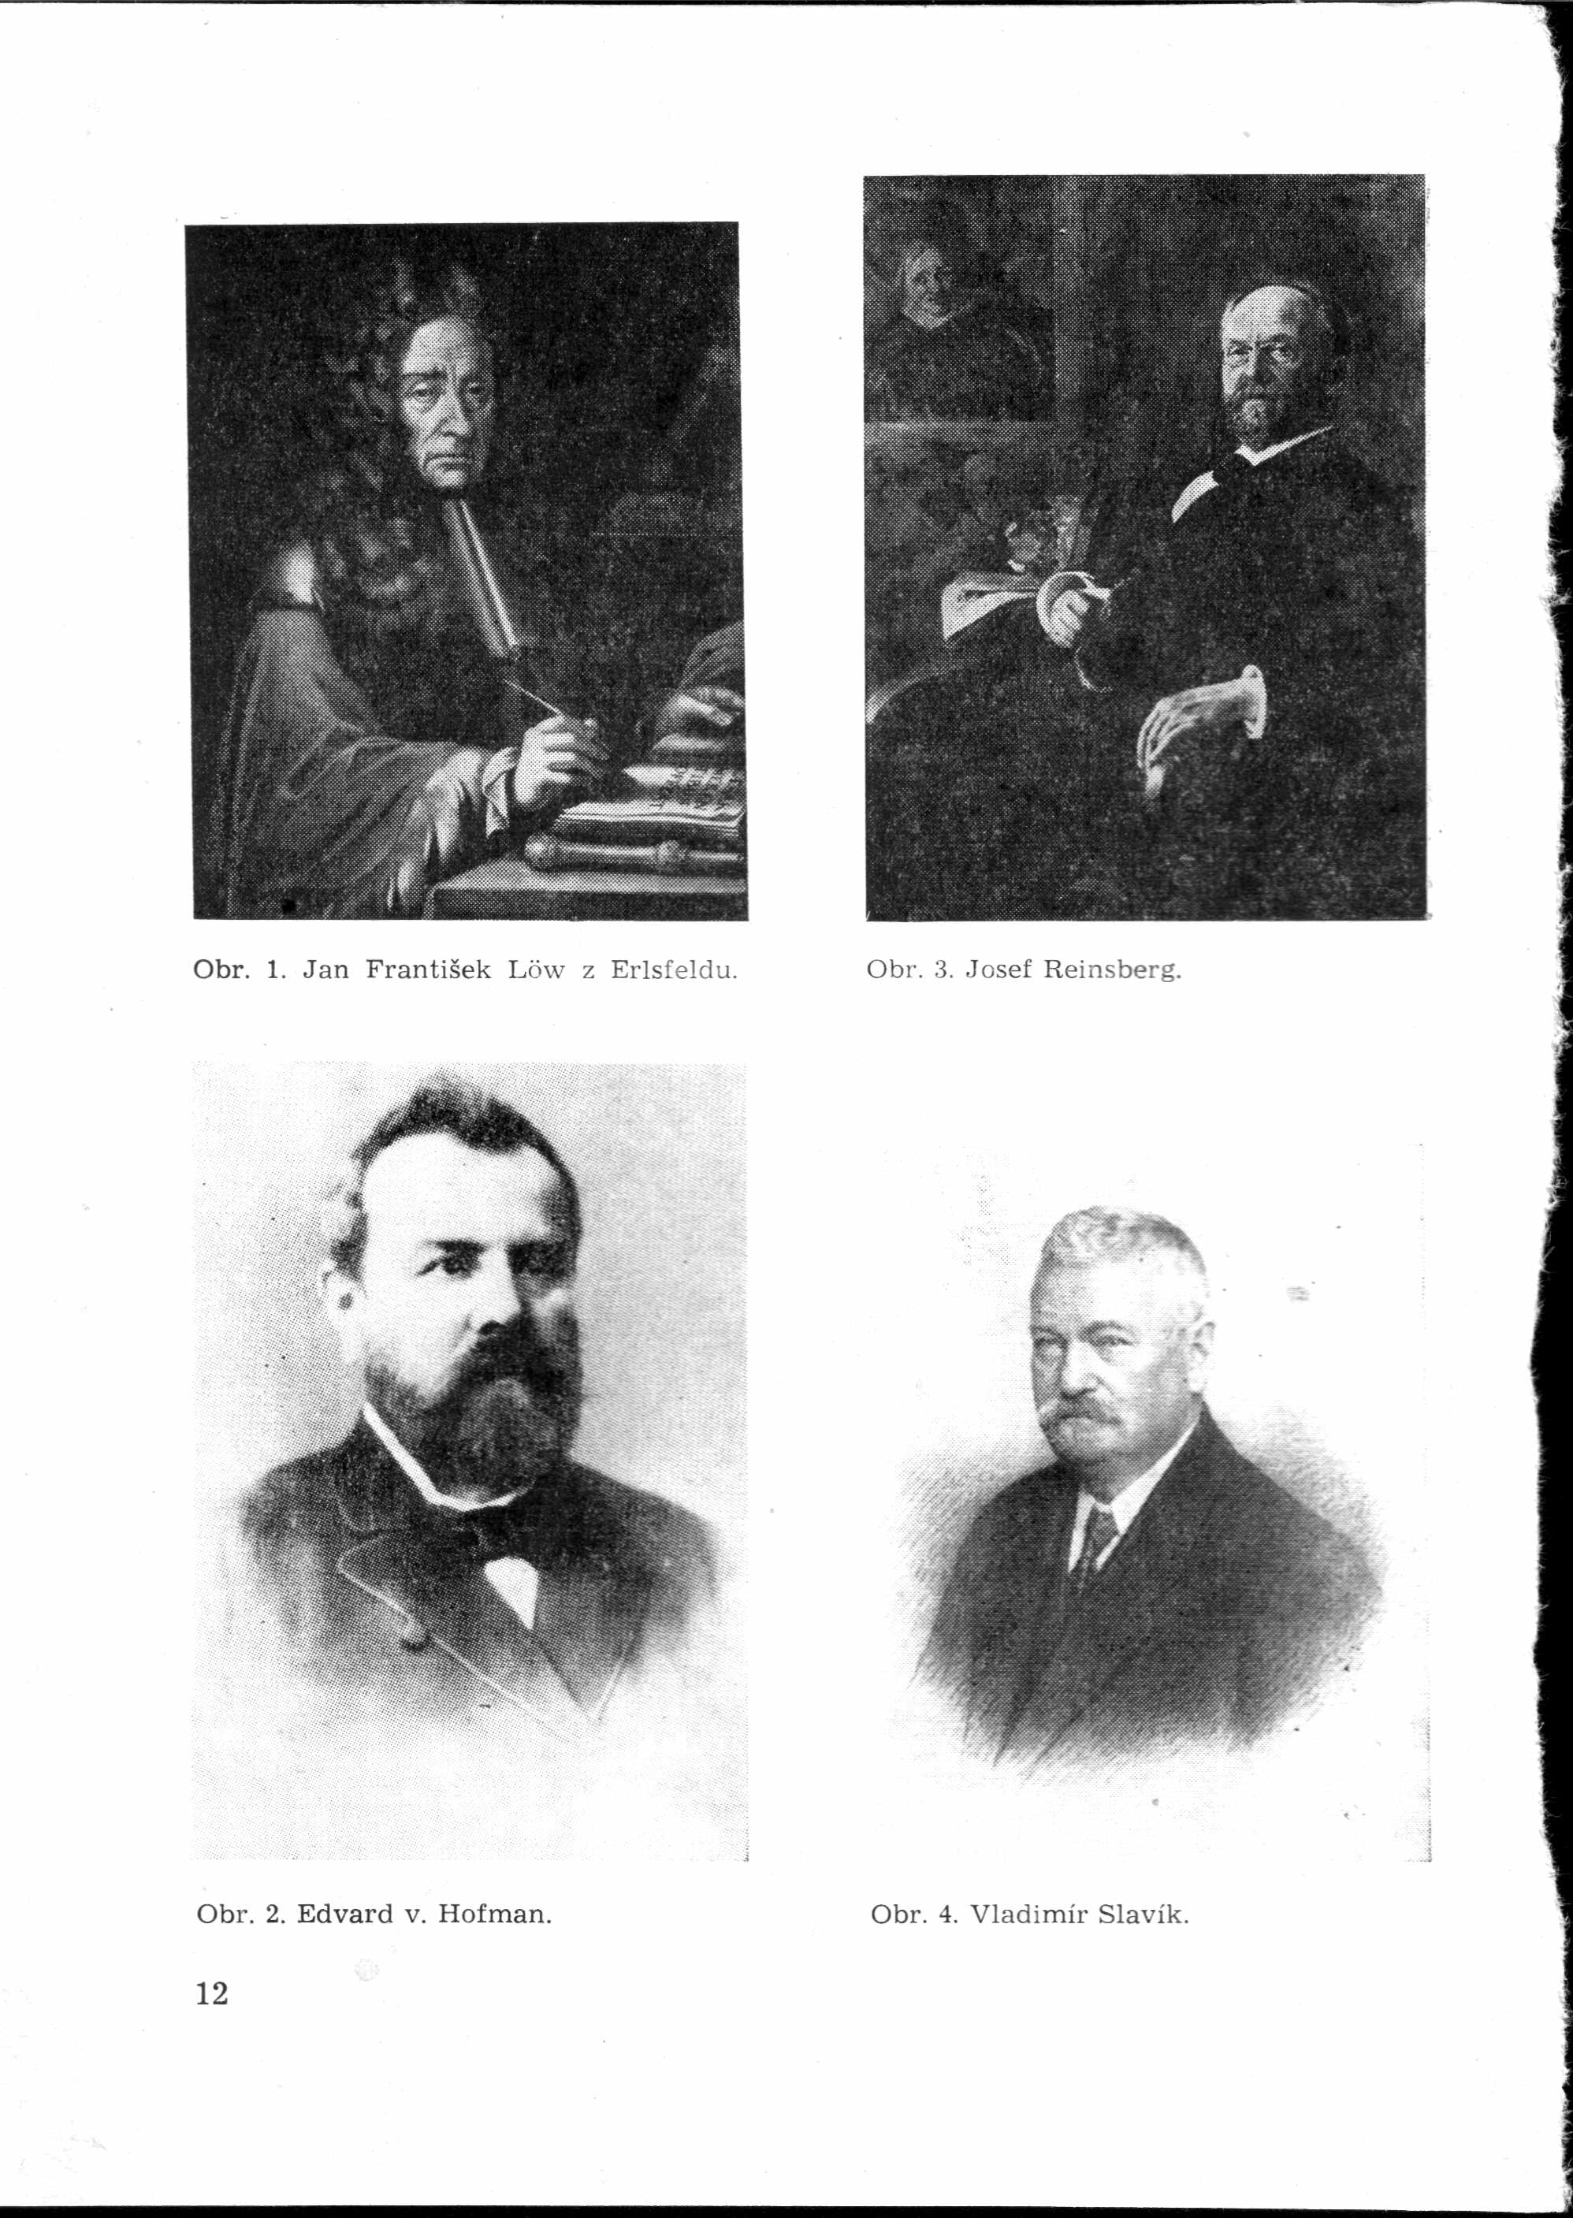
Jan František Löw z Erlsfeldu
1648 – 1720
Writings:
Theatrum medicoiuridicum
His writing has overhelming 870 pages and deals with questions about delivery, paternity, wounds, cause of death, relation between injury and death, sexual abnormities, adultery, simulations of diseases, virginity,
Notes:
His writing has overhelming 870 pages and deals with questions about delivery, paternity, wounds, cause of death, relation between injury and death, sexual abnormities, adultery, simulations of diseases, virginity,

Slide 19
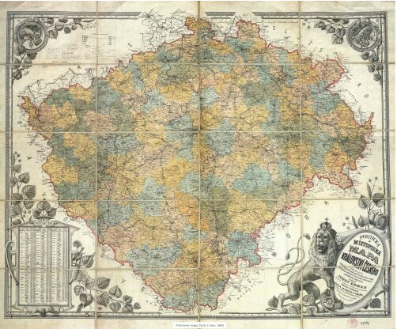
Mapa Čech z r. 1883
Notes:
1883

Slide 20
Important persons in the history of Forensic Medicine in Czech
Křišťan z Prachatic (1366(68?) – 1439)
Naučení Mistra Chrystyna, kterak člověk poznati má na raněném umřel-li čili nic. (The percept of the Master Chrystyna how to distinguish on the injured man whether he is dead or not)
Borbonius z Borbenheymu Matyáš (1560-1629)
Expertise about intoxication by arsen
Johanes Marcus Marci de Kronland (1595-?)
He studied the action of mechanical force on the alive organism, mechanism of skull fracture
Jan Václav Dobřenský z Černého Mostu (1623-1697)
He made the autopsy of a man who died cause of mercury intoxication and published results of the autopsy in the year-book „Miscellanea seu Ephemerides naturae curiosum“.
Daniel de Luna
The army physician from Poland who issued „Questiones legales“ in 1642

Slide 21
Important persons in the history
of Forensic Medicine in Czech
Jan Jakub Srinci
He described mass intoxication by ergotoxin in 1741 and published a report about this event „De inflammationibus, gangrena et sphacelo, Pragae 1741
Edvard Vincenc Guldener von Lobes (1763-1872)
He gave as the first the lectures at the faculty of medicine; at this time autopsies became regular (since 1785 when the chair of forensic and police medicine was established) He issued „Positiones medicoinaugurales“
Jan Knobloch
He gave lectures on forensic medicine during 1786-1795
Vojtěch Zarda (1755-1811)
He gave lectures during 1796-7 and 1806-7 He issued „Scheintod“, Taschenbuch der Rettungsmittel“.

Slide 22
Important persons in the history of Forensic Medicine in Czech
Josef Bernt (1770-1842)
He gave lectures during 1807-1813. He wrote „Lehrbuch der gerichtlichen Medizin, „Fundscheine und Gutachten“, „Zweitelhafte Todesarten der Neugebornen“, „Visa reperta“.
Ignác Nádherný (1789-1867)
He gave lectures on forensic medicine during 1814-1820
Vincenc Julius Krombholz (1782-1843)
He was the head of the chair of forensic medicine until 1892. He issued the collection of medico-legal expertises and „Conspectus fungorum esculentorum, qui 1820 Pragae vendebantur“
Václav Bedřich Rilke
He gave lectrure during 1830-32
Matěj Popel (1798-1865)
He founded a new building for anatomical pathology and forensic medicine (this building still exists). He was the first who gave lectures on forensic medicine in czech language.

Slide 23
Edvard v. Hoffman
1837 - 1897
Lehrbuch der gerichtlichen Medizin
8 editions, translated in french,italy,russian and spain language
Notes:
He is considered as the founder of modern forensic medicine. He was the head of the chair in Prague and later in Insbruck and Wien

Slide 24
Josef Reinsberg
1844 - 1930
He issued textbook of forensic medicine written in four volumes
Notes:
The head of the chair of forensic medicine in czech university within 1884 - 1908

Slide 25
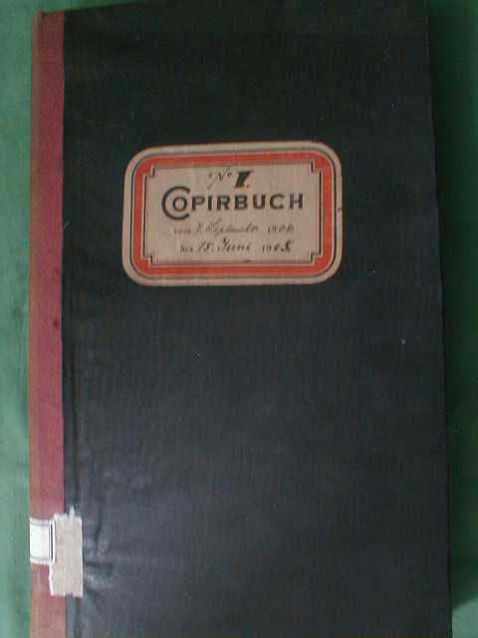

Slide 26
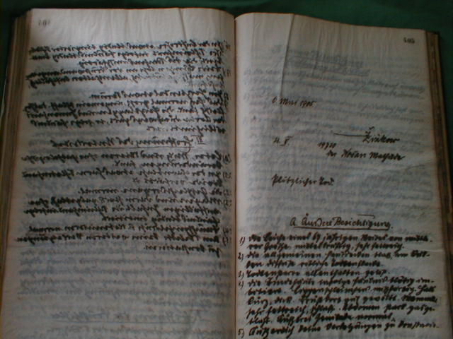

Slide 27
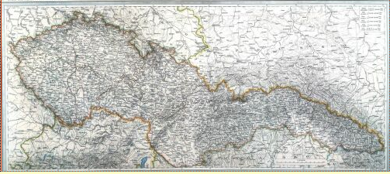
Mapa Republiky československé z. 1935

Slide 28
Vladimír Slavík
1866 - 1933
Aetiologie náhlého úmrtí
Soudně-lékařská diagnostika otrav
Učebnice soudního lékařství pro mediky a právníky
Notes:
The head of the institute since 1908 - 1933

Slide 29
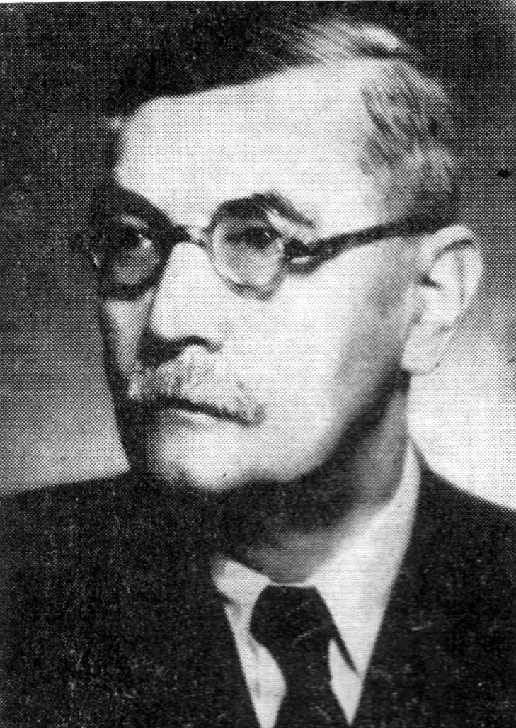
František Hájek
1886 - 1962
Soudní lékařství
Soudní lékařství v praxi
(five editions)
Notes:
He was the head of the institute since 1933 - 1957

Slide 30
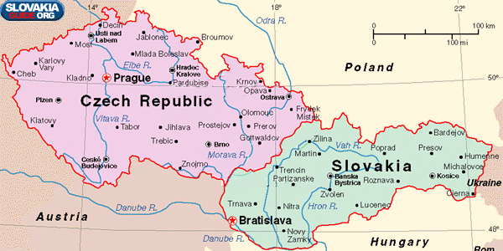
Notes:
Czechoslovak Republic – since 1945 till 1991

Slide 31
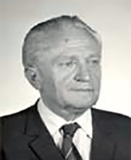
Soudní lékařství pro právníky
Soudní lékařství pro stomatology
Praktikum ze soudního lékařství se stručnou diagnostikou
Zjišťování identity
Laboratorní vyšetřovací metody v soudním lékařství
Základy soudního lékařství pro právníky
Soudní lékařství
Základy soudního lékařství
Soudní lékařství pro kriminalisty
Sbírka základních posudků z oboru soudního lékařství
Učebnice soudního lékařství pro kriminalisty
Soudní lékařství pro posluchače všeobecného lékařství
Jaromír Tesař
1912 - 29.1.2004
Notes:
He was the head of the institute since 1957 till 1983. He is the true founder of modern forensic medicine in Czech republic. He was very active and he wrote lot of medico-legal writings. He introduced modern toxicological, serological and histochemical methods into forensci medicine.

Slide 32
Jiří Sobotka
1925-1990
Head of the institute since 1983-1986
Notes:
The head of the insititute since 1983 - 1986

Slide 33
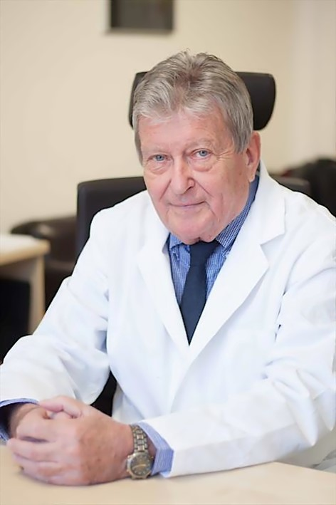
Přemysl Strejc
1942 -2020
Soudní lékařství pro právníky

Slide 34
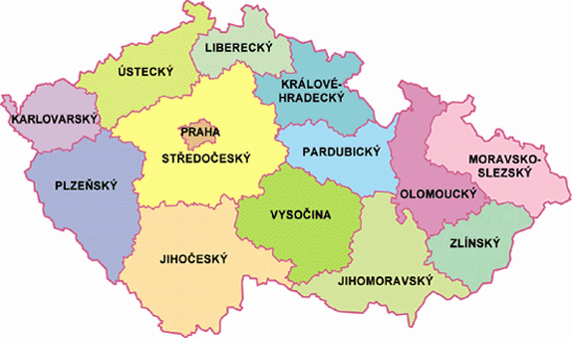
Ústí nad Labem
Hradec Králové
Sokolov
Praha
Pardubice
Ostrava
Plzeň
Olomouc
Brno
České Budějovice

Slide 35
Institutes of Forensic Medicine
in Czech Republic
Prague:
has the longest history of forensic medicine, it is related to the Charles University
Hradec Králové:
established in 1945, related to the Charles University
Plzeň:
established in 1946, related to the Charles University
České Budějovice:
department of forensic medicine at the regional hospital
Sokolov
department of forensic medicine at the regional hospital
Ústí nad Labem
department of forensic medicine at the regional hospital
Pardubice
department of forensic medicine at the regional hospital

Slide 36
Institutes of Forensic Medicine
in Czech Republic
Brno:
established in 1919,now joined with the University of Masaryk
Olomouc:
has the eldest tradition after Prague institute. First information about lectures on forensic medicine in Olomouc come from the beginig 19th century. The institute was established in 1946 and it is related to the Palacký University.
Ostrava:
departement of forensic medicine at the Faculty Hospital

Slide 37
Organization of Forensic Medicine in Czech Republic
Forensic Medicine is organized from Ministry of Health.
It is considered as the part of health care because of data about health condition of population obtained from autopsies.

Slide 38
Main duties of Forensic Medicine in Czech Republic
Forensic Medicine ascertains
information provision to the state health administration for evaluation of the level of diagnostic and curative care, accidents and health condition of non-treated people according to performed autopsies
monitoring of the extent of abuse of illicit psychotropic drugs
enables to evaluate the diagnostic and curative procedures according to the analysis of causes of death which happened after diagnostic or curative procedure
it warrants assessment of cases suspicious from incorrect diagnostic or curative procedure mainly in the lethal cases

Slide 39
Main duties of Forensic Medicine in Czech Republic
For law enforcement:
to provide forensic expertises in the cases of the action of violence against the health
Notes:
It means any kind of violence, not only mechanical but chemical – intoxications, child abuse, sexual offences,

Slide 40
Forensic pathologist as expert witness
Law act on experts and translators :
who can become an expert
To give expert assessment about injury
– living person
– cases of death

Slide 41
Autopsies
Are performed
for establishing main disease, cause of death, complications and therapeutic procedures
for establishing cause of death and elucidation of circumstances important from the point of view of health care (sudden death, unnatural death)
for scientific and education reasons
when suspicion of criminal act led to the death*
*so called „forensic autopsies“ according to §115 of penal code
Notes:
The examination of the scene of the death: it is performed by an emergency physician, sometimes by the police physician and rarely by forensic pathologist.

Slide 42
Autopsies
Forensic medicine department make autopsies in cases
of natural death of persons out of hospital (from the „street“) and from hospital before the admission of the patient to the hospital
violent death
Notes:
We distinguish autopsies made in anatomical pathology dept. Or in forensic medicine dept. Anatomical pathology dept. Makes autopsies obligatory in cases of still born children, death of children minor 15 years of age, in pregnant women, death during the pregnancy or delivery and in the period of puerperium.

Slide 43
Autopsies
The autopsy has to be performed (the Law Act 372/2011):
when the cause of death is unknown or not certain
in any cases of unnatural death
industrial intoxications or injury due working accident
or suspicion that it led to the death
death in the custody or in prison
in suspicion that incorrect therapeutic procedures caused the death

Slide 44
Education in Forensic Medicine
Institute for Postgraduate Medical Education
The board examination in
anatomical pathology (after 2 years of work)
forensic medicine (after 3 years of work in the forensic medicine department)
Scientific grade:
PhD in pathology and forensic medicine

Slide 45
Research and science
Toxicology: introducing of new analytical methods, participation in governmental projects against illicit drugs
Forensic pathology:
study of adhesive molecules as the marker of wound timing
neurohistochemistry
study of action of drug of abuse on myocardial metalloproteinases
Molecular biology:
paternity
Identification: age estimation, forensic odontology

Slide 46
Scientific society
The Czech Medical Society of Jan Evangelista Purkyně
Society of Forensic Medicine and Toxikology

