Slide 1
Natural death
It means that the death occurs due to pathologic conditions not by external force.
period of symptoms
period of apparent disease
period of healing
death × complete recovery
chronic stage

Slide 2
Natural death
Sudden natural death
occurs in a person who feels to be completely healthy or reports only small unimportant troubles
Unexpected natural death
occurs in a persons who is ill and he is treated.
Usually it is a status when the diagnosis is done and the illness is compensated by the treatment. The health conditon could be worsen from different reason so the death occurs.

Slide 3
Sudden deatah
Sudden death usually happens due to loading of organism due to:
Factors external:
active: physical effort, mental distress, light flicker (epilepsy), strenous defecation; triggers which start heart failure in cardiomyopathies; temperature;
passive: long lasting sitting, changes of barometric pressure;
Factors internal:
damaged structure cannot perform its physiological function eg. raised blood pressure may cause rupture aneursym;; rupture of esopheageal varices etc.

Slide 4
Natural death
importance of autopsy:
the cause of death can not be recognized on the scene of death
combined cases – natural death with traumatic changes
minute traumatic changes that can not explain the death

Slide 5
Natural death
Importance of the autopsy:
cause of death
main disease
verification of the curative procedures
exclude or confirm participation of traumatic changes

Slide 6
Natural death
Natural death can be caused by any illness

Slide 7
Natural death
Gates of death:
Cardiovascular system
Respiratory system
Nervous system
Digestive system
Secretory system
Regulation of metabolism

Slide 8
Nervous system
The basis of brain death are disease states:
Vascular
Inflammations
Tumors
Peripheral nervous system - rare diseases like myasthenia gravis
Brain swelling:
vasogenic (occurs when the blood-brain barrier is disrupted physically or by the effect of vasoactive substances),
cytotoxic (caused by a malfunction of the sodium-potassium/calcium ion pump with subsequent intracellular fluid accumulation; it is caused by hypoxia of the brain, the effect of toxins, metabolic disorders),
osmotic (occurs when the osmolality of the blood plasma decreases: the osmolality of the cerebrospinal fluid and the extracellular brain fluid is somewhat higher than that of the blood plasma, and during hemodilution due to the osmotic gradient, water penetrates into the extracellular space of the brain),
interstitial (occurs when the drainage channels of the cerebrospinal fluid are obstructed by its penetration into the brain tissue).

Slide 9
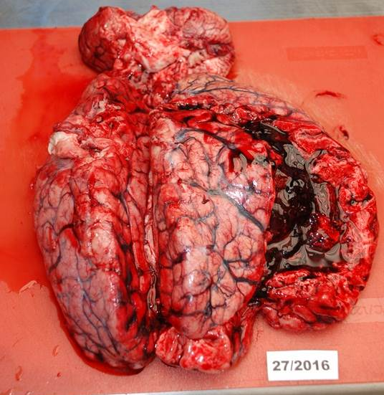
Bleeding to the brain

Slide 10
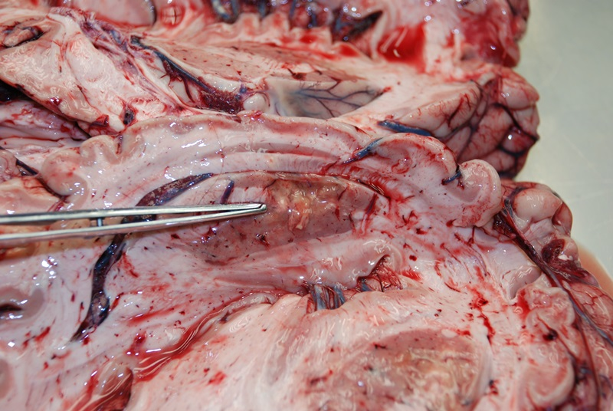
Malatia of basal ganglia

Slide 11
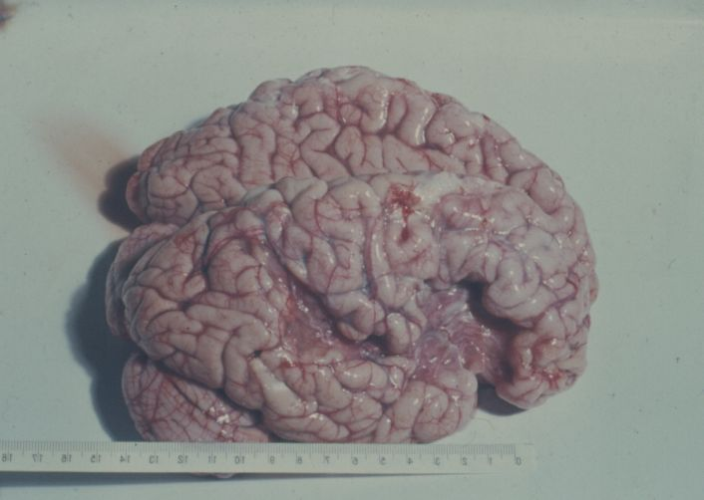
A healed scar after a brain infarctionu

Slide 12
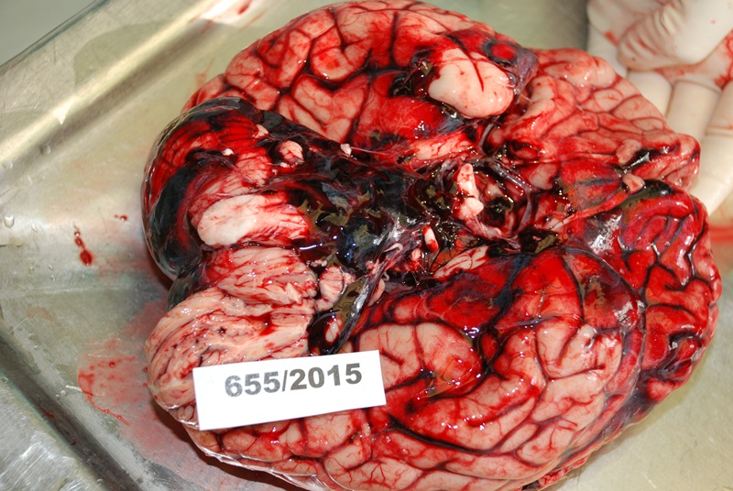
Subarachnoid hemorrhage from a ruptured aneurysm of the cerebral artery

Slide 13
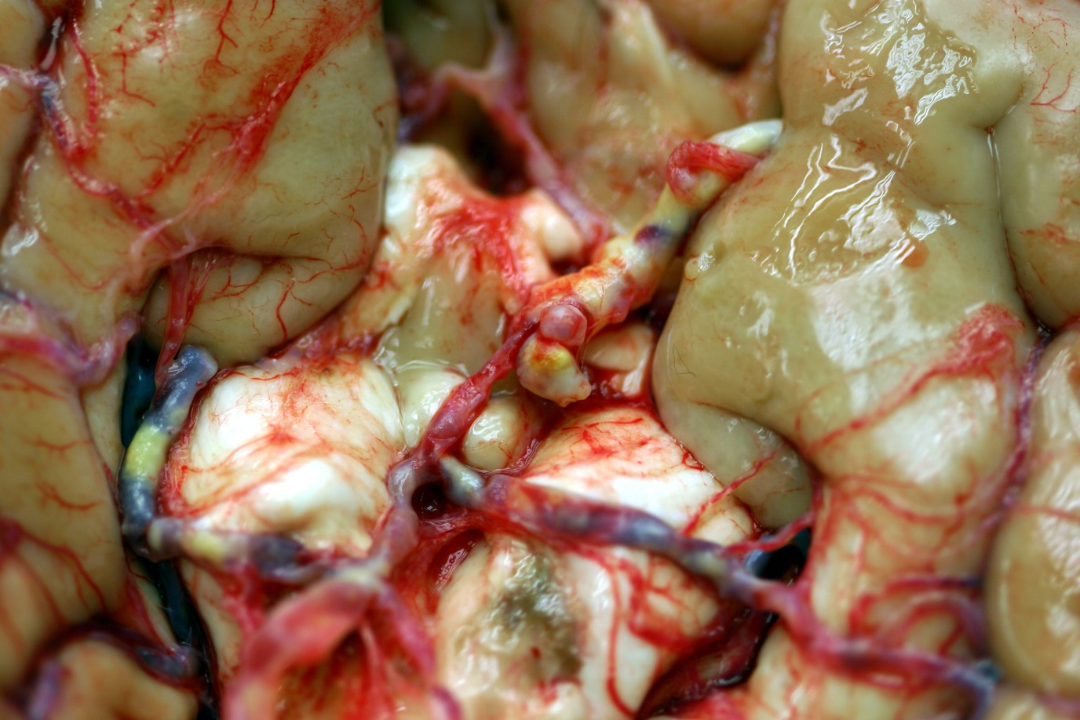
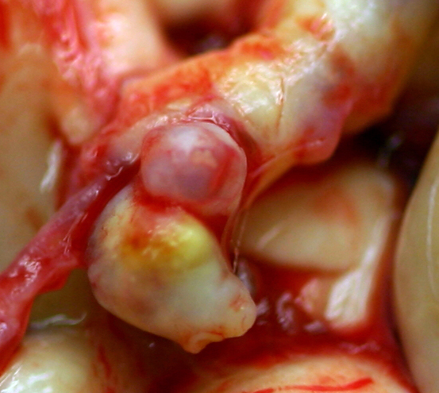
Aneurysm of basal artery

Slide 14
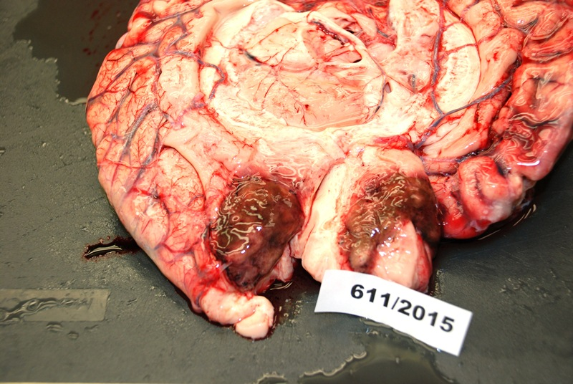
Glioblastoma

Slide 15
Cardiovascular system
The most common cause of sudden and unexpected death
Causes can be:
in the heart itself (left-sided, right-sided or bilateral failure):
myocardial infarction,
ischemic heart disease
Inflammation
cardiomyopathy – genetically or metabolically determined
outside the heart:
by circulatory failure of either the small or large circulation (e.g. shock).

Slide 16
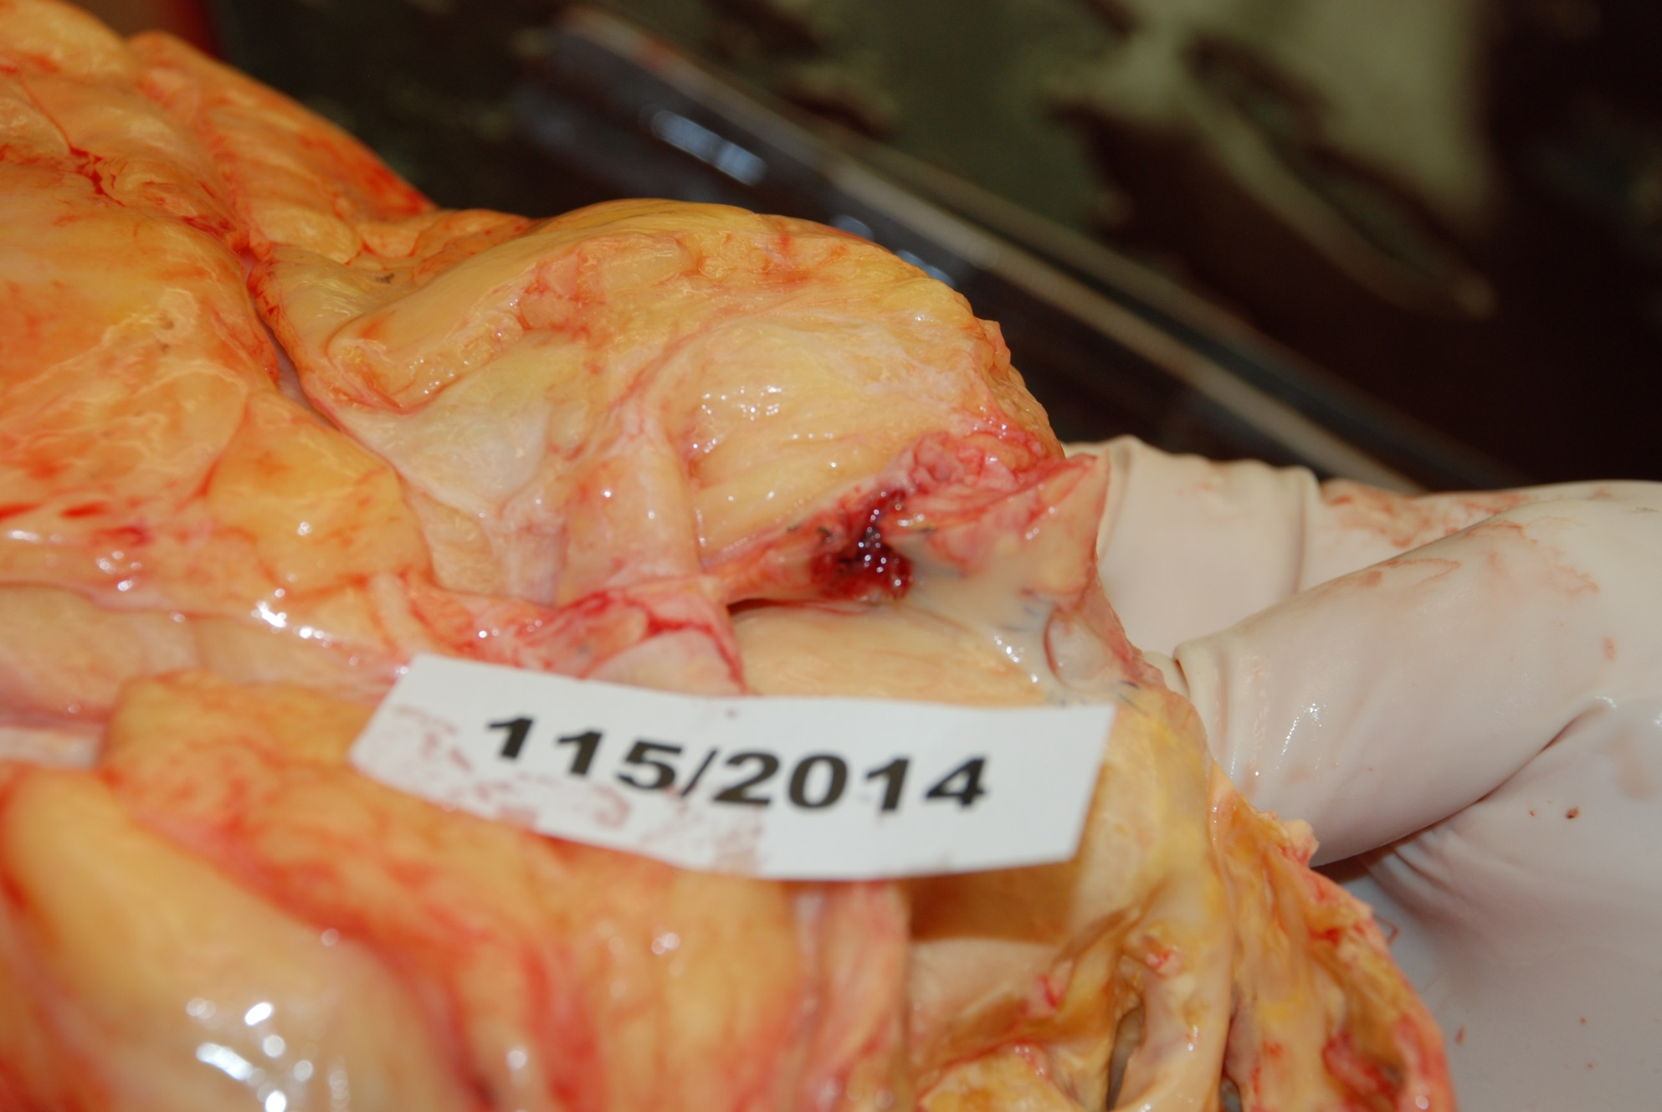
Thrombosis of a coronary artery

Slide 17
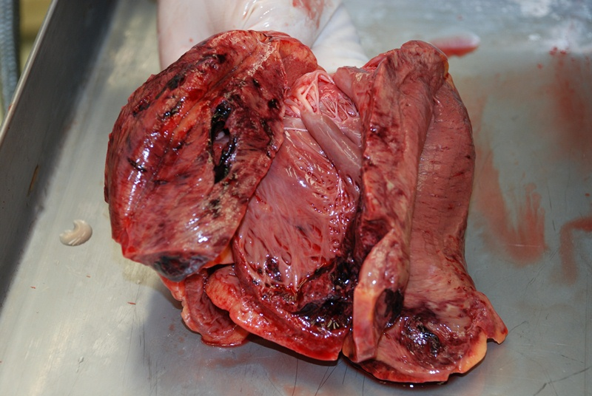
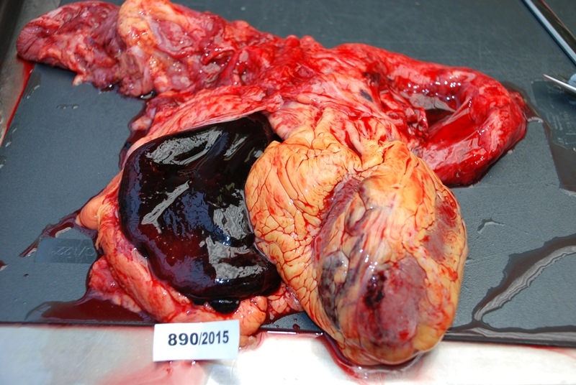
Myocardial infarction
Heart tamponation

Slide 18
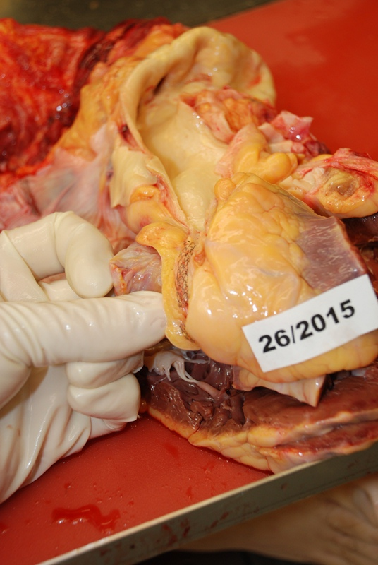
Stent in the coronary artery

Slide 19
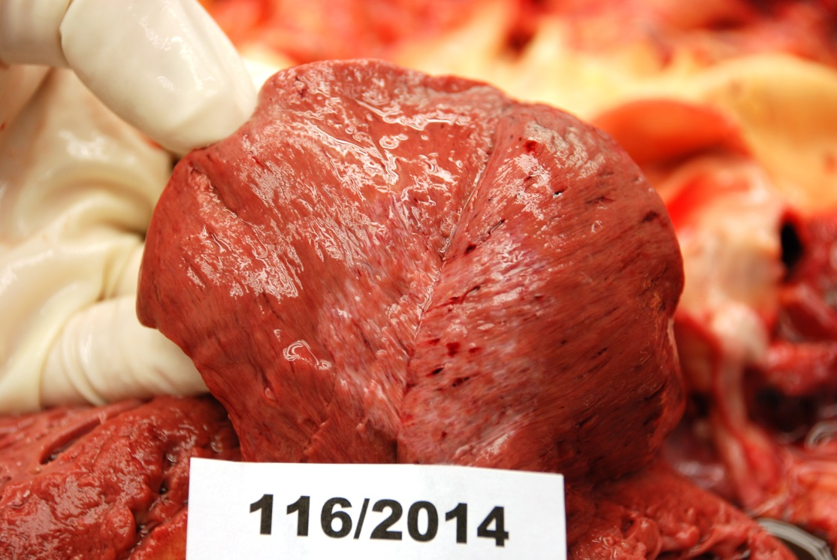
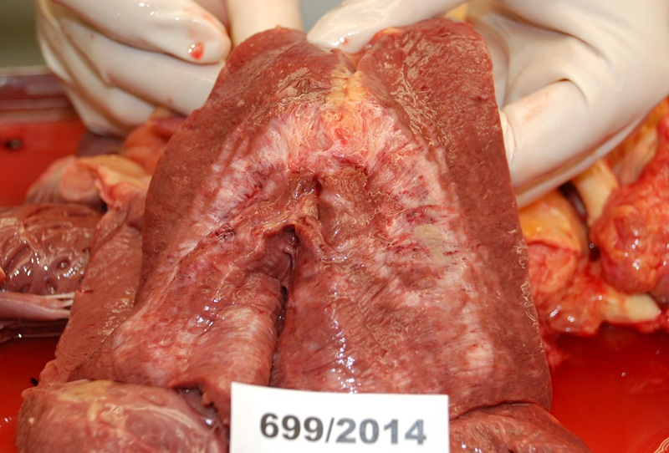
myomalatia
Post infarction scar

Slide 20
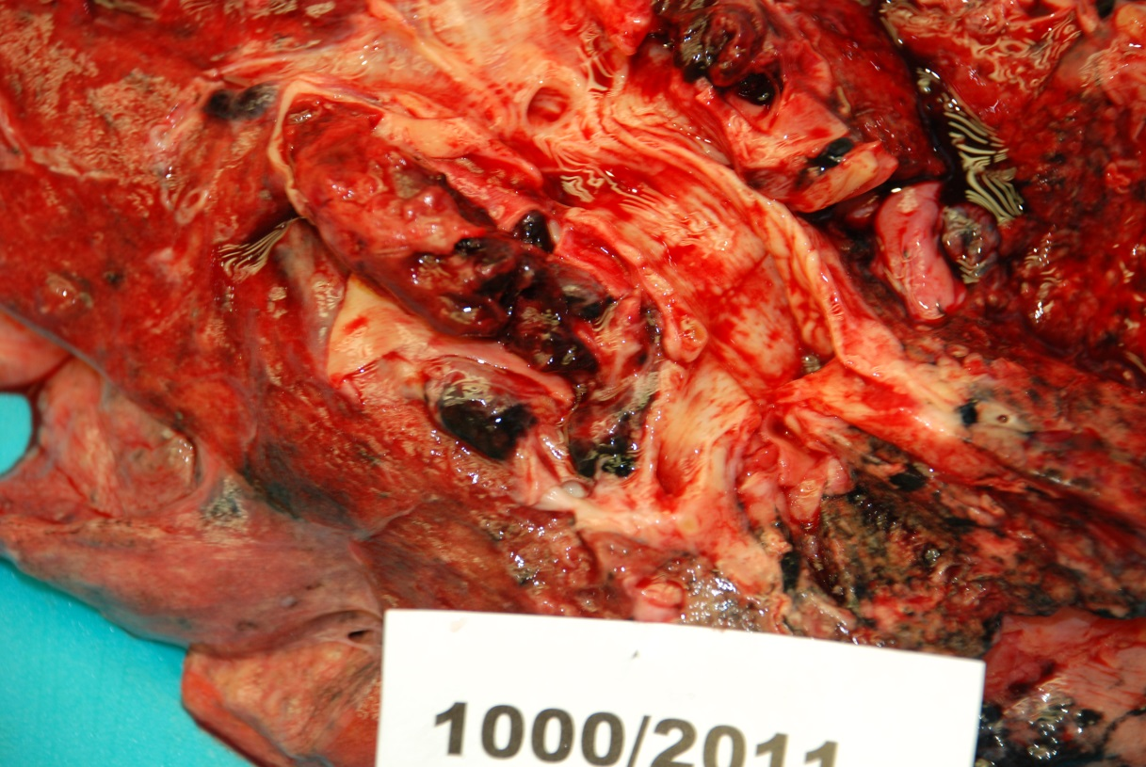
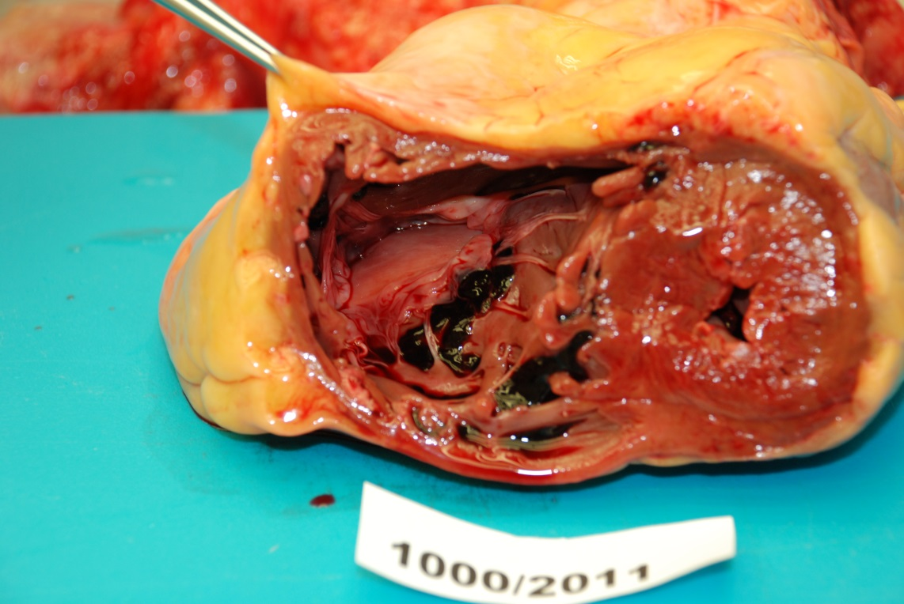
Thrombotic embolia in the pulmonary artery
Chronic cor pulmonale

Slide 21
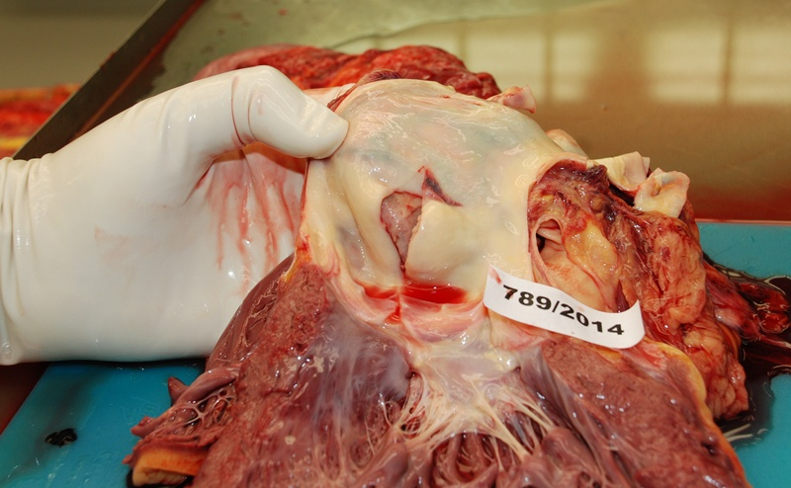
Ruptured aortic aneurysm

Slide 22
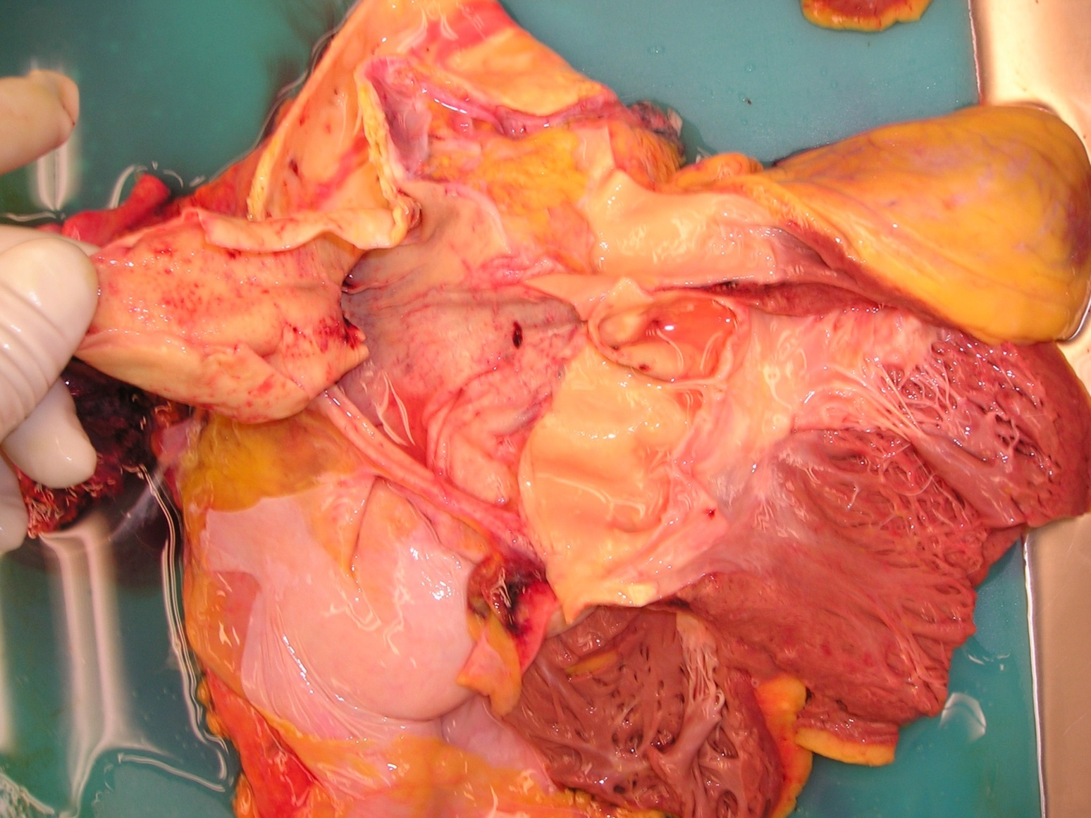
Aortic dissection

Slide 23
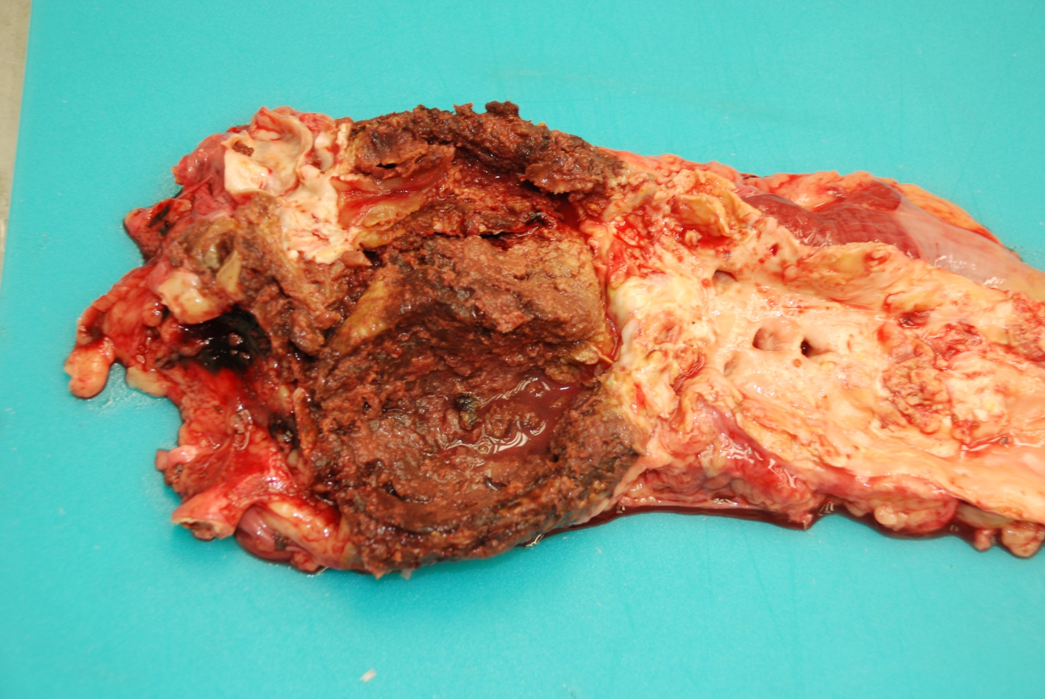
The 4th degree of Atherosclerosis o abdominal aorta –
atheromatous masses fills aneurysm

Slide 24
Respiratory system
Vessels:
Thrombotic embolism
Inflammations non specific:
Influenza
Bronchopneumonia
Chronic bronchitis
Emphysema
Chronic obstructive bronchopulmonary disease
Inflammations specific:
TBC!!!
Tumors
Different types of carcinoma
vorsen ischemic heart disease

Slide 25
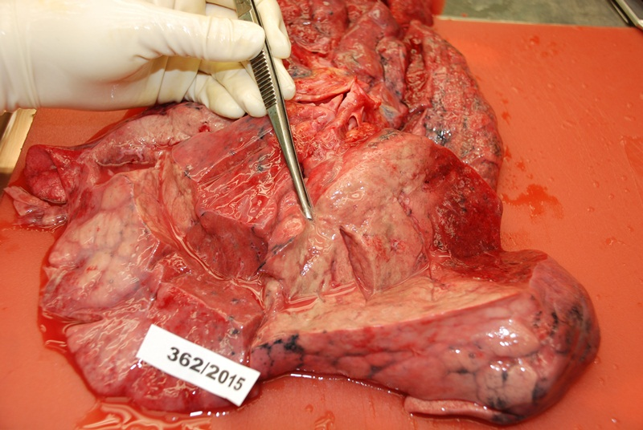
Lobar pneumonia

Slide 26
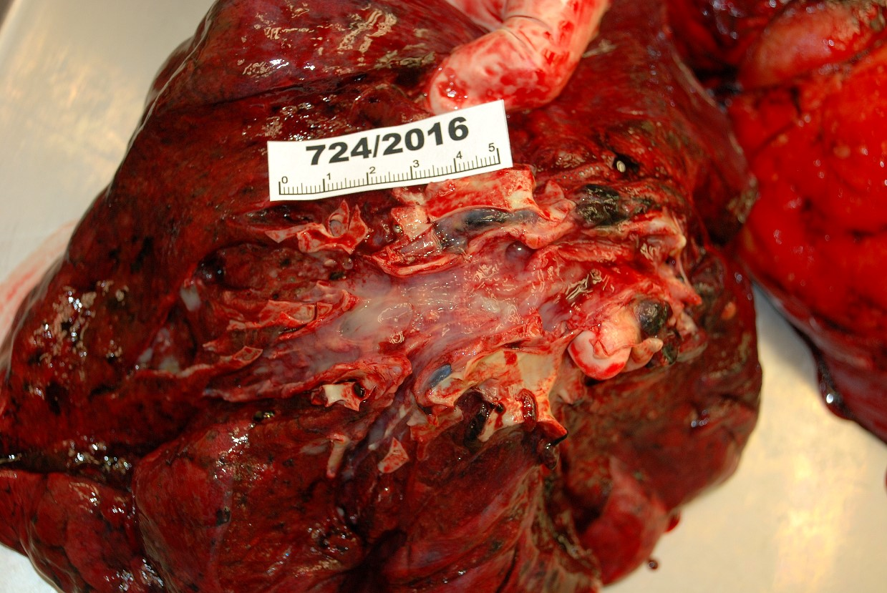
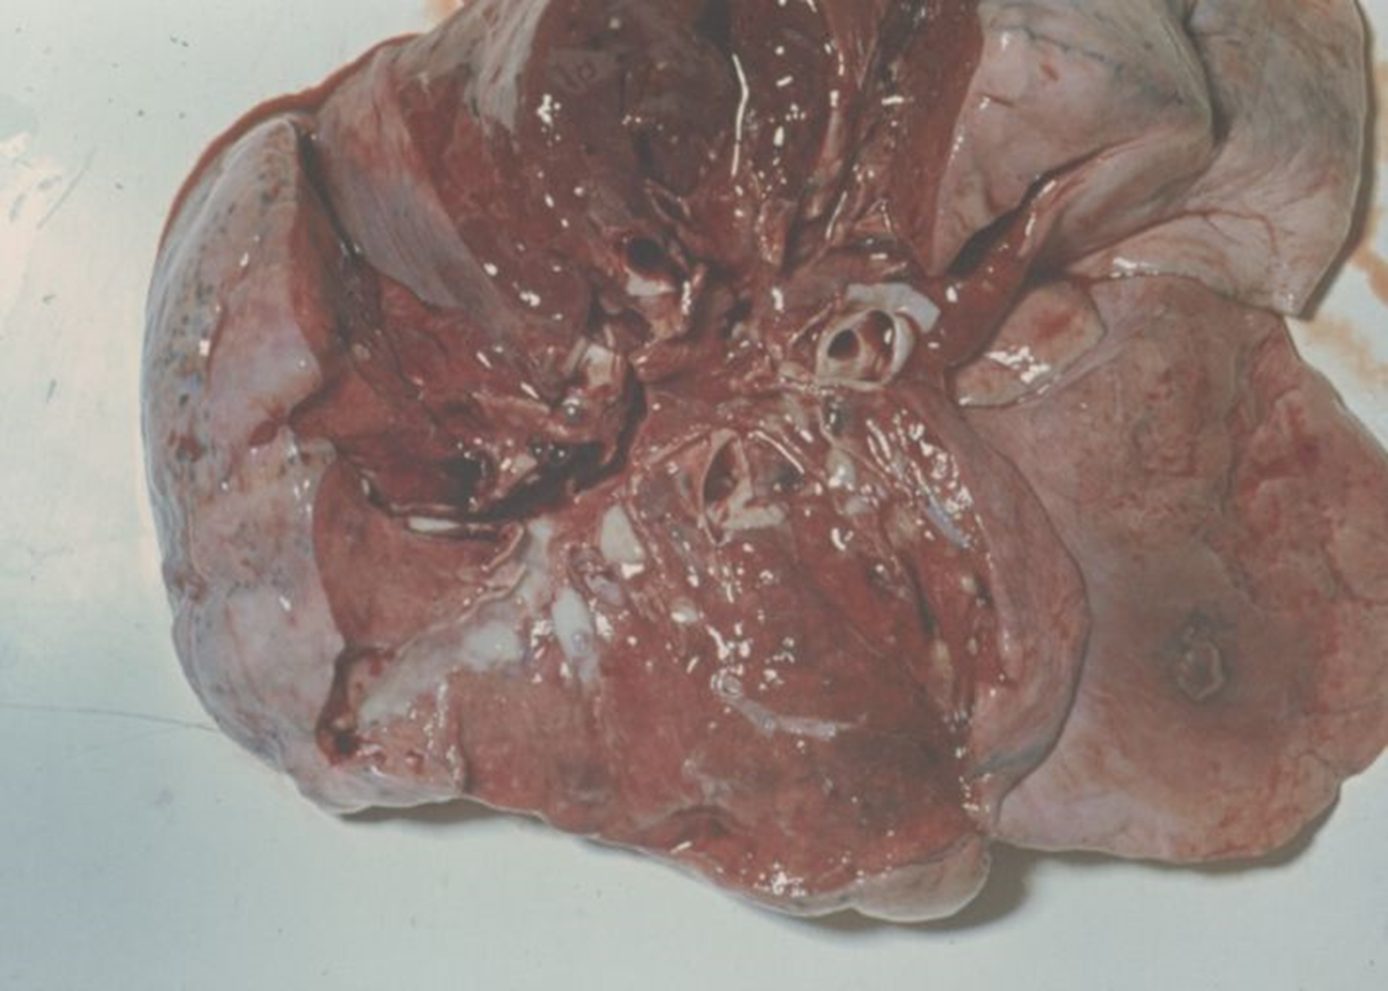
Acute bronchitis – bronchi are filled with musus

Slide 27
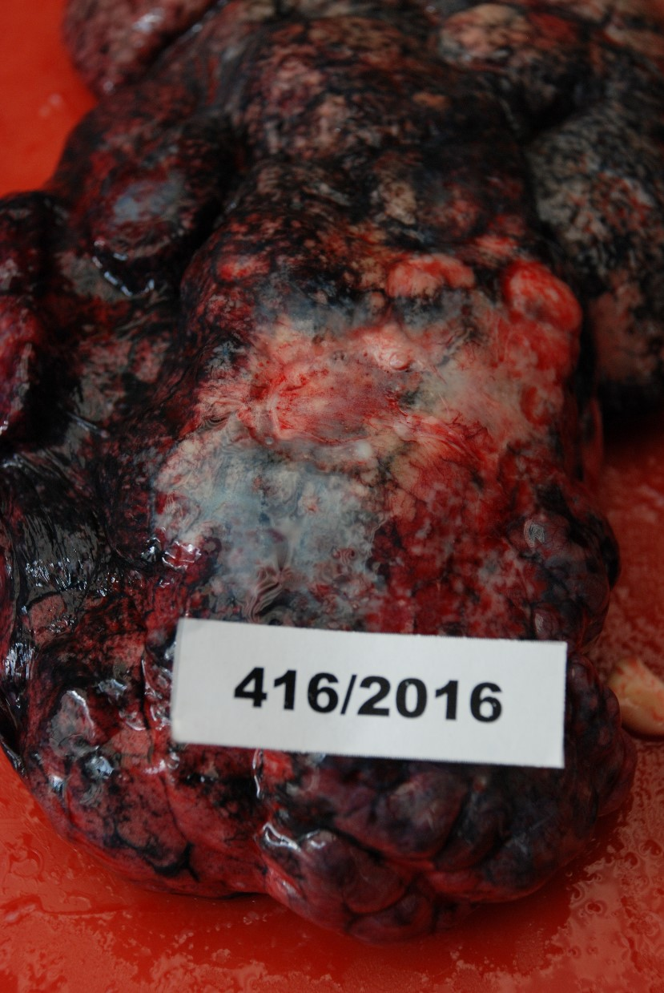
Whitish tumor masses penetrating lung tissue
Bronchogenic carcinoma

Slide 28
Excretory system
Renal failure may happen as:
pre renal
intra renal
post renal
Inflammations:
glomerulonephritis
purulent inflammation of the kidney
metastatic – infected thrombi
nephrolithiasis
ascending infection from the bladder
Tumors

Slide 29
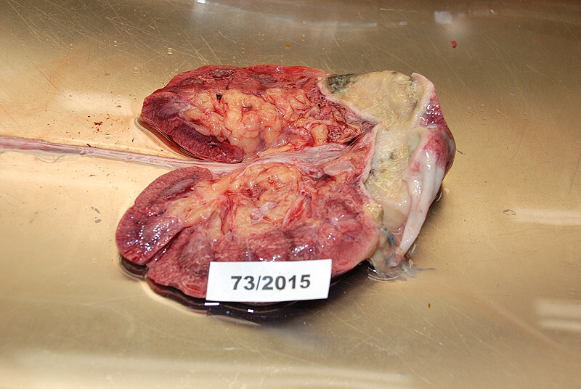
absces
Abscessing purulent inflmation of kidney

Slide 30
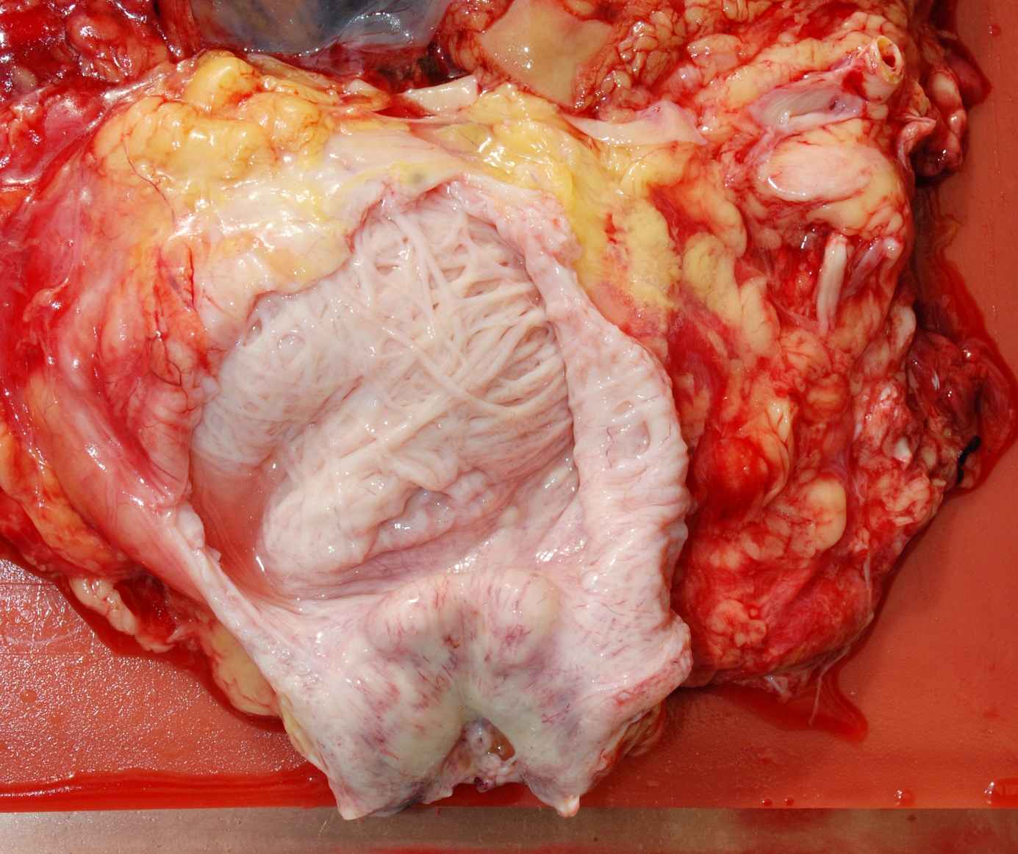
Hypertophia of the prostate leads to obstruction of urinary ways and causes trabecular hypertrophy of bladder wall. The residual amount of uriny causes inflamation.

Slide 31
Digestive system
A complex system of organs whose diseases can lead to death.
oral cavity
pharynx
esophagus
stomach
pancreas
small intestine
colon
malformation
inflammations
vascular diseases
tumors
alcohol

Slide 32
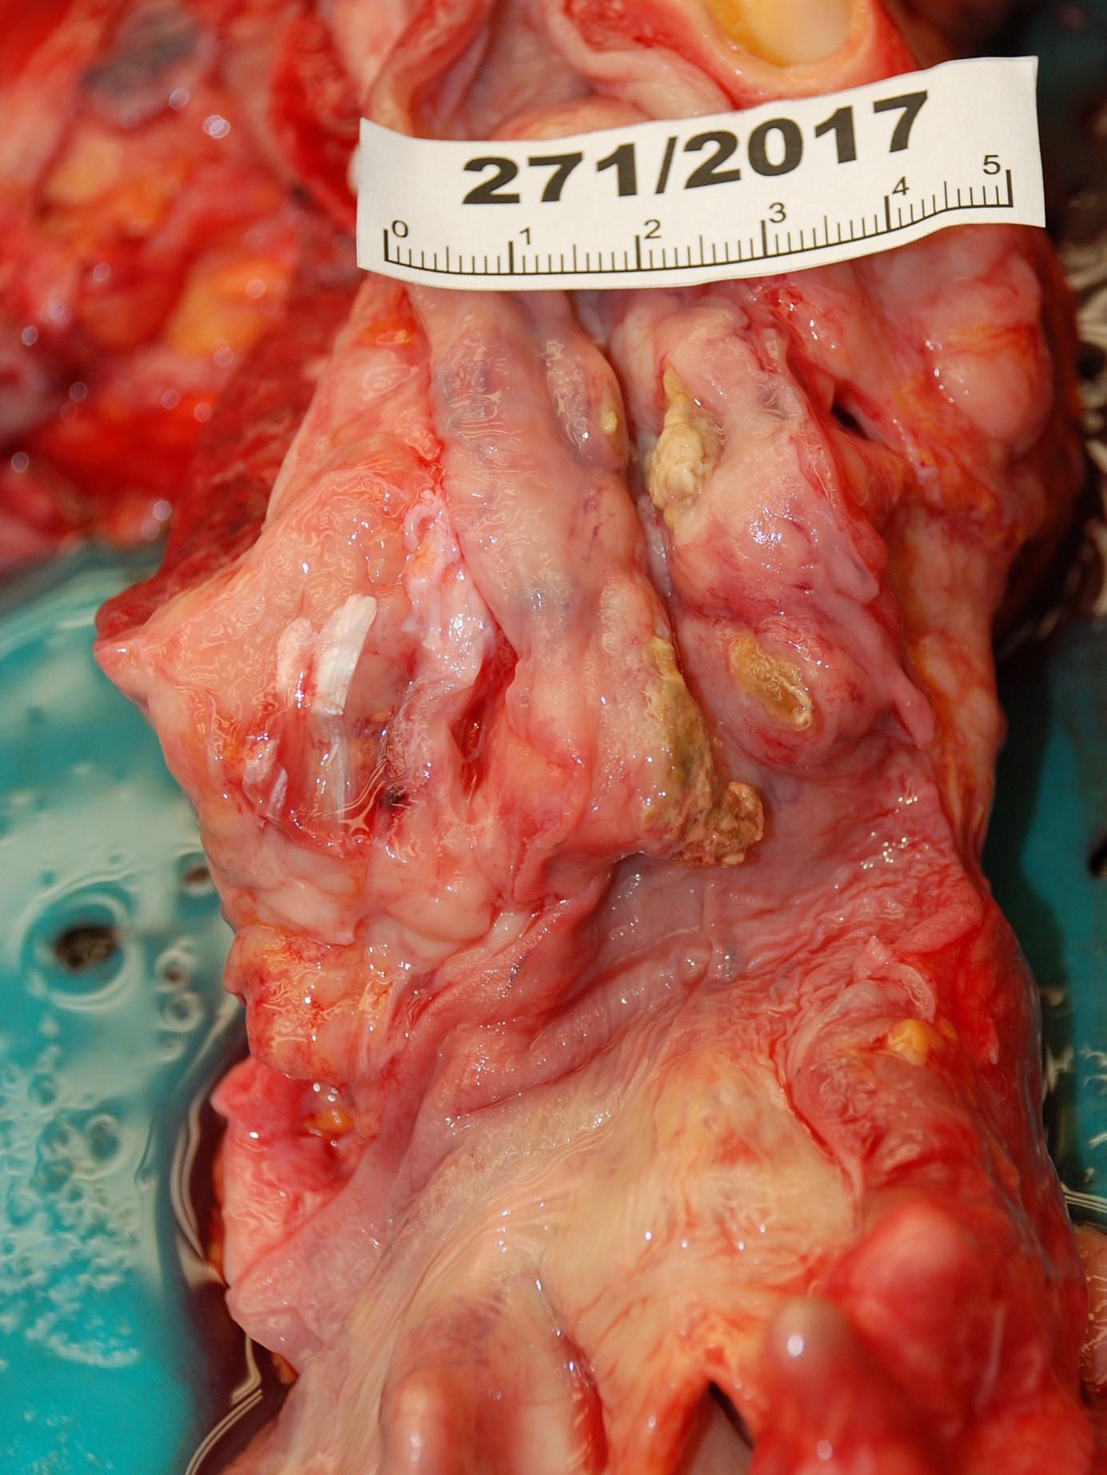
Oesophageal carcinoma

Slide 33
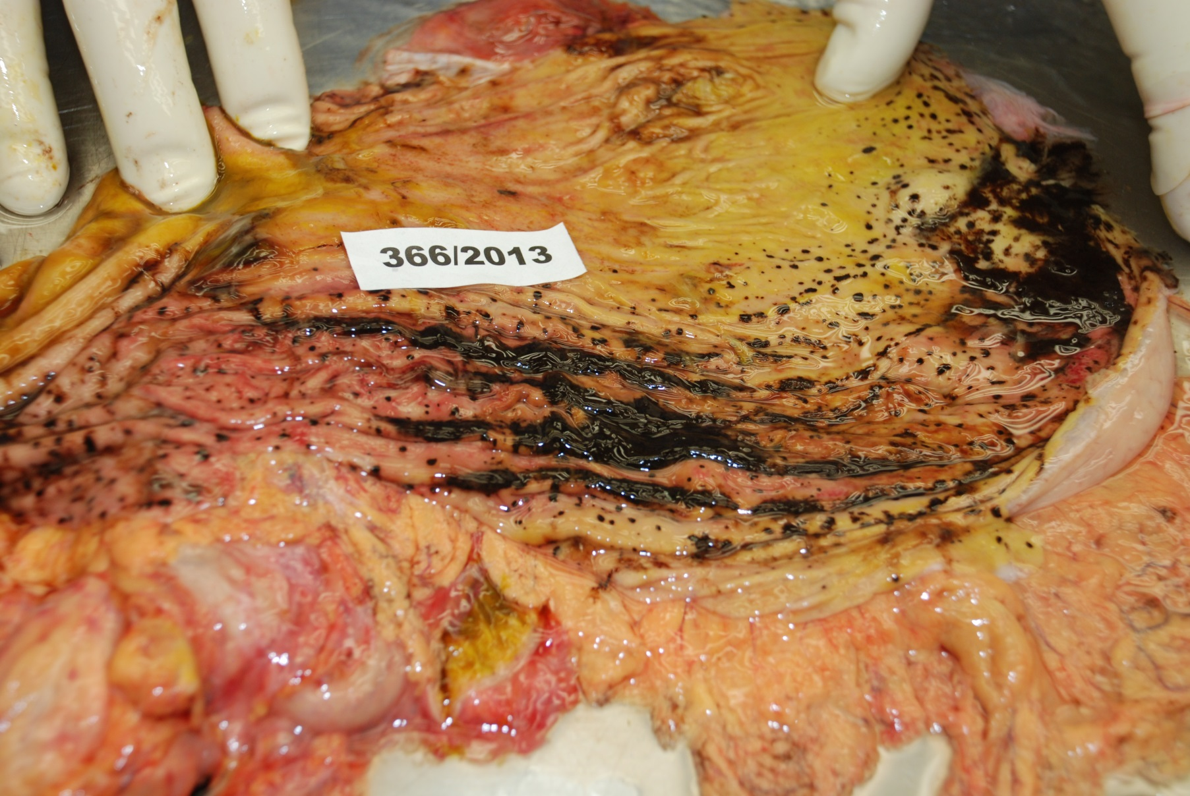
Erosive gastritis – with bleeding

Slide 34
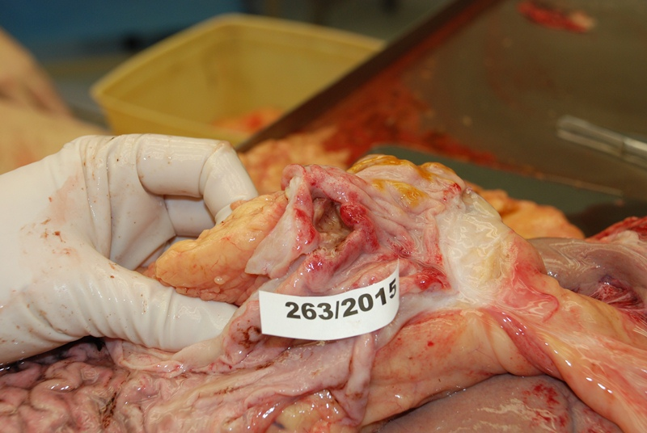
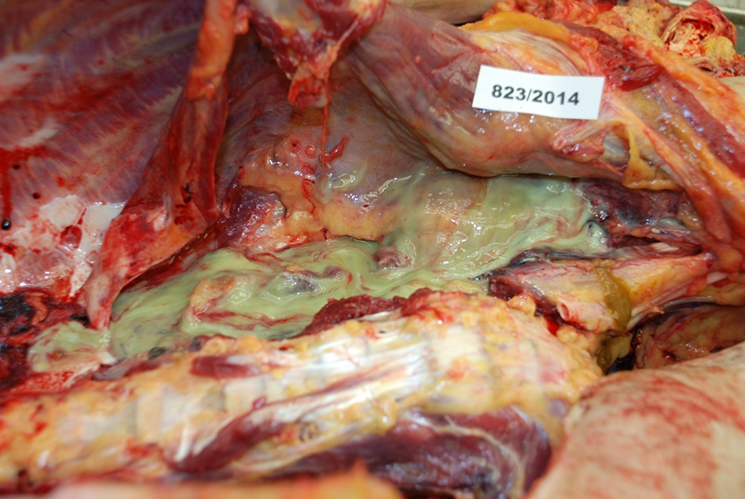
Chronic duodenal ulcus with perforation
Pus in abdominal cavity

Slide 35
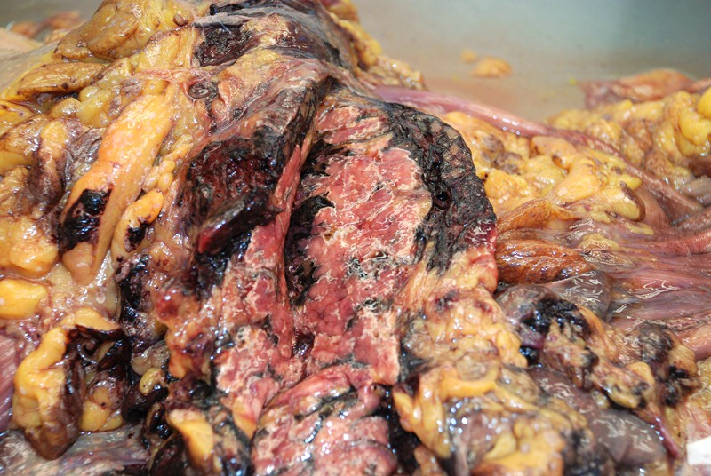
Haemoragic pancreatitis

Slide 36
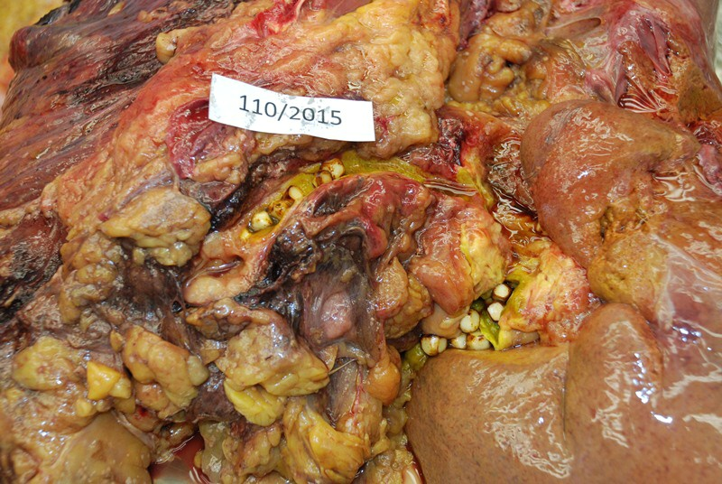
Stones in the biliary ways

Slide 37
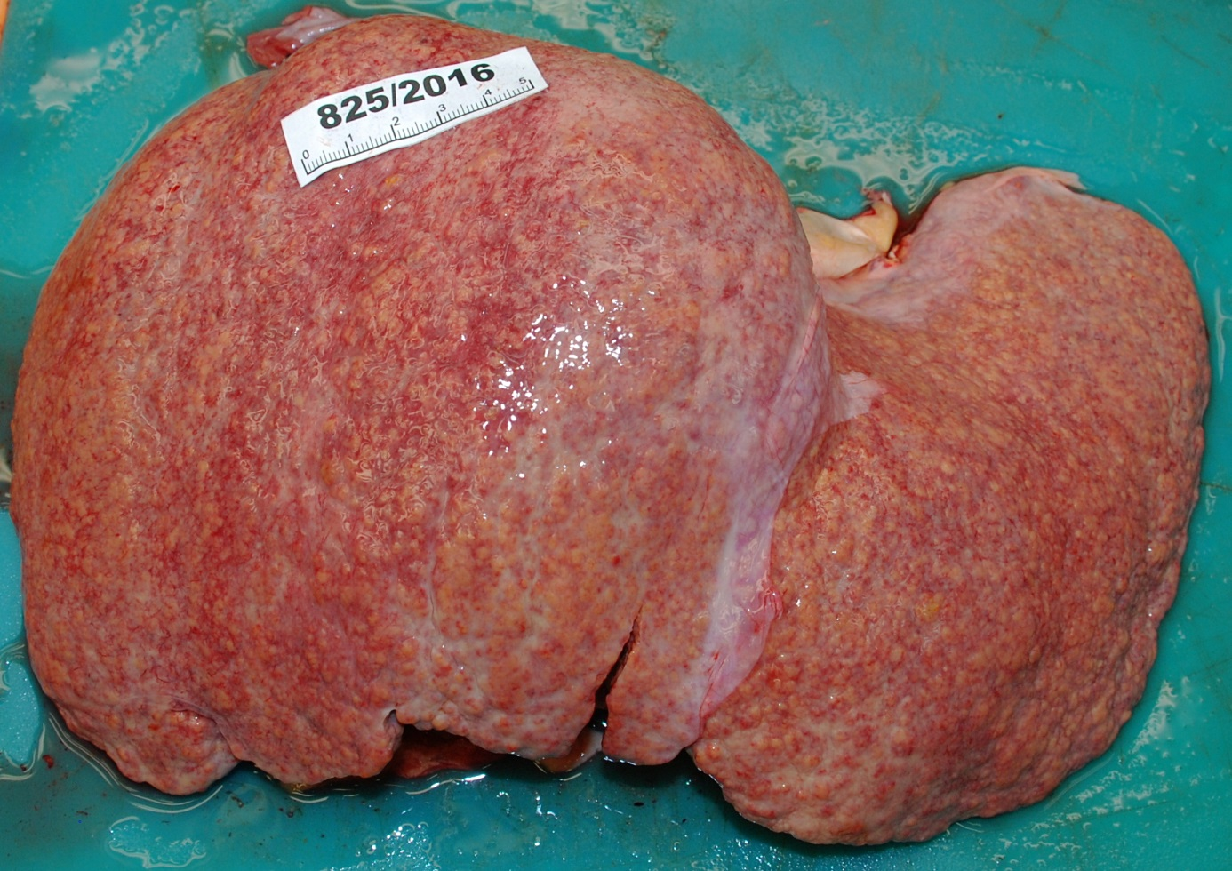
Liver cirrhosis

Slide 38
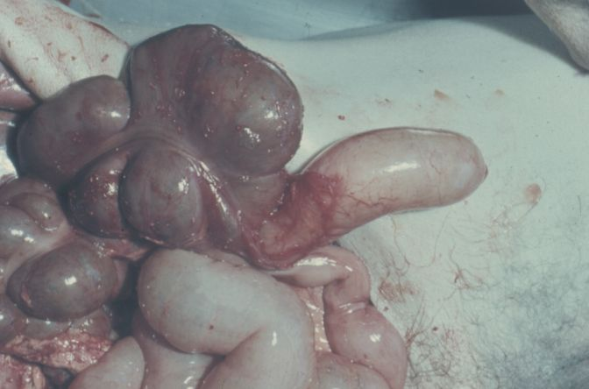
Apendicitis

Slide 39
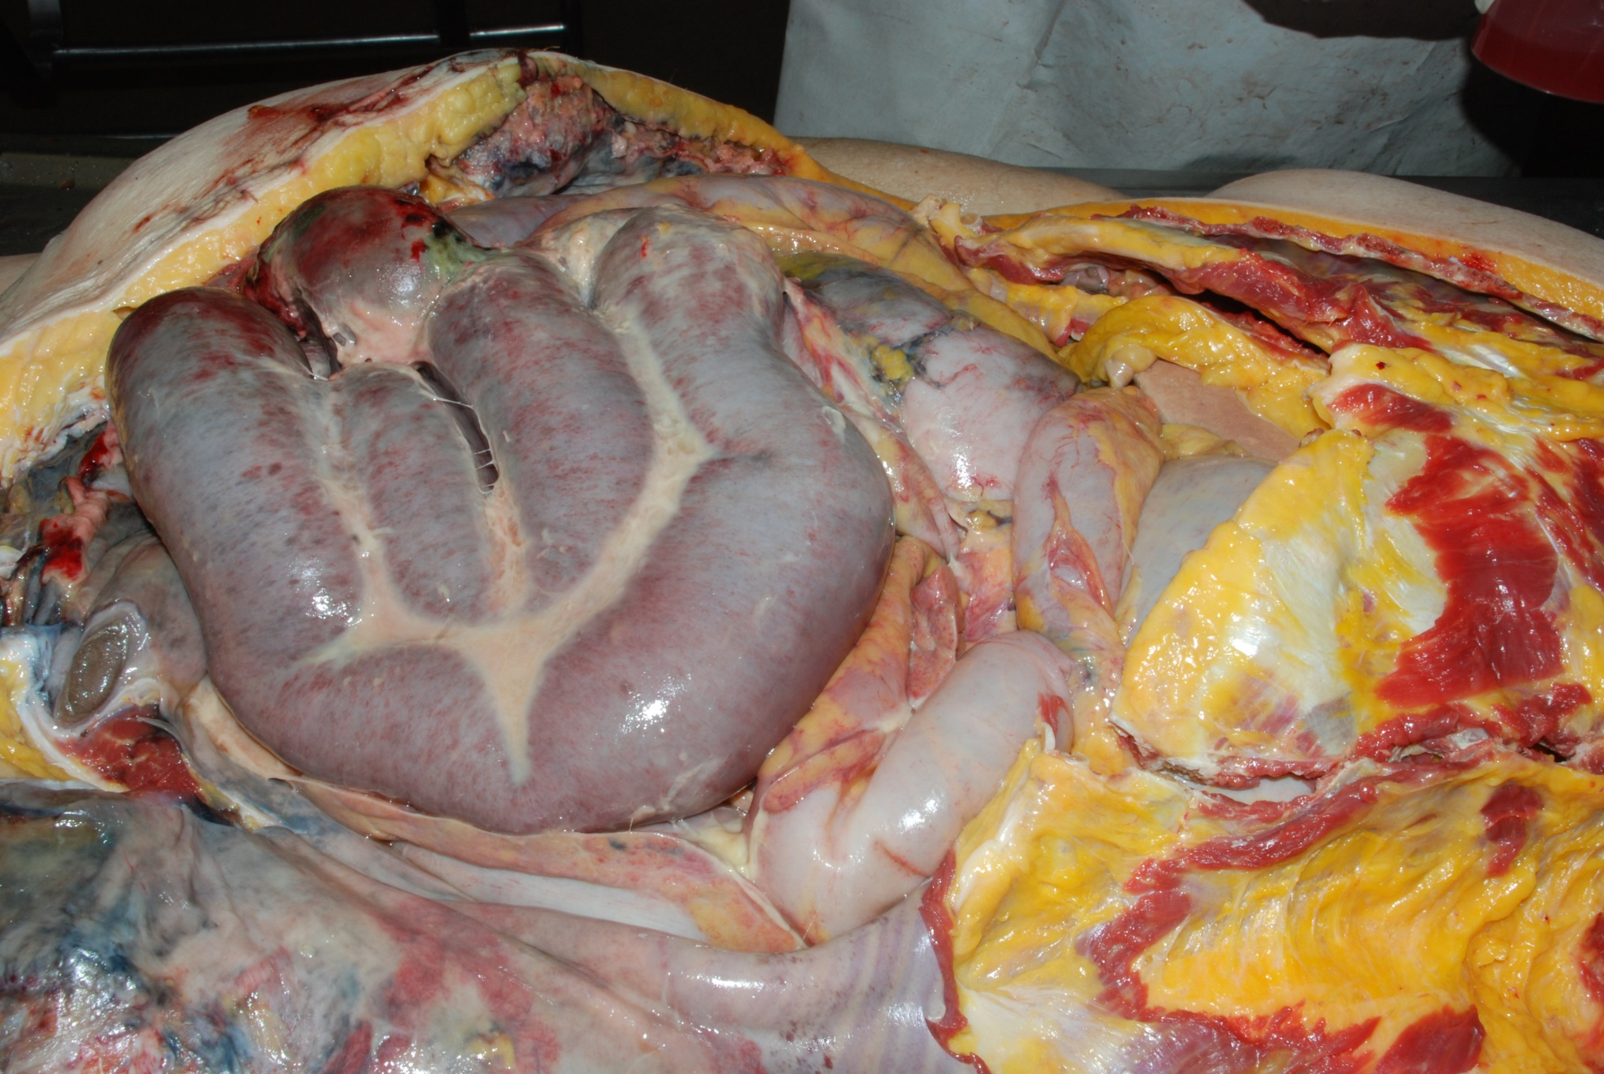
Intestinal obstruction and purulent peritonitis

Slide 40
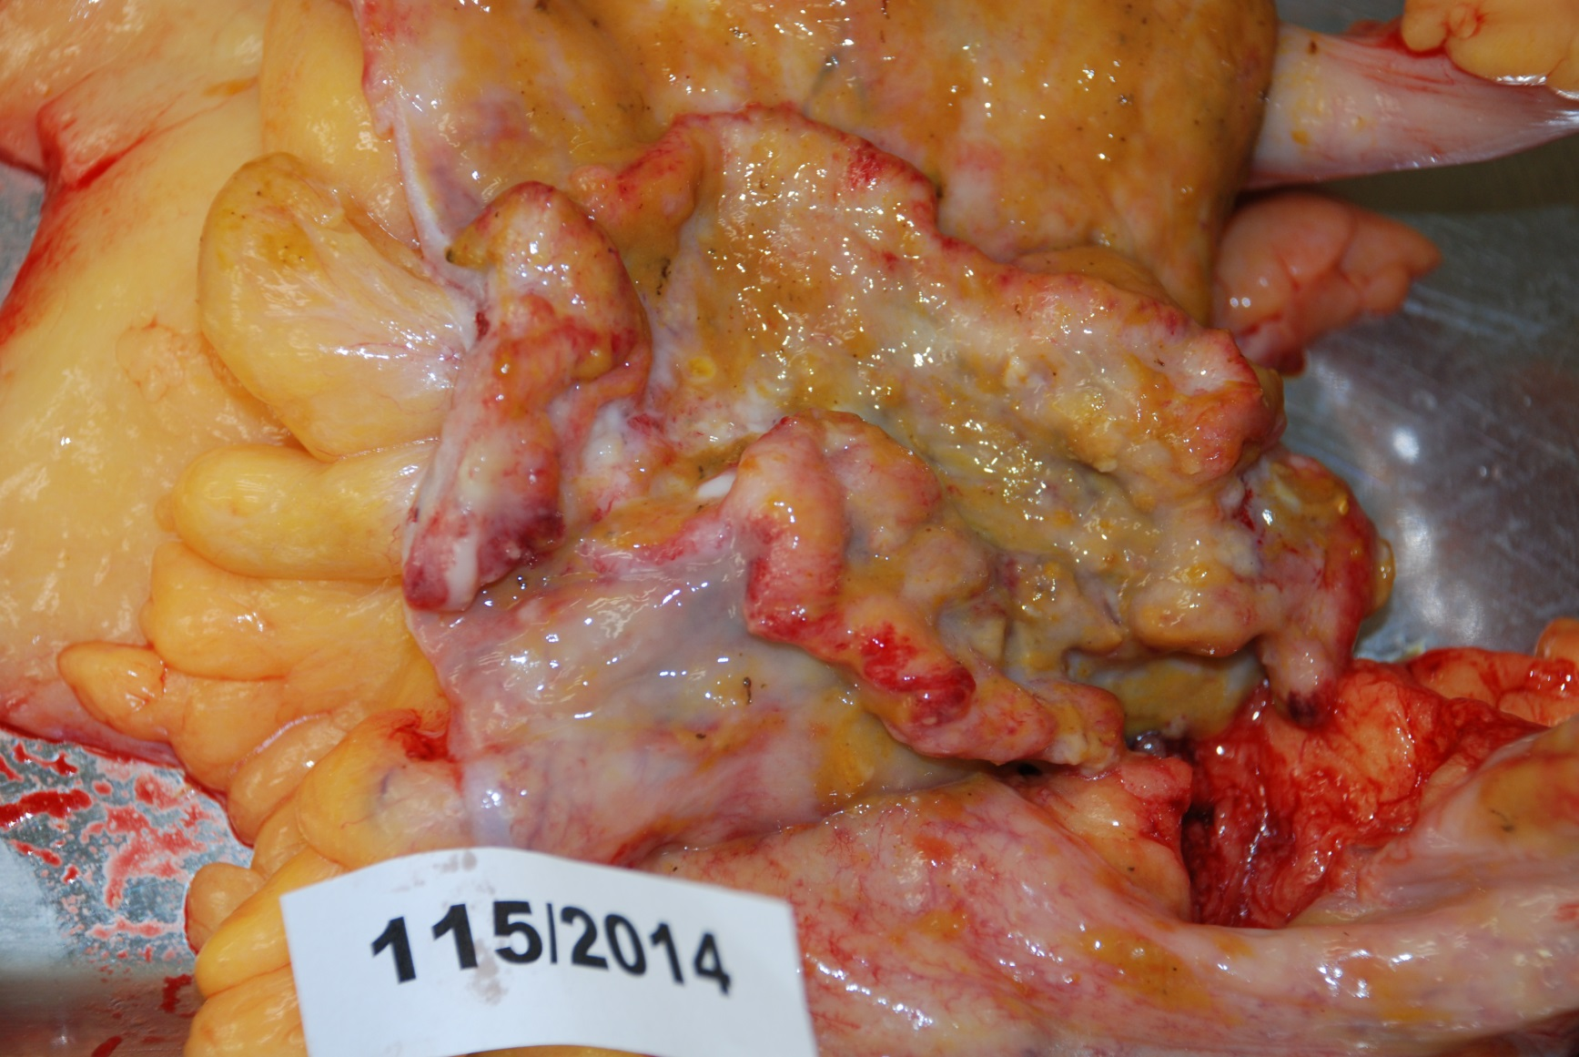
Large bowel carcinoma

